Slide 1
MN101 Principles of Management
Week 13
Managing the value chain, information technology and e-business (Chapter 20)

Slide 2
Learning objectives
Define operations management, describe its application within manufacturing and service organisations, and explain today’s partnership approach to supply chain management.
Summarise considerations in designing facilities layout.
Discuss new technologies used for manufacturing and service operations, and explain what is meant by lean manufacturing.
Explain why small inventories are preferred by most organisations, and describe just-in-time inventory management.
Identify ways in which information technology has transformed the manager’s job, and describe different types of IT systems used in today’s organisations and how they support daily operations and decision making.
Summarise the key components of e-business and explain common e-business strategies.

Slide 3
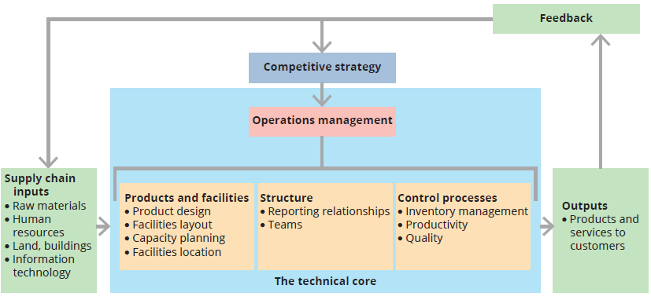
THE ORGANISATION AS A VALUE CHAIN
Value chain perspective views organisation as a system used for transforming inputs into outputs.
Value chain refers to all the internal activities a company performs to deliver a valuable product or service to the market. It includes:
  Primary activities: inbound logistics, operations, outbound logistics, marketing & sales, and service.
  Support activities: firm infrastructure, human resources, technology development, and procurement.
The focus of the value chain is on adding value at each step to gain competitive advantage.
Supply Chain Management involves the planning, coordination, and control of activities across organizations to move goods, services, and information from suppliers to customers.
  This includes: Sourcing raw materials, Manufacturing, Warehousing, Transportation, Distribution.

Slide 4
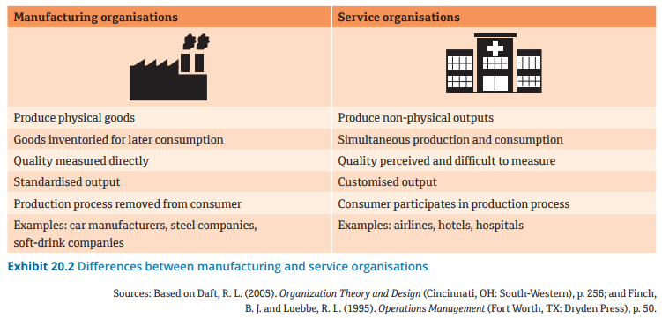
SERVICE AND MANUFACTURING OPERATIONS
Operations management applies to both service and manufacturing

Slide 5
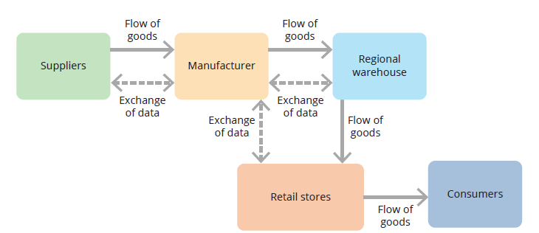
SUPPLY CHAIN MANAGEMENT
An integrated supply chain
Supply chain management
  Managing the sequence of suppliers and purchasers, covering all stages of processing from obtaining raw materials to distributing finished goods to consumers.
  Managing all the activities that facilitate the satisfactory fulfilment of an order at the highest degree of customer satisfaction and the lowest possible cost.

Slide 6
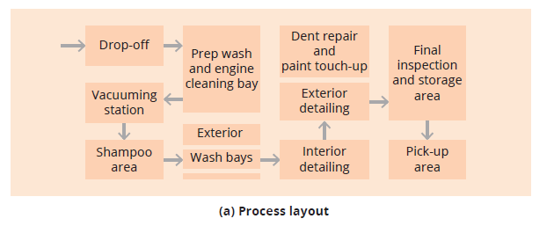
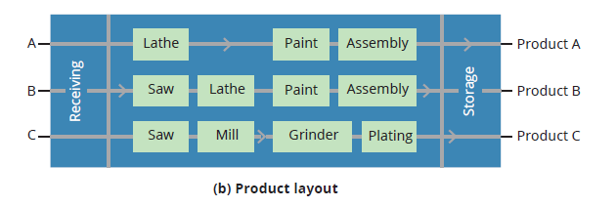
FACILITIES LAYOUT
Important to plan the facilities layout for production
Four common types of layout:
  Process
  product
  cellular
  fixed-position
Process layout
  A facilities layout in which machines that perform the same function are grouped together in one location.
  Advantage: potential for economies of scale, but the product path can be long
(2) Product layout
Machines and tasks are arranged according to the sequence of steps in the production of a single product.
This layout is efficient when the organisation produces or provides huge volumes of identical products or services.

Slide 7
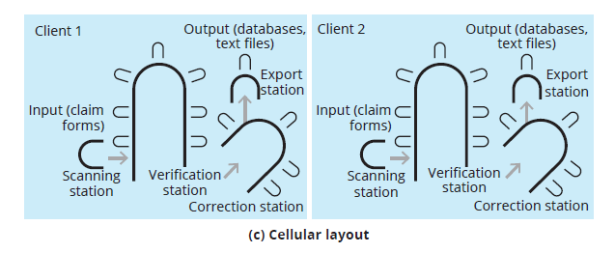
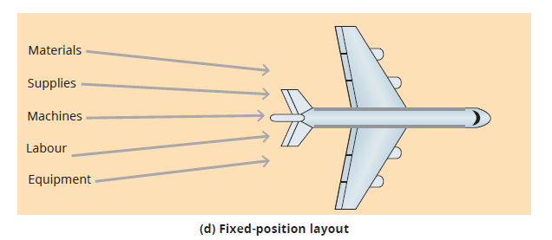
FACILITIES LAYOUT (cont.)
(3) Cellular layout
Machines dedicated to sequences of production are grouped into cells in accordance with group-technology principles
efficiencies of process as well as product
multiskilling, joint problem solving.
(4) Fixed-position layout
the product remains in one location and required tasks and equipment are brought to it.
e.g. aircraft, ships, buildings

Slide 8
TECHNOLOGY AUTOMATION
Advanced manufacturing systems
Most of today’s factories use a variety of sophisticated technologies, including
Advanced robotics, numerically controlled machine tools, radio-frequency identification (RFID), wireless technology, and software and artificial intelligence (AI) for product design, engineering analysis and remote control of machinery.
With an advanced manufacturing system, a single production line can be readily adapted to create small batches of different products based on computer instructions.
saves time and expenses connected with making changes

Slide 9
Technology automation (cont.)
Lean thinking
Lean thinking basically means combining advanced technology and innovative management processes, and using highly trained employees to:
solve problems
cut waste
improve the productivity, quality and efficiency of products and services
increase customer value.

Slide 10
Inventory management
Inventory is the goods the organisation keeps on hand for use in the production process.
Most organisations have three types of inventory:
Finished-goods inventory
Inventory consisting of items that have passed through the complete production process but have yet to be sold
Work-in-process inventory
Inventory composed of the materials that are still moving through the stages of the production process
Raw materials inventory
Inventory consisting of the basic inputs to the organisation’s production process

Slide 11
Inventory management (cont.)
The importance of inventory
Inventory sitting idly on the shop floor or in a warehouse costs money. Today, inventory is recognised by cost-conscious firms as an unproductive asset.
Inventory management is crucial for companies because finished products sitting in warehouses depreciate quickly as new technology emerges.
Just-in-time inventory
Just-in-time (JIT) inventory systems
An inventory control system that schedules materials to arrive precisely when they are needed on a production line
Designed to reduce the level of an organisation’s inventory
Advantages:
  reduced inventory frees capital for other company uses
  enhances flexibility.

Slide 12
Operations deliver outcomes
Managers focus on four major outcomes to build a highly effective operations system:
Achieving superior customer responsiveness
The operations system should be designed so that the organisation can satisfy customer needs, giving customers what they want, when they want it, at an acceptable price.
Achieving superior innovation with speed and flexibility
Innovation leads to new and better products and services, as well as better ways of producing them and delivering them to customers.
Achieving superior quality
Quality means producing products or services that are highly reliable and have features or characteristics that customers desire.
Achieving superior efficiency
An organisation that uses fewer inputs for a given level of outputs is more efficient, meaning its costs will be lower and it can provide outputs to customers at a more competitive price and still make money.

Slide 13
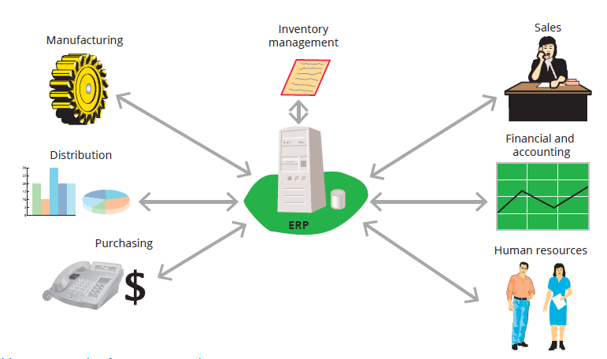
Impact of information technology on supply chain management
Information technology
  hardware, software, telecommunications, database management, and other technologies used to store, process, and distribute information
    Dissolves boundaries
    Encourages collaboration
Knowledge management
  Efforts to systematically gather knowledge, organise it, make it widely available throughout the organisation, and foster a culture of continuous learning and knowledge sharing.
Enterprise resource planning systems
  A networked information system that collects, processes and provides information about an organisation’s entire enterprise, from identification of customer needs and receipt of orders to distribution of products and receipt of payments.

Slide 14
The internet and e-business
E-business is any business that takes place by digital processes over a computer network rather than in physical space.
E-commerce is a more limited term that refers specifically to business exchanges or transactions that occur electronically.
An intranet is an internal communications system that uses the technology and standards of the internet but is accessible only to people within the organisation.
An extranet is an external communications system that uses the internet and is shared by two or more organisations.

Slide 15
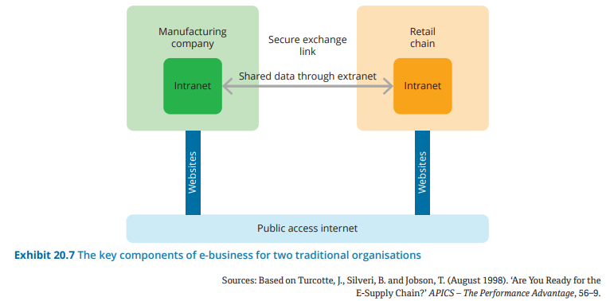
The key components of e-business for two traditional organisations

Slide 16
Summary
Operations management refers to using various tools and techniques to ensure that goods and services are delivered successfully to customers or clients.
Facilities layout, which can be focused around process, product, fixed-position or in cells, provides the process design and structure needed to make the operation effective.
Advanced technical systems can support the never-ending quest to improve products and the costs, quality and delivery performance of these.
Inventory is an important contributor to both cost and service levels.
An organisation’s information technology (IT) consists of the hardware, software, telecommunications, database management and other technologies that the company uses to store data and make it available in the form of information for organisational decision making.
E-business can be defined as any business that takes place by digital processes over a computer network rather than in physical space

