Slide 1
MN101 Principles of Management
Revision

Slide 2
Learning objectives
Define the fundamentals of management including its control processes, functions, and roles in contemporary organisations.
Identify key management issues affecting organisations in contemporary society.
Demonstrate effective application of basic management frameworks in problem analysis.
Identify effective remedies to address managerial problems defined in an analysis.
Successfully write a sound professional management report.
Conduct a presentation that engages an audience and conveys key ideas effectively.
Notes:
LO1

Slide 3
Topics
Topic | Chapter
Introduction to management: The changing world of management & evolution of management theory | Chapter 1 Chapter 2
Managing in a global environment Ethics and social responsibility | Chapter 4 Chapter 5
Organisational planning and goal setting Strategy formulation and implementation | Chapter 7 Chapter 8
Managerial decision making | Chapter 9
Designing organisational structure Managing change and innovation | Chapter 10 Chapter 11
Managing human resource | Chapter 12
Leadership | Chapter 15
Motivating employees | Chapter 16
Communication in organisations | Chapter 17
Leading teams | Chapter 18
Managerial quality and performance | Chapter 19
Managing value chain, information technology and E-business | Chapter 20
Notes:
LO1

Slide 4
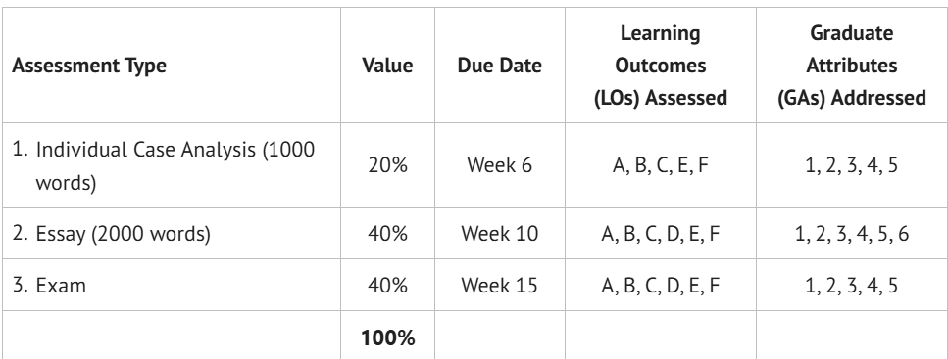
Assessment
Notes:
LO1

Slide 5
Final exam
  Nature of questions
    Short answer questions (20%)
      Requirement: Answer any four out of eight management concepts.
      Marks: 5 marks each, total 20 marks.
    Essay-type questions (20%)
      Requirement: Answer any two out of four questions.
      Marks: 10 marks each, total 20 marks
  Chapters:
  Chapter 5, 7, 9, 10, 11, 15, 16, 18, 19, 20
Notes:
LO1

Slide 6
Final exam- topics
  Short answer questions. Answer any four out of eight management concepts. 5 marks each.
  Topics/lecture week/chapters/number of questions:
  Managerial Decision Making – Week 4 (Chapter 9) (1 question)
  Designing organization structure – Week 5 (chapter 10) (1 question)
  Managing change and innovation – Week 5 – (chapter 11) (2 questions)
  Leadership – week 8 (chapter 15) (1 question)
  Motivating employees – (week 9) (1 question)
  Leading teams – Week 11 (chapter 18) (1 question)
  Managing the Value Chain, Technology, E-Business - week 13 (chapter 20) ( 1 question)
Notes:
LO1

Slide 7
Final exam - topics
  Essay-type questions (20%). Answer any two out of four questions. Marks: 10 marks each, total 20 marks.
  Topics/lecture week/chapters/number of questions:
  CSR & Ethical Management Practices – Week 2 ( chapter 5), 1 question
  Organization planning and goal setting- week 3 (chapter 7), 1 question
  Managing Human Resources – week (chapter 12), 1 question
  Managerial quality and performance – week 12 (chapter 19), 1 question
Notes:
LO1

Slide 8
Final exam
  How to get maximum marks?
  Review
    lecture slides, relevant topics in your textbook,
    tutorial questions
  Questions?
  Email: bteklay@sheridan.edu.au
Notes:
LO1

Slide 9
How to Answer Short Answer Questions Effectively
To answer short answer questions effectively, it is important to be concise yet thorough. Each question is worth 5 marks, so your answer should be well-structured to demonstrate a clear understanding of the concept. A good structure includes three key components: first, provide a clear and accurate definition of the concept; second, offer an explanation of its significance or how it functions within a management context; and third, include an example or practical application to show how the concept is used in practice.

Slide 10
How to Answer Essay-Type Questions Effectively
How to Answer Essay Questions Effectively
Each is worth 10 marks, so keep the answers:
Structured (introduction → main points → conclusion).
Focused on the specific question asked.
What to Include:
Introduction: Brief context and define any key terms.
Body: 2–3 main points or arguments, each with explanation and example.
Conclusion: Summary.
Writing Tips:
Stay on-topic and avoid repetition.
Use examples from business contexts or current events to support arguments.
Link back to the question in your conclusion.

Slide 11
Review of key points
Ethics and social responsibility
  Discussed what CSR is all about: management’s obligation to make choices and take actions that will contribute to the welfare and interests of society, not just the organisation.
  Explained that a company’s CSR strategy can be assessed and measured alongside environmental, social, and governance (ESG) dimensions.
  Learned that CSR provides a broader view of responsibility that goes beyond legal compliance and profit-making, embedding ethical considerations into strategic and operational decision-making.
  The adoption of CSR leads managers to prioritise ethical behaviour, transparency,
  Ethical leadership is at the heart of the success of a CSR and sustainability initiative. practising ethical leadership.
  Managers can use both a values-oriented approach (including codes of ethics) and ethical structures (such as ethics committees) to create an ethical organisation.
Notes:
LO1

Slide 12
Review of key points
Organisational planning and goal setting
  Defined goals and plans and explained the relationship between them.
  Discussed the benefits and limitations of planning.
  Described and explained the importance of contingency planning, scenario building, and crisis planning for today’s managers.
  Discussed various types of planning managers use when operating in a turbulent environment: Contingency planning, scenario planning, and crisis planning. Looked at the Japan nuclear disaster or the BP oil spill as an example.
  Explained innovative planning approaches that managers use in a fast-changing environment.
Notes:
LO1

Slide 13
Review ….
Managerial decision making
Defined decision making: the process of identifying problems and opportunities and then resolving them.
Discussed types of decisions: programmed decision and non-programmed decision
Learned that decisions differ according to the amount of certainty, risk, uncertainty or ambiguity in the situation.
Discussed types of decision models:
  Rational approach to decision making (classical model)
  Administrative model
  Political model
Learned the steps in the managerial decision-making process: recognising the need, diagnosing causes, developing alternatives, selecting an alternative, implementing the alternative and evaluating decision effectiveness.
Discussed that managers make bad decisions due to biases, and these can be minimized by applying innovative techniques for decision making.
Notes:
LO1

Slide 14
Review ….
Designing organisational structure
Defined organizing: the deployment of organisational resources to achieve strategic goals.
We also defined rrganisation structure as the set of formal tasks assigned to individuals and departments, involving formal reporting relationships, including lines of authority, decision responsibility, number of hierarchical levels, and span of managers’ control
Discussed the tall structure, the flat structure
Explained centralization and decentralization.
Discussed the five approaches to structural design
  Vertical functional, Divisional, Matrix, Team-based, and Network
Discussed factors shaping organization structure: organization size, strategy, and production technology
Notes:
LO1

Slide 15
Review ….
Managing change and innovation
  Discussed disruptive innovation: innovations in products, services, or processes that radically change an industry’s rules of the game for producers and consumers.
  Realised that companies that initiate disruptive innovation are typically successful, while companies affected by a disruptive technology may be put out of business. Discussed some examples such as Uber, Netflix, and smartphones
  Discussed internal and external forces of change as well as examples of these forces of change.
  Explained product change and technology Change
  Discussed Lewin’s change management model
Notes:
LO1

Slide 16
Review ….
Managing human resource
Defined HRM: the design and application of formal systems in an organisation to ensure the effective and efficient use of human talent to accomplish organisational goals.
Discussed the strategic role of HRM in driving organisational performance.
  Four key areas:
    Recruitment
    Training
    Performance appraisal
    Compensation
Discussed innovative HR practices: blind hiring, branding the company as an employer of choice, and algorithm-based hiring.
Notes:
LO1

Slide 17
Review ….
Leadership
It is the ability to influence people towards the attainment of goals.
Discussed features of bosless organisations.
Explained level 5 leadership and its key characteristics – humility, strong collaborative team, shared vision, shared credit and accountability.
  Discussed each level: capable (individual), contributing (team member), competent (manager), effective (leader), and level 5 (executive).
Discussed leadership styles
  servant leadership
  Authentic leadership
  Interactive leadership
  Transformational leadership
  Charismatic leadership
Discussed followership
Notes:
LO1

Slide 18
Review ….
Motivating employees
Defined motivation and its importance in enhancing employee productivity.
Discussed various theories of motivation: Content perspectives and process perspectives
Content perspective theories are:
  Maslow’s hierarchy of needs theory
    Physiological, Safety, Belongingness, Esteem, Self-actualization
    Discussed how each of the above needs can be met in an organization
  ERG theory
    three categories of needs. Existence needs, relatedness needs, and growth needs
  Two-factor approach to motivation
    Hygiene factors and motivators
  Acquired needs
    Need for achievement, need for affiliation, need for power
  Process perspective theories of motivation include goal setting and social learning theory.
Notes:
LO1

Slide 19
Review ….
Leading teams
Defined team and explained its key components: two or more people, interact regularly, share a performance goal.
Explained the requirements for teamwork: focus on shared mission, trust one another, willing to sacrifice for the team, pull together in the same direction, and communicate their objectives and needs.
Discussed the contributions of teams, types of teams, common dysfunctions in teams,.
Discussed outcomes of team effectiveness: productive output, personal satisfaction, and the capacity to adapt and learn.
Discussed stages of team development:
  Forming, storming, norming, performing, and adjourning
Discussed types of conflicts, which occurs at the storming stage of team development stage, causes of conflicts, and ways (styles) to handle team conflict
Notes:
LO1

Slide 20
Review ….
Managerial quality and performance.
Explained why organisational control is a key management function.
Explain how the balanced scorecard addresses the four steps in the control process.
Discussed the importance of aligning organizational control with the strategy of the organization; cost leadership vs differentiation strategy, for example.
Describe the qualities of effective control systems.
Notes:
LO1

Slide 21
Review ….
Managing value chain, information technology and E-business
Defined operations management and described its application within manufacturing and service organisations.
Discussed the difference between manufacturing and service organisations
Discussed the organization as a value chain.
Defined value chain: primary and secondary activities
Discussed supply chain management
Discussed the importance of inventory management and the role of information technology
Notes:
LO1

Slide 22
Good luck!
Notes:
LO1

