Slide 1
MN101 Principles of Managemnt
Week 11
Leading teams
(Chapter 18)
©2022 John Wiley & Sons Australia Ltd

Slide 2
Learning objectives
Summarise the personal dilemmas and common dysfunctions that may arise when working in teams.
Describe the types of teams and explain the practices of effective virtual teams.
1
Explain what a team is and the value and contributions they make in organisations.
2
3
4
Outline the factors managers should consider that will influence work team effectiveness.
5
6
7
Identify ways in which team size, diversity of membership and team roles affect team performance.
Explain the processes of team cohesiveness, team norms and the general stages of team development.
Explain the causes and types of conflict within and among teams, and describe ways to reduce conflict.

Slide 3
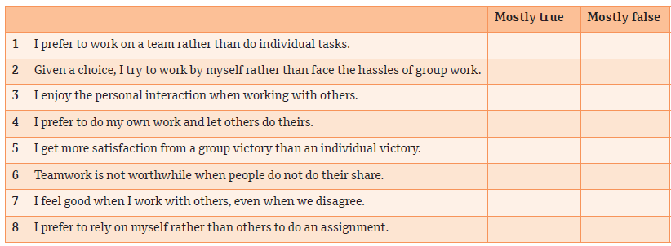
How do you like to work?
New manager self-assessment

Slide 4
1. Nature and meaning of a team
What is a team?
A team is a unit of two or more people who interact and coordinate their work to accomplish a common goal to which they are committed and hold themselves mutually accountable.
The definition of a team has three components:
  Two or more people are required.
  They interact regularly.
  They share a performance goal.

Slide 5
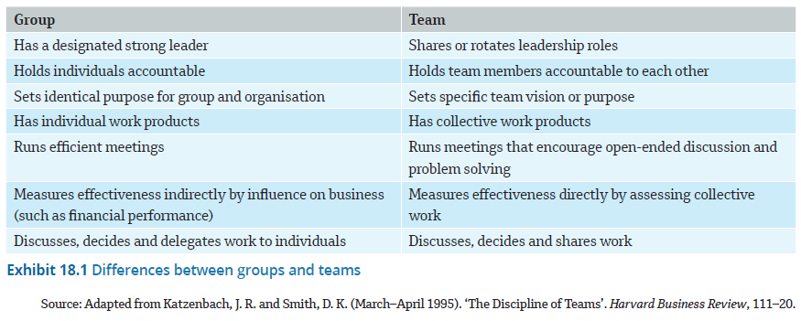
Differences between groups and teams
1. Nature and meaning of a team (cont.)

Slide 6
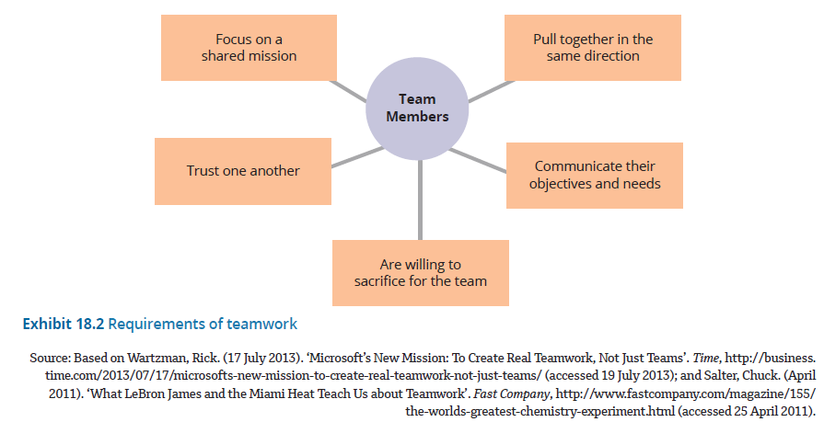
Requirements of teamwork
1. Nature and meaning of a team (cont.)

Slide 7
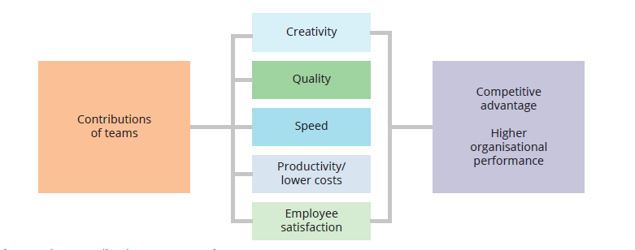
Five contributions teams make
1. Nature and meaning of a team (cont.)

Slide 8
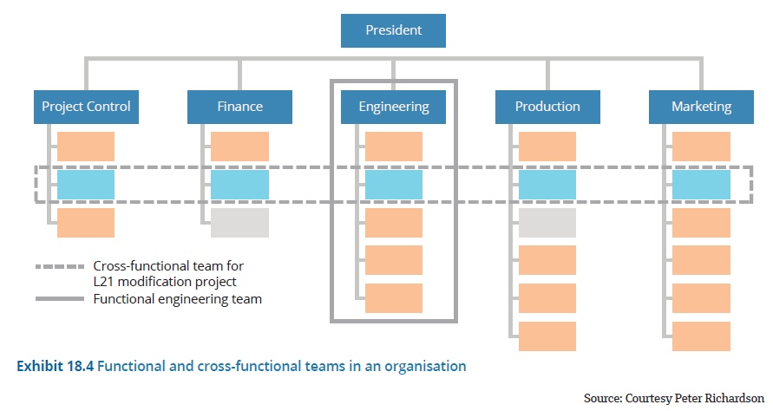
2. Types of teams
Organisations use many types of teams to achieve goals.
  Two common types of teams in organisations are functional and cross-functional
  Organisations also use self-managed teams and virtual teams to increase employee participation.
Functional and cross-functional teams in an organisation

Slide 9
2. Types of teams (cont.)
Functional teams
Composed of a manager and their subordinates in the formal chain of command.
May include three or four levels of hierarchy within a functional department.
Each is created by the organisation to attain specific goals through members’ joint activities and interactions.
Cross-functional teams
composed of employees from about the same hierarchical level, but from different areas of expertise.
  Task force: a group of employees from different departments formed to deal with a specific activity and existing only until the task is completed.
  Special-purpose team: created outside the formal organisation structure to undertake a project of special importance or creativity.

Slide 10
2. Types of teams (cont.)
Self-managed and agile teams
Self-navigated teams: typically consist of five to 20 multiskilled workers who rotate jobs to produce an entire product or service.
  linked to the trend towards the bossless organisation.
An agile team (the most advanced use of self-managed teams) is small, focused on one aspect of a larger project, and has complete responsibility and all the necessary expertise to produce its product or service.
Virtual teams
  A virtual team is a group made up of geographically or organisationally dispersed members who are linked primarily through advanced information and telecommunications technologies.
  A global team is a cross-border team made up of members of different nationalities whose activities span multiple countries.

Slide 11
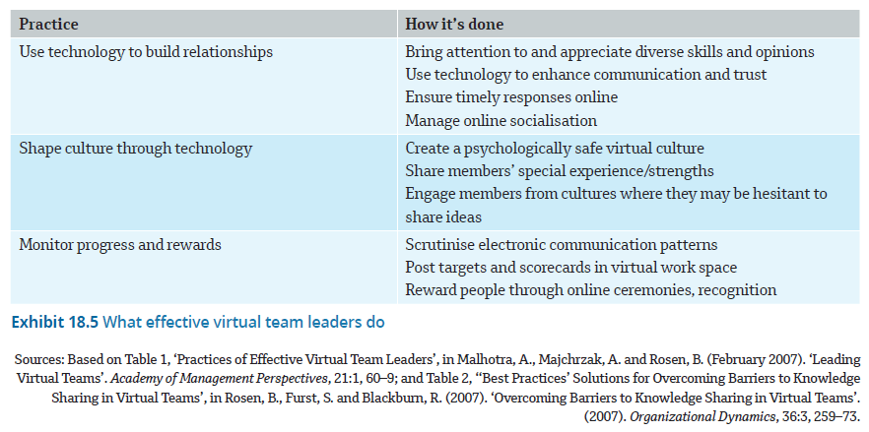
What effective virtual team leaders do
2. Types of teams (cont.)

Slide 12
3. The personal dilemma of teamwork
There are three primary reasons that teams present a dilemma for many people:
  ‘We have to give up our independence.’
  ‘We have to put up with free riders.’
  ‘Teams are sometimes dysfunctional.’
Notes:
Free rider: One who attains benefits from team membership but does not actively participate in and contribute to the team’s work.

Slide 13
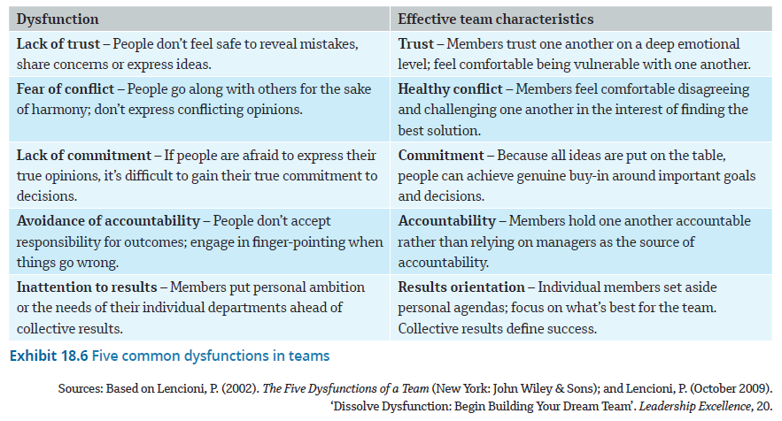
Five common dysfunctions in teams
3. The personal dilemma of teamwork (Cont.)

Slide 14
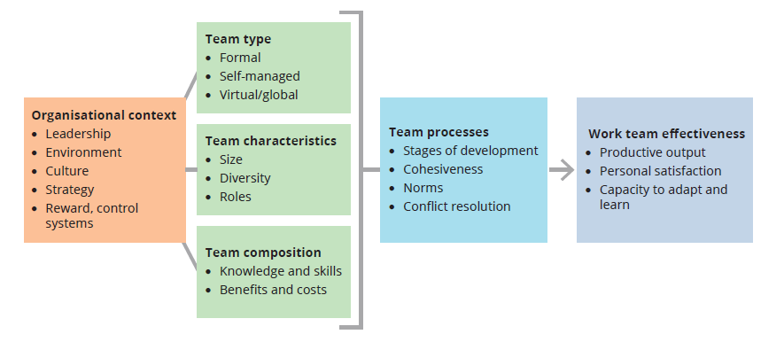
4. Model of team effectiveness
Effective teams are built by managers who take specific actions to help people come together and perform well as a team.
Work team effectiveness is based on three outcomes:
  productive output
  personal satisfaction
  the capacity to adapt and learn.

Slide 15
5. Team demographics
Size
Teams need to be:
large enough to incorporate the diverse skills needed to complete a task, enable members to express good and bad feelings, and aggressively solve problems
small enough to permit members to feel an intimate part of the team and to communicate effectively and efficiently.
Diversity
Diversity in teams:
is often a source of creativity
may contribute to a healthy level of disagreement that leads to better decision making
offers a variety of skills, knowledge, and experiences.

Slide 16
6. Member roles
Members with a task specialist role
Initiate ideas
Give opinions
Seek information
Summarise
Energise

Slide 17
5. Member roles (cont.)
Members with a socioeconomic role
Encourage
Harmonise
Reduce tension
Follow
Compromise

Slide 18
6. Team processes
Stages of team development
  Forming: The initial period of orientation and getting acquainted
  Storming: The period in which individual personalities and roles, and resulting conflicts, emerge
  Norming: The period in which conflict is resolved, and team harmony and unity emerge
  Performing: The period in which emphasis is on problem solving and accomplishing the assigned task
  Adjourning: The final period in which members prepare for the team’s disbandment

Slide 19
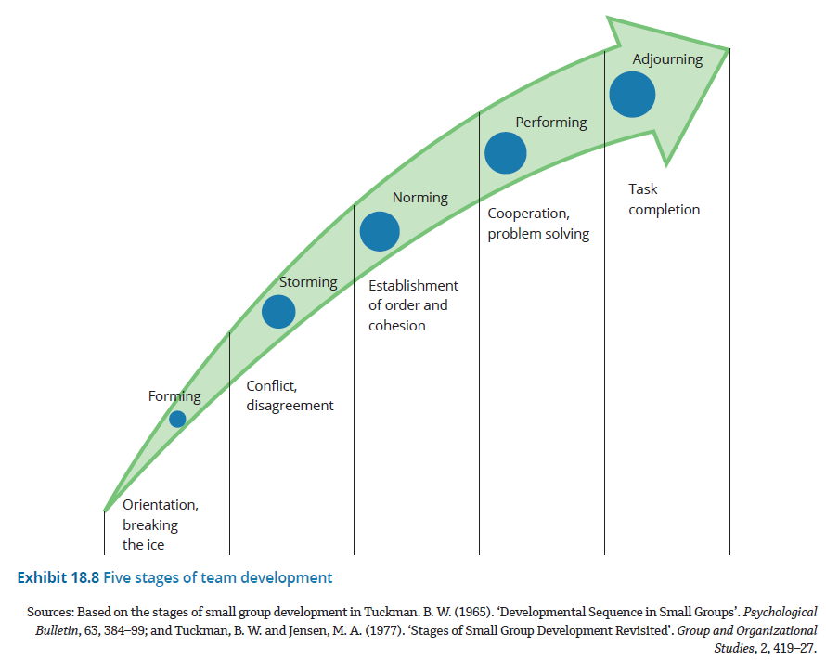
Five stages of team development
  Group task: discuss and share your understanding of each of the team development stages. Use examples to elaborate.

Slide 20
6. Team processes (cont.)
Building a cohesive team
Team cohesiveness is defined as the extent to which members are attracted to the team and motivated to remain in it.
Determinants of team cohesiveness:
  Team interaction
  Shared goals
  Personal attraction to the team
Consequences of team cohesiveness:
  Morale
  Productivity

Slide 21
6. Team processes (cont.)
Establishing team norms
A team norm is an informal standard of conduct that is shared by team members and guides their behaviour.
Norms begin to develop in the first interactions among members of a new team.
Norms are especially important to both positive team feelings and productive team output:
  Psychological safety
  Emotional expression
  Social sensitivity
  Equal participation

Slide 22
7. Managing team conflict (Cont.)
Types of conflict
Conflict refers to an antagonistic interaction in which one party attempts to block the intentions or goals of another. There are two types of conflict:
  Task conflict results from disagreements about the goals to be achieved or the content of the tasks to be performed.
  Relationship conflict results from interpersonal incompatibility that creates tension and personal animosity among people.

Slide 23
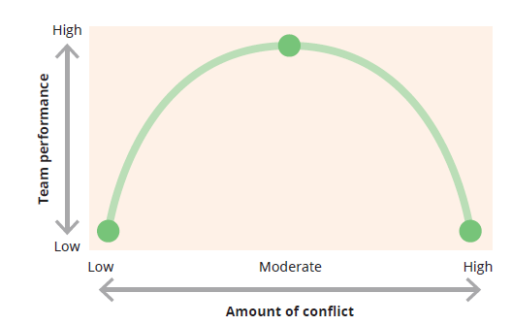
Balancing conflict and cooperation
7. Managing team conflict (Cont.)

Slide 24
7. Managing team conflict (Cont.)
Causes of conflict
Competition over resources
Different goals
Communication breakdowns
Group fault lines

Slide 25
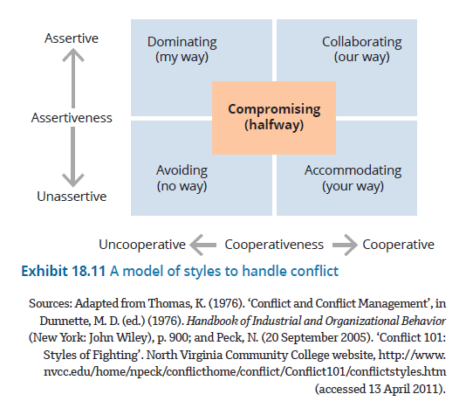
A model of styles to handle conflict
7. Managing team conflict (Cont.)

Slide 26
7. Managing team conflict (Cont.)
Ways of expressing conflict
High directness–high intensity: Unambiguous; aggressive or antagonistic verbal and non-verbal communication
High directness–low intensity: Unambiguous; low-voltage style communication
Low directness–high intensity: Ambiguous; aggressive tactics
Low directness–low intensity: Ambiguous; low-key communication

Slide 27
7. Managing team conflict (Cont.)
Negotiation
Negotiation involves people engaging in give-and-take discussions and considering various alternatives to reach a joint decision that is acceptable to both parties.
  Integrative negotiation is based on a win–win assumption, in that all parties want to come up with a creative solution that can benefit both sides.
  Distributive negotiation is a competitive and adversarial approach in which each party strives to get as much as it can, usually at the expense of the other party.

Slide 28
Summary
A team is a unit of two or more people who interact and coordinate their work to accomplish a goal to which they are committed and hold themselves mutually accountable.
The various types of teams include functional teams, cross-functional teams, self-managed or agile teams and virtual teams.
Virtual teams provide many advantages, but they also present new challenges for leaders, who must learn to build trusting relationships in a virtual environment.
Teams present a dilemma for most people because individual success depends on how well others perform; there are common dysfunctions that afflict teams, and there is the potential for free riders.
Five common dysfunctions of teams are lack of trust, fear of conflict, lack of commitment, avoidance of accountability and inattention to results.
Effective teams are built by managers who take specific actions to help people come together and perform well as a team.
Issues of particular concern to managers for team effectiveness are selecting the right type of team for the task, balancing the team’s size and diversity, and ensuring that both task and social needs are met.
Team cohesiveness refers to the extent to which team members are attracted to the team and motivated to remain a part of it.
Team norms are informal operating guidelines that establish agreed-upon behaviours about how the team’s work will get done and what members can expect from each other.
Teams develop in five stages: forming, storming, norming, performing and adjourning.
Conflict refers to antagonistic interaction in which one party attempts to block the intentions or goals of another.
Two basic types are task conflict and relationship conflict.
Causes of conflict include competition over resources, goal differences, communication breakdowns and fault lines.

