Slide 1
Accounting for Managers (BU502)
Week 10
Communication in organisations (Chapter 17)
©2022 John Wiley & Sons Australia Ltd

Slide 2
Learning objectives
Explain how factors such as creating an open communication climate, the choice of communication channels, candour, questions and non-verbal communications influence the quality of communication.
Discuss the importance of purpose-driven communications, including vision and mission and ways to persuade and influence others.
1
Explain why communication is essential for effective management.
2
3
4
Describe the manager’s role in using social media and personal networks to improve organisational communication.

Slide 3
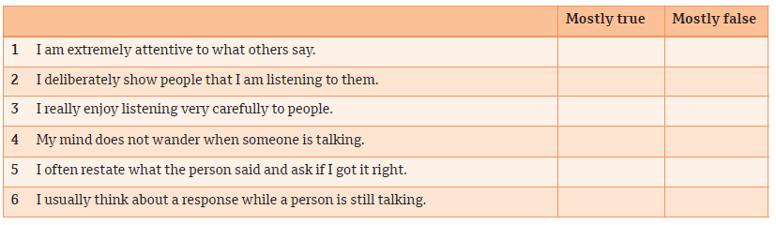
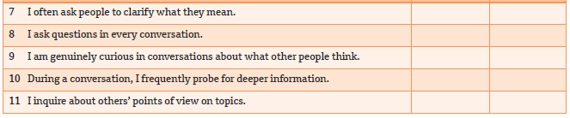
Do you focus on what others say?
New manager self-assessment

Slide 4
1. The meaning and importance of communication (cont.)
What is communication?
Communication is the process by which information is exchanged and understood by two or more people, usually with the intent to influence or motivate behaviour.
Communication is the manager’s job
  Managers spend at least 80 per cent of every working day in direct communication with others.
  Managers’ communication is purpose-directed in that it directs everyone’s attention towards the vision, values and desired goals of the team or organisation and influences people to act in a way to achieve those goals.
  Managers facilitate effective conversations by using open communication, actively listening to others, asking questions and using feedback for learning and change.

Slide 5
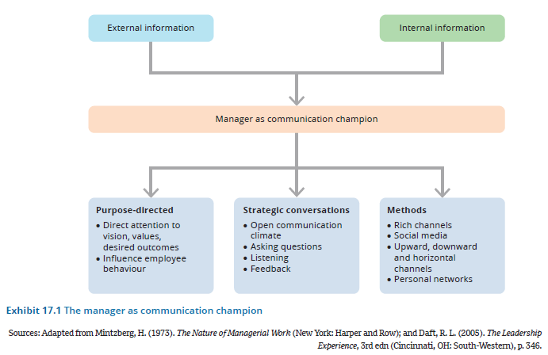
The manager as the communication champion
1. The meaning and importance of communication (cont.)

Slide 6
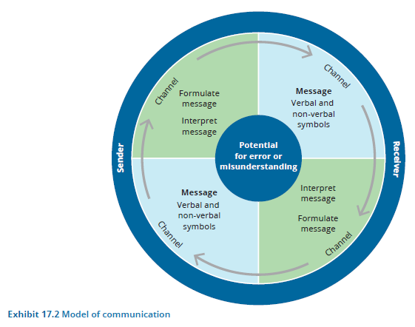
Model of communication
1. The meaning and importance of communication (cont.)

Slide 7
2. Purpose-driven communication
Communicating vision, mission and values
Strong, inspiring visions have been associated with higher organisational performance and greater employee motivation and satisfaction.
In addition to communicating a vision and purpose, managers must get people throughout the organisation to behave in ways that will gain buy-in and help attain the desired outcomes.
Communication is undertaken not just for conveying information, but also for persuading and influencing people.

Slide 8
Key points for practising the art of persuasion
2. Purpose-driven communication (cont.)
Establish credibility
Build goals on common ground
Connect emotionally
Use multiple media to send important messages

Slide 9
Communicating among people
2. Purpose-driven communication (cont.)
Open communication climate
Open communication means sharing all types of information throughout the organisation, across functional and hierarchical boundaries.
To achieve the advantages of open communication, managers should use the type of communication network that maximises employee performance and job satisfaction.
  In a centralised network, team members must communicate through one individual to solve problems or make decisions.
  In a decentralised network, individuals can communicate freely with other team members.

Slide 10
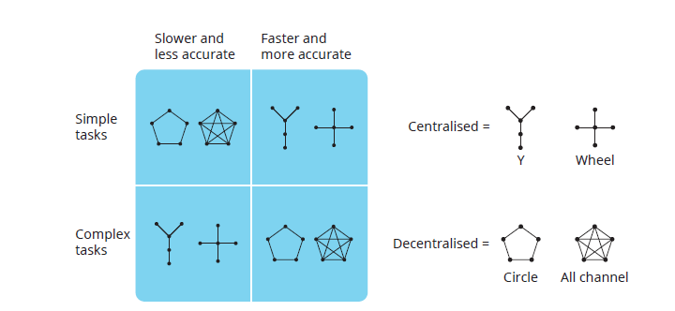
Effectiveness of team communication networks
2. Purpose-driven communication (cont.)

Slide 11
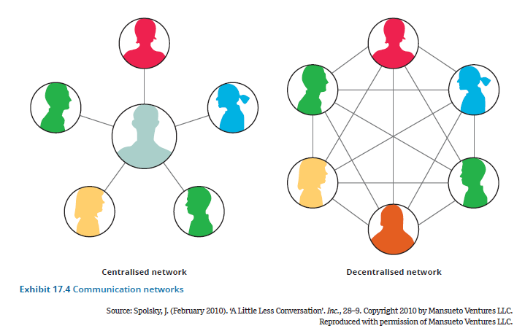
Communicating networks
2. Purpose-driven communication (cont.)

Slide 12
3. Communication channels
Managers have a choice of many channels through which to communicate.
One approach to selecting an effective communication channel is to interpret the emotions of the person who will be receiving the message, then select the channel that will result in the best outcome.
Another factor that shapes a manager’s selection of a communication channel is the type and amount of information to be communicated.

Slide 13
3. Communication Channels (cont.)
The hierarchy of channel richness
Channel richness is the amount of information that can be transmitted during a communication episode.
The capacity of an information channel is influenced by three characteristics:
  the ability to handle multiple cues simultaneously
  the ability to facilitate rapid, two-way feedback
  the ability to establish a personal focus for the communication.

Slide 14
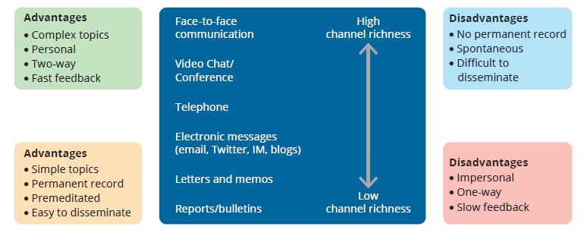
A continuum of channel richness
3. Communication Channels (cont.)

Slide 15
3. Communication channels (cont.)
Selecting the appropriate channel
Channel selection depends on whether the message is routine or non-routine:
  Non-routine messages typically are ambiguous, concern novel events and involve great potential for misunderstanding.
  Routine messages are simple and straightforward. They convey data or statistics or simply put into words what managers already agree on and understand.
The key is to select a channel to fit the message.

Slide 16
3. Communication channels (cont.)
Giving feedback
Open and honest feedback is one of the most important elements contributing to the growth and development of employees.
When a manager provides feedback, it signals that the manager cares about employee’s growth and career development and wants to help them achieve their potential.
Manager feedback occurs when a manager uses evaluation and communication to help individuals learn about themselves and improve.

Slide 17
3. Communication channels (cont.)
Communicating with candour
Communicating with candour means being direct, honest and clear about what employees need to do to meet objectives, while also expressing respect for others and not making them feel slighted, controlled or exploited.
Some valuable techniques for communicating with candour include the following:
  Use ‘I’ statements.
  Stick to facts rather than judgements.
  Be clear, specific and direct in your requests.

Slide 18
The benefits of asking questions
3. Communication channels (cont.)
Builds trust and openness between managers and employees
Builds critical-thinking skills
Stimulates the mind and gives people a chance to make a difference
An important dimension of the organisational conversation

Slide 19
3. Communication channels (cont.)
Listening
Listening involves the skill of grasping both facts and feelings to interpret the genuine meaning of a message.
Most managers now recognise that important information flows from the bottom up, not the top down, and managers had better be tuned in to those messages.
A good listener finds areas of interest, is flexible, works hard at listening and uses thought speed to mentally summarise, weigh and anticipate what the speaker says.

Slide 20
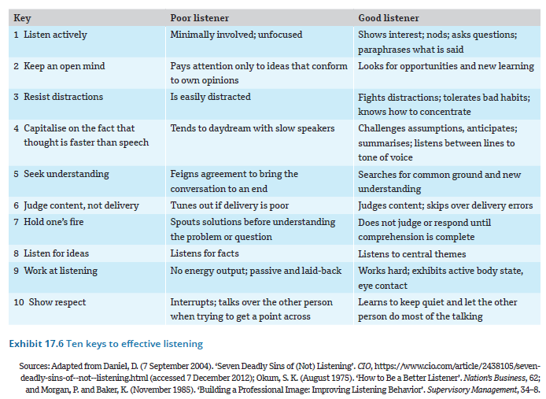
Ten keys to effective listening
3. Communication channels (cont.)

Slide 21
3. Communication channels (cont.)
Non-verbal communication
Non-verbal communication refers to messages sent through human actions and behaviour rather than through words.
Body language – such as facial expressions, gestures, touch and use of space – can communicate a range of messages, from enthusiasm, warmth, and confidence to arrogance, indifference, displeasure and condescension.
Managers are watched, and their behaviour, appearance, actions, and attitudes are symbolic of what they value and expect of others.

Slide 22
4. Workplace communication
Social media is used for:
Social media refers to a group of internet-based applications that allow the creation and exchange of user-generated content.
Social networking is the expansion of an individual’s set of business or social contacts, often using internet-based media.
Team collaboration
Listening to customers
Communicating with customers
Engaging employees

Slide 23
4.1 Personal communication networks
Personal communication networks exist outside the formally authorised channels and do not adhere to the organisation’s hierarchy of authority.
Three important types of personal communication channels are personal networks, the grapevine, and written communication.
Developing personal communication networks
Personal networking refers to the acquisition and cultivation of personal relationships that cross departmental, hierarchical, and even organisational boundaries.
Tips for building a personal communication network:
  Build it before you need it.
  Never eat lunch alone.
  Make it a win–win situation.
  Focus on diversity.

Slide 24
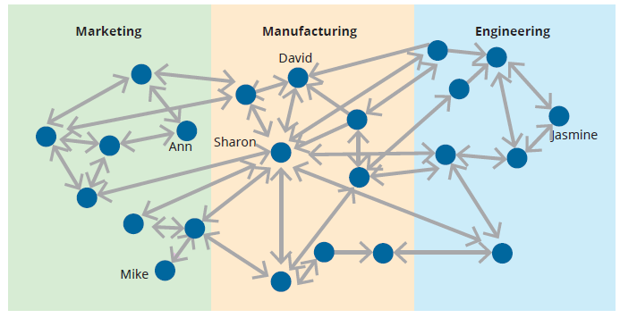
An organisational communication network
4.1. Personal communication networks

Slide 25
4.2. Personal communication networks (cont.)
The grapevine
The grapevine is an informal, person-to-person communication network of employees that is not officially sanctioned by the organisation.
The grapevine links employees in all directions, ranging from the CEO through middle management, support staff, and line employees.
Gossip travels along the grapevine, providing an efficient channel to communicate information because it will move more rapidly than through a formal channel.

Slide 26
4.1. Personal communication networks (cont.)
Managers can improve their written communication skills by:
Respecting the reader
Knowing their point and getting to it
Writing clearly rather than impressively
Getting a second opinion

Slide 27
4.2 Formal communication channels
Formal communication channels involve written and verbal ways of exchanging information among people who have recognised status in the organisation.
The three formal channels are downward, upward, and horizontal communication.

Slide 28
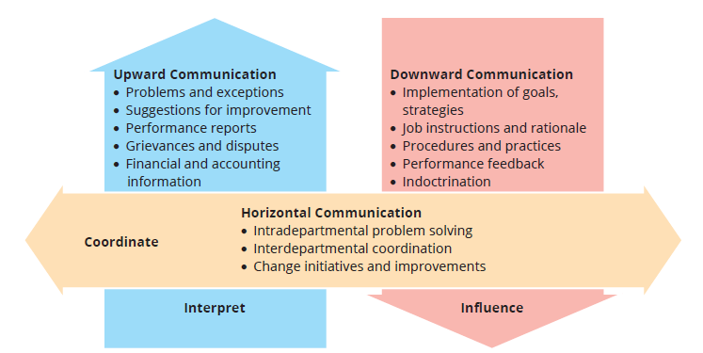
Downward, upward and horizontal communication in organisations
4.2 Formal communication channels

Slide 29
4.2 Formal communication channels (cont.)
Downward communication
The messages and information sent from top management to subordinates in a downward direction
Upward communication
The messages that flow from the lower to the higher levels of the organisation’s hierarchy
Horizontal communication
The lateral or diagonal exchange of messages among peers or co-workers that may occur within or across departments
Encompasses five topics:
Goals and strategies
Job instructions and rationale
Procedures and practices
Performance feedback
Coaching and training
Encompasses five topics:
Problems and exceptions
Suggestions and improvements
Performance reports
Grievances and disputes
Financial and accounting information
Encompasses three topics:
Intradepartmental problem solving
Interdepartmental coordination
Change initiatives and improvements

Slide 30
4.3 Crisis communication
Stay calm, listen hard
Good crisis communicators don’t allow themselves to be overwhelmed by the situation.
Be visible
Many managers underestimate just how important their presence is during a crisis.
Get the awful truth out
Effective managers gather as much information as they can, do their best to determine the facts, and tell the truth to employees and the public as soon as possible.
Communicate a vision for the future
Calmness and listening become more important than ever.
Managers also learn to tailor their communications to reflect hope and optimism as they acknowledge current difficulties.
A manager’s job is to step out immediately, both to reassure employees and respond to public concerns.
Face-to-face communication with employees is crucial for letting people know that managers care about them and what they’re going through.
Getting the truth out quickly prevents harmful rumours and misunderstandings.
People need to feel that they have something to work for and look forward to.
Moments of crisis present opportunities for managers to communicate a vision of a better future and unite people towards common goals.

Slide 31
Chapter summary
The manager’s role as communication champion means engaging in purpose-driven strategic conversations via multiple channels.
Managers spend at least 80 per cent of every working day in direct communication with others.
One of a manager’s most important communication challenges is to unite people around a common sense of purpose by communicating the organisation’s vision, mission and values.
To achieve the mission and vision also requires that managers persuade and influence others.
Managers persuade and influence by establishing credibility and trust, building goals on common ground, connecting emotionally and using multiple media.

Slide 32
Chapter summary
To act as communication champions and achieve the best possible outcomes, managers must understand how factors such as an open communication climate, various communication channels, providing feedback, communicating with candour, asking questions and non-verbal behaviour all work to enhance or detract from communication.
Open communication means sharing all types of information throughout the organisation and across functional and hierarchical boundaries.
Communicating with candour means being direct, honest and clear, while also expressing respect for others.
Four elements of workplace communication are using social media, using personal communication networks, establishing formal communication channels and developing strategies for crisis communication.
Organisations are using social media to enable employees to communicate among themselves and with managers, to communicate with customers and other outsiders, and to build employee engagement.
Personal communication networks exist outside formally authorised workplace channels and include personal networks, the grapevine and written communication.

