Slide 1
LEADING
PART FIVE

Slide 2
Week 9: Motivating employees
CHAPTER 16

Slide 3
Learning objectives
Describe process theories of motivation.
Describe content theories of motivation.
1
Explain how motivation is related to individual needs, and the difference between intrinsic and extrinsic rewards.
2
3
4
Explain how the reinforcement perspective can be used to
5
6
Discuss how job design influences motivation.
Explain how empowerment and engagement approaches can
motivate employees.
be used to heighten employee motivation.

Slide 4
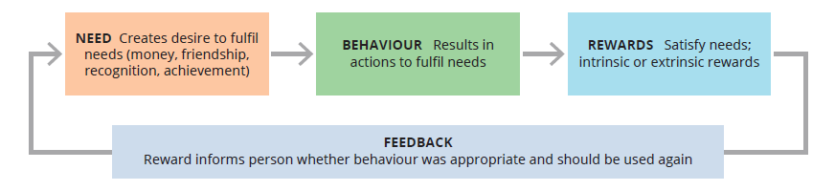
1. Individual needs and motivation
Motivation refers to the forces either within or external to a person that arouse enthusiasm and persistence to pursue a certain course of action.
Employee motivation affects productivity; it is the responsibility of managers to find the right combination of motivational techniques and rewards to satisfy employees’ needs and simultaneously encourage great work performance.
Model of motivation

Slide 5
Intrinsic and extrinsic rewards
1. Individual needs and motivation (cont.)
Intrinsic rewards are the satisfactions a person receives in the process of performing a particular action.
Extrinsic rewards are given by another person, typically a manager, and include promotions, praise and pay increases.
People give their best effort when the work itself interests and excites them, when they feel that their work provides meaning and purpose, and when they feel appreciated for their work and contributions.

Slide 6
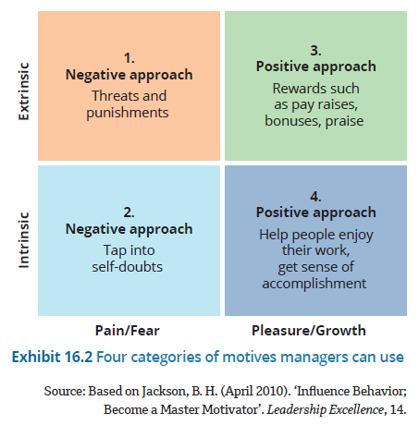
Four categories of motivation
1. Individual needs and motivation (cont.)
The Horizontal Dimensions of Motivation

Slide 7
Motivating in a bossless environment
An organisation that wants to go bossless should consider the following motivation methods:
1. Individual needs and motivation (cont.)
Don’t hide information
Rely on intrinsic rewards
Let people own the goal
Reward the team
Hire attitude over aptitude
Reinvent management

Slide 8
2. Content perspectives on motivation
(i) The hierarchy of needs theory
Abraham Maslow’s hierarchy of needs theory proposes that people are motivated by multiple needs, and that these needs exist in a hierarchical order:
  Physiological
  Safety
  Belongingness
  Esteem
  Self-actualisation
Low-order needs take priority – they must be satisfied before higher-order needs are activated.
Watch the following video: Abraham Maslow’s hierarchy of needs
https://www.youtube.com/watch?v=L0PKWTta7lU&ab_channel=TheSchoolofLife

Slide 9
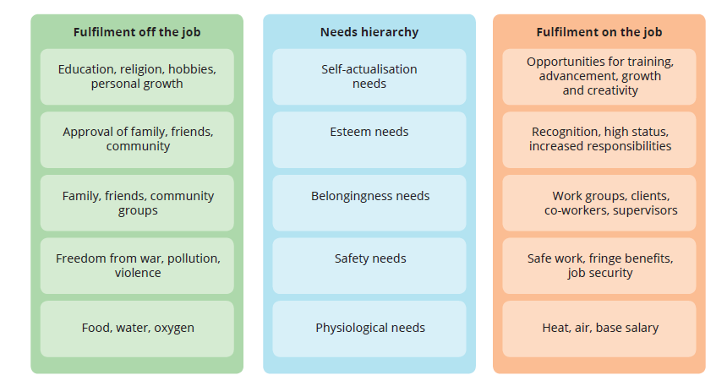
Maslow’s hierarchy of needs
2. Content perspectives on motivation (cont.)

Slide 10
2. Content perspectives on motivation (cont.)
(ii) ERG theory
Clayton Alderfer proposed a modification to Maslow’s theory in an effort to simplify it and respond to criticisms regarding its lack of empirical verification. His ERG theory identified three categories of needs.
ERG theory is based on the idea of the frustration–regression principle: the idea that failure to meet a high-order need may cause a regression to an already satisfied lower-order need.

Slide 11
2. Content perspectives on motivation (cont.)
(ii) ERG theory (cont.)
Existence needs
The needs for physical wellbeing
Relatedness needs
The needs for satisfactory relationships with others
Growth needs
The needs that focus on the development of human potential, and the desire for personal growth and increased competence
Watch the following video
https://www.youtube.com/watch?v=upBHae2J-LI&ab_channel=EPM

Slide 12
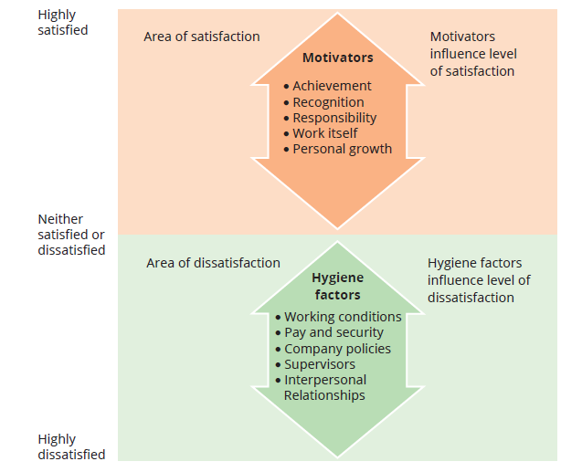
2. Content perspectives on motivation (cont.)
Herzberg’s two-factor theory
(iii) A two-factor approach to motivation
Frederick Herzberg and the two-factor theory
Two entirely separate dimensions contribute to an employee’s behaviour at work:
  Hygiene factors: The presence or absence of job dissatisfiers, such as working conditions, pay, company policies and interpersonal relationships
  Motivators: Focus on high-level needs and include achievement, recognition, responsibility and opportunity for growth.
Watch the following video
https://www.youtube.com/watch?v=CIhJ0Ggf8_w&ab_channel=NejlaAbdulkadir

Slide 13
2. Content perspectives on motivation (cont.)
(iv) Acquired needs
David McClelland and the acquired needs theory
The idea that people are not born with needs but may learn them through their life experiences
Need for achievement
The desire to accomplish something difficult, attain a high standard of success, master complex tasks and surpass others
Need for affiliation
The desire to form close personal relationships, avoid conflict and establish warm friendships
Need for power
The desire to influence or control others, be responsible for others and have authority over others
Entrepreneurs
Excellent people skills
Top managers

Slide 14
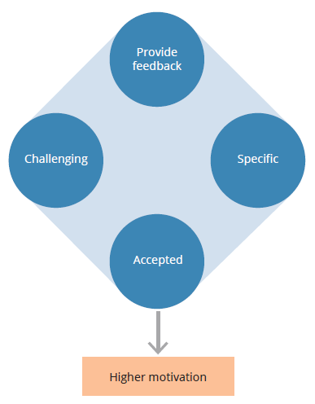
3. Process perspectives on motivation
Process theories explain how employees select behaviours with which to meet their needs and determine if their choices were successful. The basic process theories are equity theory and expectancy theory.
Goal-setting
Goal setting theory proposes that managers can increase motivation and enhance performance by setting specific, challenging goals, then helping people track their progress towards goal achievement by providing timely feedback.
Goal specificity refers to the degree to which goals are concrete and unambiguous.
Goal difficulty acknowledges that difficult goals are more motivating than easy ones.
Goal acceptance means that employees have to ‘buy into’ the goals and be committed to them.
Criteria for motivational goals
Watch the following video
https://www.youtube.com/watch?v=o2yVu5-o274&ab_channel=GreggU

Slide 15
3. Process perspectives on motivation (cont.)
(i) Equity theory
Equity theory focuses on individuals’ perceptions of how fairly they are treated compared with others.
If people perceive their compensation to be equal to what others receive for similar contributions, they will believe that their treatment is fair and equitable.
Inequity occurs when the input-to-outcome ratios are out of balance.

Slide 16
3. Process perspectives on motivation (cont.)
(i) Equity theory (cont.)
The most common methods for reducing inequity are as follows:
Change work effort
A person may choose to increase or decrease their input in the organisation
Change outcomes
A person may change their outcomes, e.g., an underpaid person may request a salary increase or a bigger office
Change perceptions
A person may change perceptions of equity if they are unable to change inputs or outcomes
Leave the job
A person who feels inequitably treated may decide to leave their job rather than suffer the inequity of being under- or overpaid

Slide 17
3. Process perspectives on motivation (cont.)
(ii) Expectancy theory
Expectancy theory suggests that motivation depends on individuals’ expectations about their ability to perform tasks and receive desired rewards.
It is concerned with the thinking process that individuals use to achieve rewards.
It is based on the relationships between the individual’s effort, the individual’s performance and the desirability of outcomes associated with high performance.
Watch the following video
https://www.youtube.com/watch?v=pCFq2ibunvY&ab_channel=GreggU

Slide 18
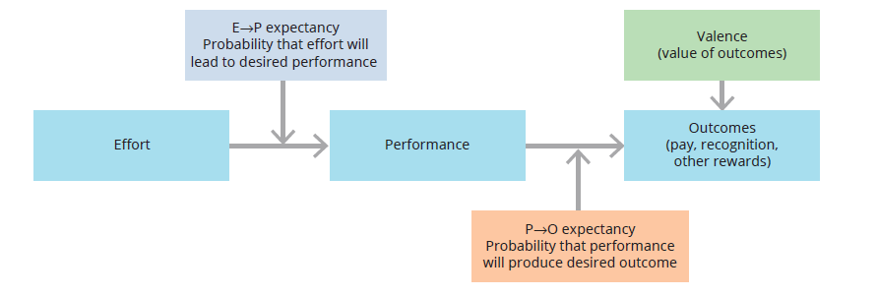
3. Process perspectives on motivation (cont.)
(ii) Expectancy theory – Major elements

Slide 19
4. Reinforcement perspective on motivation
Direct reinforcement
Behaviour modification is the name given to the set of techniques by which reinforcement theory is used to modify human behaviour.
The basic assumption underlying behaviour modification is the law of effect: behaviour that is positively reinforced tends to be repeated and behaviour that is not reinforced tends not to be repeated.
Reinforcement is defined as anything that causes a certain behaviour to be repeated or inhibited.

Slide 20
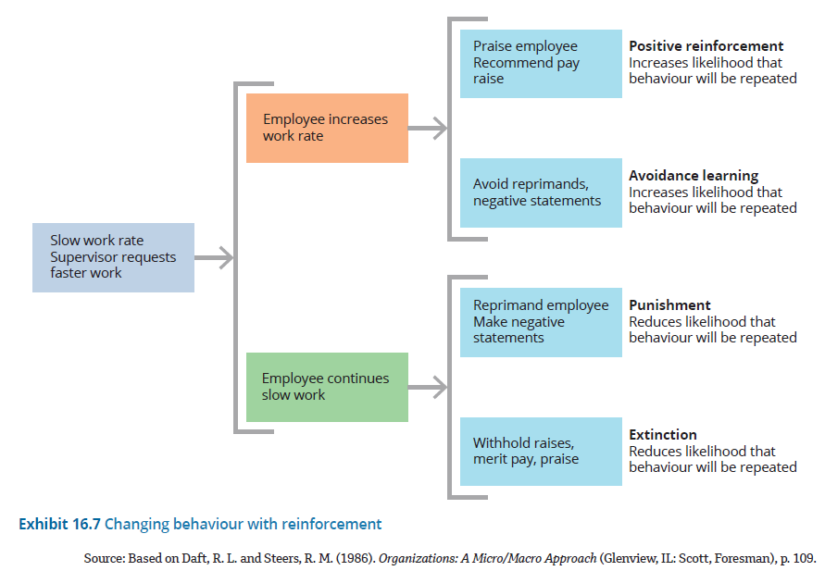
Changing behaviour with reinforcement
4. Reinforcement perspective on motivation (cont.)

Slide 21
Direct reinforcement (cont.)
4. Reinforcement perspective on motivation (cont.)
Reinforcement tools
Positive reinforcement
The administration of a pleasant and rewarding consequence following a desired behaviour, such as praise for an employee who arrives on time or does a little extra work
Avoidance learning
The removal of an unpleasant consequence once a behaviour is improved, thereby encouraging and strengthening the desired behaviour
Punishment
The imposition of unpleasant outcomes on an employee, typically occurring after undesirable behaviour
Extinction
The withholding of a positive reward, such as praise or other positive outcomes

Slide 22
Social learning theory
4. Reinforcement perspective on motivation (cont.)
Social learning theory proposes that an individual’s motivation can result from observations of other people’s behaviour.
Vicarious learning occurs when an individual sees others perform certain behaviours and be rewarded for them.
Managers can enhance an individual’s motivation by ensuring the individual:
  has a chance to observe the desirable behaviours
  accurately perceives the behaviours
  remembers the behaviours
  has the necessary skills to perform the behaviours
  sees that the behaviours are rewarded by the organisation.
  Watch the following video
  https://www.youtube.com/watch?v=5z1Ka5aL09U&ab_channel=GreggU

Slide 23
5. Job design for motivation
A job in an organisation is a unit of work that a single employee is responsible for performing.
Job design is the application of motivational theories to the structure of work for improving productivity and satisfaction.
Job enrichment
Job enrichment means incorporating high-level motivators into the work, including responsibility, recognition and opportunities for growth, learning and achievement.
In an enriched job, employees have control over the resources necessary for performing tasks, make decisions on how to do the work, experience personal growth and set their own work pace.

Slide 24
5. Job design for motivation (cont.)
Job characteristics model
The job characteristics model concerns work redesign, which is defined as altering jobs to increase both the quality of employees’ work experience and their productivity.
It is a model of job design that comprises core job dimensions, critical psychological states and employee growth–need strength.

Slide 25
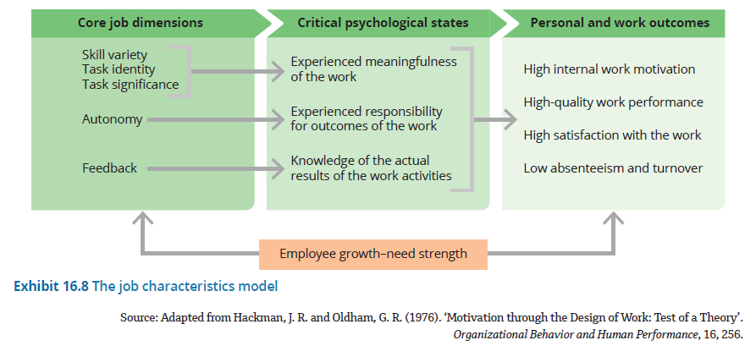
The job characteristics model
5. Job design for motivation (cont.)

Slide 26
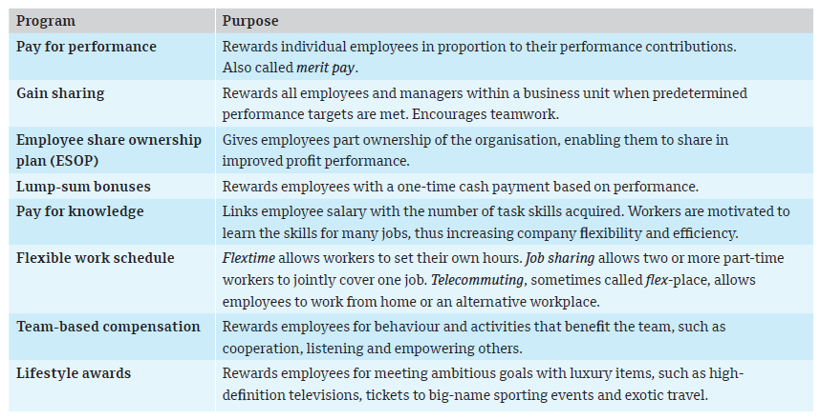
6. Innovative ideas for motivating
Organisations are increasingly using various types of incentive compensation to motivate employees to higher levels of performance.

Slide 27
6. Innovative ideas for motivating (cont.)
Building a thriving workforce
A thriving workforce is one in which people are not only satisfied and productive, but also engaged in creating the future – both their own and the organisation’s.
Two components of thriving individuals are vitality and learning.
Two specific approaches to building a thriving workforce are empowering employees and creating an environment that promotes employee engagement.

Slide 28
6. Innovative ideas for motivating (cont.)
Empowering people to meet higher needs
Empowerment is power sharing, the delegation of power and authority to subordinates in an organisation.
Empowering employees involves giving them four elements that enable them to act more freely to accomplish their jobs:
  Information
  Knowledge
  Power
  Rewards

Slide 29
6. Innovative ideas for motivating (cont.)
Giving meaning to work through engagement
Fully engaged employees care deeply about the organisation and actively seek ways to serve the mission.
Active disengagement means that people are actively undermining their organisation’s success.
Three elements that create employee engagement are:
  a sense of meaningfulness
  a sense of connection
  a sense of growth.

Slide 30
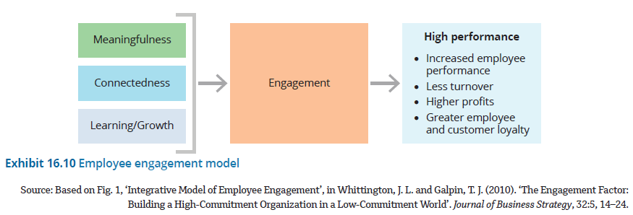
Employee engagement model
6. Innovative ideas for motivating (cont.)

Slide 31
Summary
Motivation is the arousal of enthusiasm and persistence to pursue a certain course of action.
Intrinsic rewards are the internal satisfactions and positive feelings that a person receives in the process of performing a particular action.
Extrinsic rewards are given by another person, such as a manager, and include pay increases, promotions and praise.
Content theories emphasise the needs that motivate people.
The best-known content theory is Maslow’s hierarchy of needs, which proposes that people are motivated by five categories of needs – physiological, safety, belongingness, esteem and self-actualisation – that exist in a hierarchical order.
Process theories – including goal-setting theory, equity theory and expectancy theory – explain how people select behaviours with which to meet their needs and determine whether their choices were successful.
Reinforcement theory is based on the relationship between a given behaviour and its consequences.
The law of effect asserts that positively reinforced behaviour tends to be repeated, and unreinforced or negatively reinforced behaviour tends to be inhibited.
Managers can use positive reinforcement to encourage desired behaviours.
Job design refers to applying motivational theories to the structure of work to improve motivation, productivity and satisfaction.
Employee empowerment and engagement are recent motivational trends that focus less on extrinsic rewards and more on creating a work environment that enables people to achieve intrinsic rewards and meet higher-level needs.
Empowering employees involves giving them information, knowledge, power and rewards.
Managers create an environment that promotes engagement by providing employees with a sense of meaning, a sense of connection, and a sense of competence and growth.

Slide 32
Chapter summary (cont.)
Reinforcement theory is based on the relationship between a given behaviour and its consequences.
Job design refers to applying motivational theories to the structure of work to improve motivation, productivity and satisfaction.
Employee empowerment and engagement are recent motivational trends that focus less on extrinsic rewards and more on creating a work environment that enables people to achieve intrinsic rewards and meet higher-level needs.
The law of effect asserts that positively reinforced behaviour tends to be repeated, and unreinforced or negatively reinforced behaviour tends to be inhibited.
Managers can use positive reinforcement to encourage desired behaviours.
Empowering employees involves giving them information, knowledge, power and rewards.
Managers create an environment that promotes engagement by providing employees with a sense of meaning, a sense of connection, and a sense of competence and growth.

