Slide 1
MN101 Principles of Management
Designing organisation structure
Lecture 5 (I)

Slide 2
Learning objectives
Discuss the fundamental characteristics of organising the vertical structure of organisations and explain concepts such as work specialisation, chain of command, span of management and centralisation versus decentralisation.
Describe the ways that organisations are often departmentalised, with focus given to the different functional and divisional approaches to structure, and explain the matrix approach to structure and its application to both domestic and international organisations.
Describe more contemporary approaches to departmentalisation, including team and virtual network structures, and why they are being adopted by organisations.
Explain why organisations need coordination across departments and hierarchical levels, and describe mechanisms for achieving coordination.
Identify how structure can be used to achieve an organisation’s strategic goals, and define production technology, explaining how it influences organisation struct

Slide 3
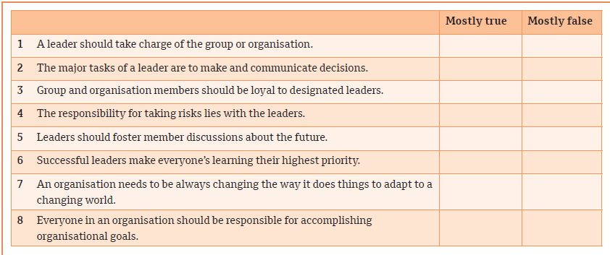
What are your leadership beliefs?
New manager self-assessment

Slide 4
1. Organising the vertical structure
Organisation structure is defined as:
    the set of formal tasks assigned to individuals and departments
    formal reporting relationships, including lines of authority, decision responsibility, number of hierarchical levels and span of managers’ control
    the design of systems to ensure effective coordination of employees across departments.
The set of formal tasks and formal reporting relationships provides a framework for vertical control of the organisation.
The characteristics of vertical structure are portrayed in the organisation chart, which is the visual representation of an organisation’s structure.
Work specialisation
the degree to which organisational tasks are subdivided into individual jobs; it is also called division of labour.
When organisations face new strategic issues, managers often create new positions or departments to deal with them.

Slide 5
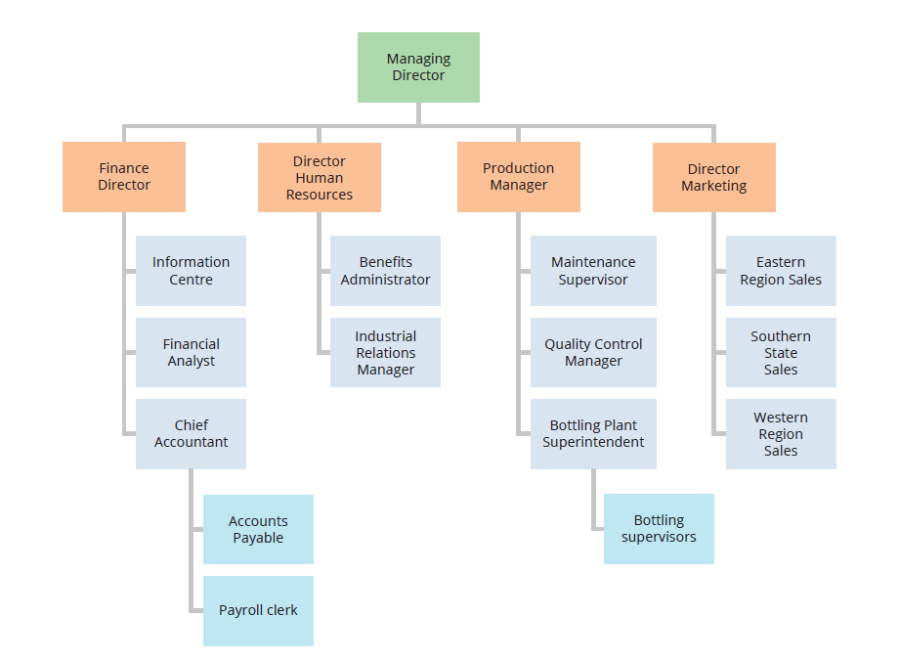
Organisational chart for a soft drink bottling plant
1. Organising the vertical structure (cont.)
Organising the vertical structure
Chain of command
  The chain of command is an unbroken line of authority that links all employees in an organisation and shows who reports to whom.
  It is associated with two underlying principles:
    Unity of command: each employee is held accountable to only one supervisor.
    The scalar principle: a clearly defined line of authority in the organisation that includes all employees.

Slide 6
1. Organising the vertical structure (cont.)
Authority, responsibility, and delegation
Authority is the formal and legitimate right of a manager to make decisions, issue orders and allocate resources to achieve organisationally desired outcomes.
Responsibility is the duty to perform the task or activity an employee or other stakeholder has been assigned.
Accountability is the fact that the people with authority and responsibility are subject to reporting and justifying task outcomes to those above them in the chain of command.
Authority is distinguished by three characteristics:
Authority is vested in organisational positions, not people
Managers have authority because of the positions they hold, and other people in the same positions would have the same authority.
Authority flows down the vertical hierarchy
Positions at the top of the hierarchy are vested with more formal authority than positions at the bottom.
Authority is accepted by subordinates
Although authority flows from the top down, subordinates comply because they believe that managers have a legitimate right to issue orders.

Slide 7
1. Organising the vertical structure (cont.)
Span of management (span of control)
The span of management is the number of employees reporting to a supervisor.
  determines how closely a supervisor can monitor subordinates.
  determines whether the structure is tall or flat.
A tall structure has an overall narrow span and more hierarchical levels.
A flat structure has a wide span, is horizontally dispersed and has fewer hierarchical levels.

Slide 8
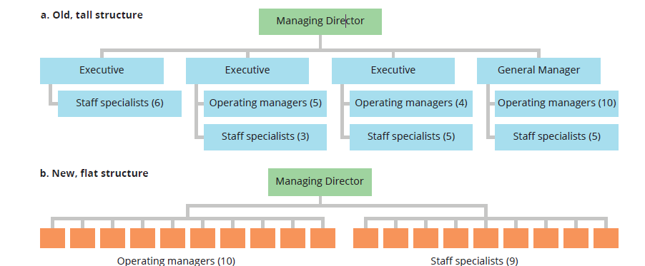
Reorganisation to increase span of management in an international metals company
1. Organising the vertical structure (cont.)

Slide 9
1. Organising the vertical structure (cont.)
Centralisation and decentralisation
Centralisation and decentralisation relate to the hierarchical level at which decisions are made.
    Centralisation is the location of decision authority at a single point, usually near top organisational levels.
    Decentralisation is the dispersed location of decision authority, usually near lower organisational levels.
Organisations may have to experiment to find the correct hierarchical level at which to make decisions.

Slide 10
1. Organising the vertical structure (cont.)
Factors that typically influence centralisation versus decentralisation:
Level of uncertainty: greater change and uncertainty in the environment are usually associated with decentralisation.
Risk: In times of crisis or risk of organisation failure, authority may be centralised at the top.
Firm’s strategy: the amount of centralisation or decentralisation should fit the firm’s strategy.

Slide 11
2. Departmentalisation
A fundamental characteristic of organisation structure is departmentalization.
  the basis for grouping positions into departments, and departments into the total organisation.
Managers make choices about how to use the chain of command to group people together to perform their work.
Five approaches to structural design reflect different uses of the chain of command in departmentalisation:
  Vertical functional
  Divisional
  Horizontal matrix
  Team-based
  Network
The basic difference among structures is the way in which employees are departmentalised and to whom they report.

Slide 12
2. Departmentalisation (cont.)
(i) Vertical functional approach
This approach uses an organisation structure in which positions are grouped into departments based on similar skills, expertise and resource use.
It can be thought of as departmentalisation by organisational resources, because each type of functional activity – accounting, HR, engineering and manufacturing – represents specific resources for performing the organisation’s task.
Information flows up and down the vertical hierarchy and the chain of command converges at the top of the organisation.

Slide 13
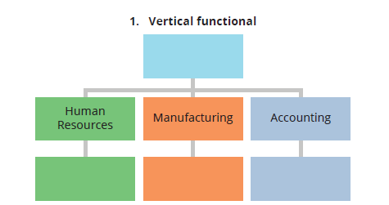
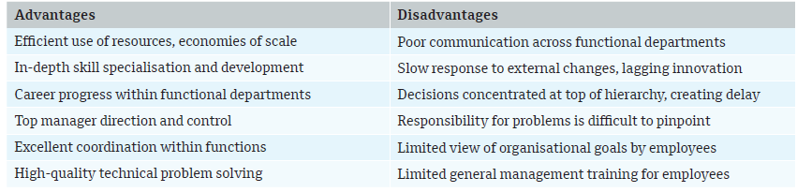
(i) Vertical functional approach (cont.)
2. Departmentalisation (cont.)

Slide 14
2. Departmentalisation (cont.)
(ii) Divisional approach
This approach uses an organisation structure in which departments are grouped based on similar organisational outputs.
Separate divisions can be organised with responsibility for producing individual products, services, product groups, major projects or programs, divisions, businesses or profit centres.
Divisions are created as self-contained units, with separate functional departments for each division.

Slide 15
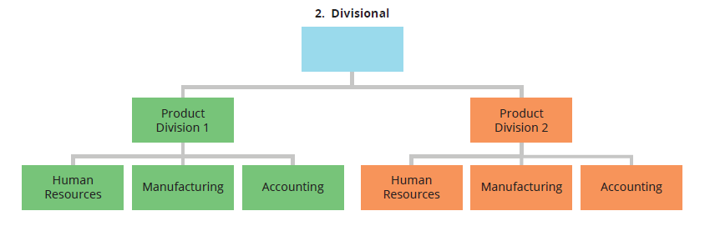
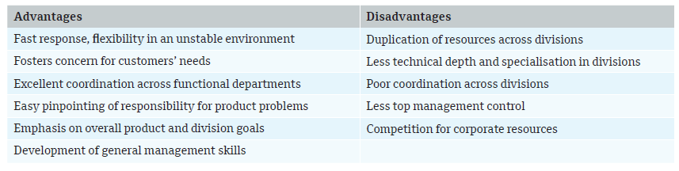
(ii) Divisional approach (cont.)
2. Departmentalisation (cont.)

Slide 16
2. Departmentalisation (cont.)
(iii) Matrix approach
This approach combines aspects of both functional and divisional structures simultaneously, in the same part of the organisation.
One unique feature of the matrix is that it has dual lines of authority.
The vertical structure provides traditional control within functional departments and the horizontal structure provides coordination across departments.
The matrix structure therefore provides a formal chain of command for both functional and divisional relationships.
As a result of this dual structure, some employees report to two supervisors simultaneously.

Slide 17
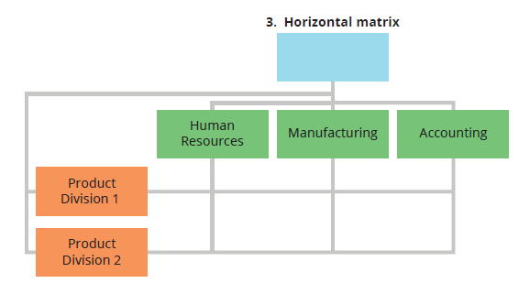
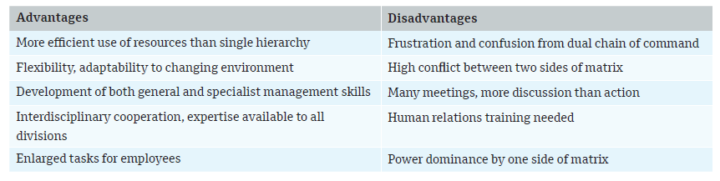
(iii) Matrix approach (cont.)
2. Departmentalisation (cont.)

Slide 18
3. Innovative approaches to departmentalisation
(i) Team-based approach
  This approach gives managers a way to delegate authority and create participative teams that engage the commitment of workers.
  One approach to using teams in organisations is through cross-functional teams, which consist of employees from various functional departments who are responsible for meeting as a team and resolving mutual problems.
  The second approach is to use permanent teams, groups of participants from several functions who are permanently assigned to solve ongoing problems of common interest.

Slide 19
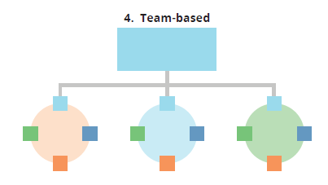
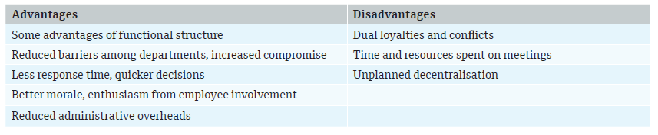
(i) Team-based approach (cont.)
3. Innovative approaches to departmentalization (cont.)

Slide 20
3. Innovative approaches to departmentalization (cont.)
(ii) Virtual network approach
This approach uses an organisational structure in which the organisation subcontracts most of its major functions to separate companies and coordinates their activities from a small headquarters organisation.
The idea behind networks is that a company can concentrate on what it does best and contract out other activities to companies with distinctive competence in those specific areas, which enables a company to do more with less.

Slide 21
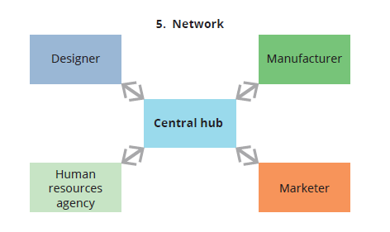
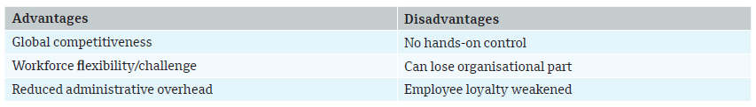
(ii) Virtual network approach (cont.)
3. Innovative approaches to departmentalization (cont.)

Slide 22
4. Organising for horizontal coordination
The need for coordination
Coordination
    a managerial task of adjusting and synchronising the diverse activities among different individuals and departments.
Collaboration
    a joint effort between people from two or more departments to produce outcomes that meet a common goal or shared purpose.
Re-engineering
    the radical redesign of business processes to achieve dramatic improvements in cost, quality, service and speed.

Slide 23
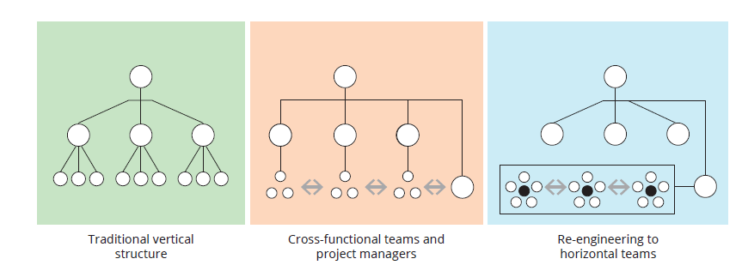
Evolution of organisational structures
4. Organising for horizontal coordination (cont.)

Slide 24
4. Organising for horizontal coordination (cont.)
Task forces, teams and project management
  A task force is a temporary team or committee designed to solve a short-term problem involving several departments.
  In addition to creating task forces, organisations set up cross-functional teams. A cross-functional team furthers horizontal coordination because participants from several departments meet regularly to solve ongoing problems of common interest.
  A project manager is a person who is responsible for coordinating the activities of several departments for the completion of a specific project.

Slide 25
4. Organising for horizontal coordination (cont.)
Relational coordination
Relational coordination refers to frequent horizontal coordination and communication carried out through ongoing relationships of shared goals, shared knowledge and mutual respect.
In an organisation with a high level of relational coordination, people share information freely across departmental boundaries, and people interact on a continuous basis to share knowledge and solve problems.

Slide 26
5. Factors shaping structure
Factors to consider
  the organisation’s strategic goals
  the maturity of the organisation’s adoption of analytical technologies.
An organisation that is designed to fit the company’s situation – considering factors such as organisation size, strategy and production technology – will achieve better performance.

Slide 27
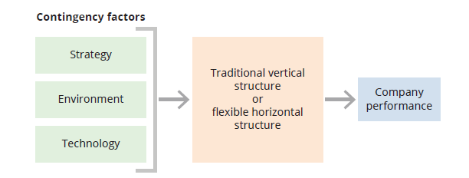
Contingency factors that influence organisation structure
5. Factors shaping structure (cont.)

Slide 28
5. Factors shaping structure (cont.)
Structure follows strategy
Studies demonstrate that business performance is strongly influenced by how well the company’s structure is aligned with its strategic intent and the needs of the environment, so managers strive to pick strategies and structures that are congruent.
  With a differentiation strategy, the organisation attempts to develop innovative products unique to the market.
  With a cost leadership strategy, the organisation strives for internal efficiency.

Slide 29
5. Factors shaping structure (cont.)
Structure fits the workflow technology
Workflow technology includes the knowledge, tools, techniques, and activities used to transform organisational inputs into outputs.
Research shows that manufacturing firms could be categorised according to three basic types of production technology:
  Small-batch and unit production
  Large-batch and mass production
  Continuous process production

Slide 30
Summary
Organising refers to the deployment of organisational resources to achieve strategic goals.
Fundamental characteristics of vertical organisation structure include division of labour, chain of command, span of management, and centralisation and decentralisation.
Departmentalisation is the basis for grouping individual positions into departments, and departments into the total organisation.
The functional, divisional and matrix are traditional approaches that rely on the chain of command to define departmental groupings and reporting relationships along the hierarchy.
The matrix approach uses both functional and divisional chains of command simultaneously in the same part of the organisation.

Slide 31
Summary
Popular contemporary approaches to departmentalisation include team and virtual network structures.
Contingency factors of strategic goals, environment and technology influence the correct structural approach.
A mechanistic, vertical structure is appropriate for a cost leadership strategy, which typically occurs in a stable environment.
An organic, horizontal approach is needed for a differentiation strategy and when the organisation needs flexibility to cope with an uncertain environment.

Slide 32
Managing Change and Innovation
Lecture 5 (2)

Slide 33
Learning objectives
Explain how disruptive innovation and the ambidextrous approach are possible responses to the forces that drive innovation and change in today’s organisations.
Describe the exploration activities that organisations can undertake to ensure their products and technologies remain relevant for the work that they do and the value they create – the value of cooperation, creativity, a bottom-up approach, internal contests, idea incubators, idea champions and new-venture teams for innovation.
Describe the benefits of training and organisational development for influencing employees and organisational culture.
Identify and explain common reasons why people tend to be resistant to change, and the implementation tactics that managers can use to overcome resistance.

Slide 34
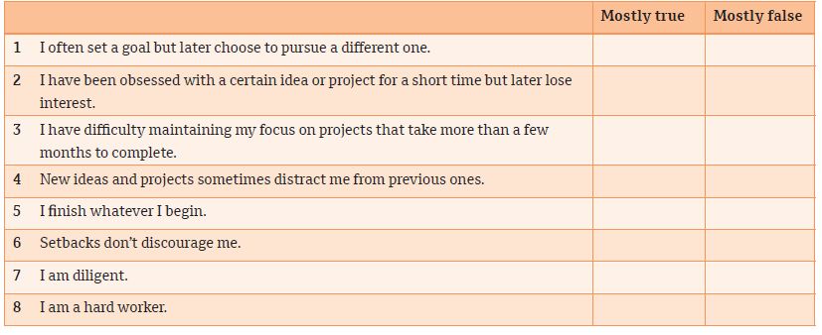
Do you have true determination?
New manager self-assessment

Slide 35
1.Innovation and the changing workplace
Disruptive innovation
  Disruptive innovation refers to innovations in products, services or processes that radically change an industry’s rules of the game for producers and consumers.
  Companies that initiate disruptive innovation are typically successful, while companies affected by a disruptive technology may be put out of business.
  Examples of disruptive innovation are in almost every industry:
    Uber disrupted the taxi industry.
    Smartphones disrupted the compact digital camera business.
    Netflix introduced a new way to rent videos and DVDs.

Slide 36
1.Innovation and the changing workplace (cont.)
The ambidextrous approach
  An ambidextrous approach means incorporating structures and processes that are appropriate for both the creative impulse and for the systematic implementation of innovations.
  Look at factors that are important for exploring new ideas versus those that are most suitable for exploiting current capabilities.
    Exploration means encouraging creativity, risk-taking, experimentation and developing new ideas.
    Exploitation means implementing those ideas with established capabilities and routines.

Slide 37
2. Changing things: new products and technologies
A product change is a change in the organisation’s product or service outputs.
A technology change is a change that pertains to the organisation’s production process.
  Three critical innovation strategies for changing products and technologies are exploration, cooperation, and innovation.

Slide 38
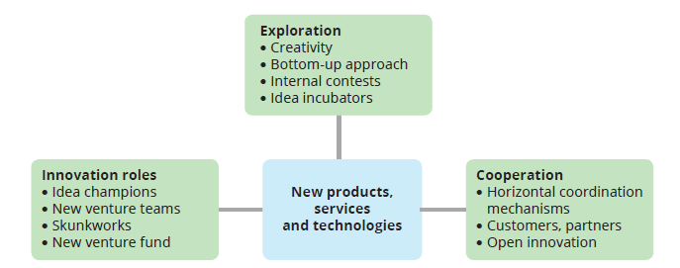
2. Three innovative strategies for new products and technologies

Slide 39
2. Three innovative strategies for new products and technologies (cont.)
Exploration
  The exploration stage is where ideas for new products and technologies are born.
  Managers design the organisation for exploration by establishing conditions that encourage creativity and allow new ideas to arise.
  Creativity, which refers to the generation of new ideas that might meet perceived needs or respond to opportunities for the organisation, is the essential first step in innovation.

Slide 40
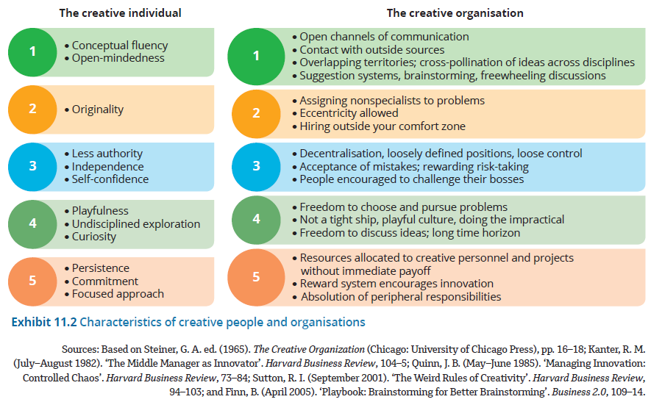
Characteristics of creative people and organisations
2. Three innovative strategies for new products and technologies (cont.)

Slide 41
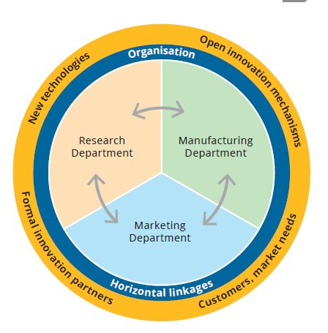
Coordination model for innovation
2. Three innovative strategies for new products and technologies (cont.)
Horizontal collaboration and open innovation
  Horizontal collaboration within the organization,
  Coordination and cooperation with external parties through the process of open innovation.
  The horizontal linkage model is an approach to product change that emphasises shared development of innovations among several departments.
  Open innovation means extending the search for, and commercialisation of, new ideas beyond the boundaries of the organisation.

Slide 42
3. Changing people and culture
People change: a change in the attitudes and behaviours of a few employees in the organisation.
Culture change: a major shift in the norms, values, attitudes and mindset of the entire organisation.
Tools for changing people and culture are training and development programs and organisational development.
Training and development
offer training programs to employees on subjects such as teamwork, diversity, emotional intelligence, quality circles, communication skills or participative management.
training and development for managers, with the idea that the behaviour and attitudes of managers will influence people throughout the organisation and lead to culture change.
Organisation development (OD)
The application of behavioural science techniques to improve an organisation’s health and effectiveness through its ability to cope with environmental changes, improve internal relationships, and increase learning and problem-solving capabilities.
Helps resolve the conflicts that can occur even within a healthy organisation.
OD consultants use a variety of specialised techniques to help meet their goals. Three of the most popular and effective are shown on the following slide.

Slide 43
3. Changing people and culture (cont.)
Team-building activities
A type of OD intervention that enhances the cohesiveness of departments by helping members learn to function as a team
Survey–feedback activities
A type of OD intervention in which questionnaires on organisational climate and other factors are distributed among employees and their results reported back to them by a change agent
Large-group interventions
An approach that brings together participants from all parts of the organisation (and may include key outside stakeholders as well) to discuss problems or opportunities and plan for major change

Slide 44
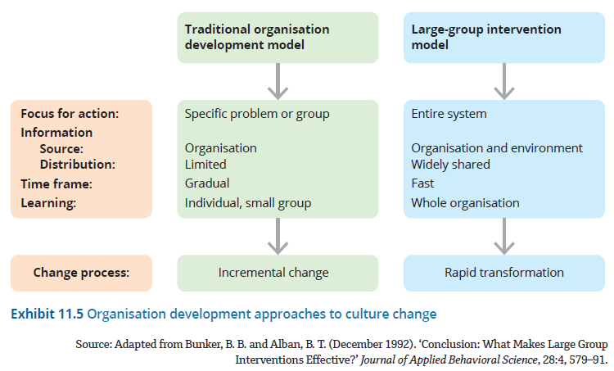
Organisation development approaches to culture change
3. Changing people and culture (cont.)

Slide 45
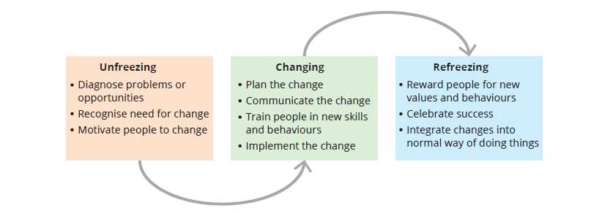
4. Implementing innovation and change
The final step in the innovation and change process is implementation.
Kurt Lewin’s model proposes three distinct stages for achieving behavioural and attitudinal change.
Lewin’s three-stage model for implementing change

Slide 46
Why change is hard
4. Implementing innovation and change
Self-interest
People typically resist a change they believe conflicts with their self-interest.
Lack of understanding and trust
Employees often distrust the intentions behind a change or do not understand the intended purpose of a change.
Uncertainty
Uncertainty is a lack of information about future events.
Different assessments and goals
Employees who will be affected by a change or innovation may assess the situation differently from managers or promoters of a new idea.
It is especially threatening for employees who have a low tolerance for change and who fear anything out of the ordinary.

Slide 47
4. Implementing innovation and change
Creating a sense of urgency
  A crisis or strong need for change lowers resistance.
  To effectively lead change, managers help employees and stakeholders feel the need for change rather than just giving them facts and figures, as people are much more likely to change their behaviour when they both understand the rational reasons for doing so and see a picture of change that influences their feelings.

Slide 48
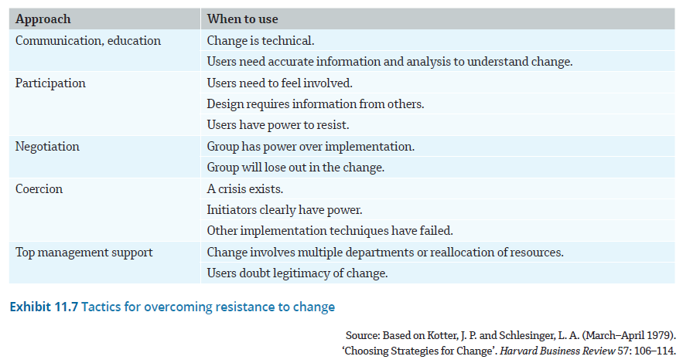
Using implementation tactics
4. Implementing innovation and change
Researchers have studied various methods for dealing with resistance to change. There are five key tactics that have proven successful.

Slide 49
summary
Organisational change often focuses on shifting structures and processes that support employee behaviours.
Change can be slow and methodical, or fast and disruptive, and depends largely on the strategic objectives of the organisation and the environment that the organisation faces.
Every organisation must change and innovate to survive.
Innovation begins when people recognise and generate new ideas that solve problems or address opportunities.
Disruptive innovation refers to innovations in products, services or processes that radically change competition in an industry.
Exploration involves designing the organisation to encourage creativity and the initiation of new ideas.
Successful product and service innovation depends on strategies including exploration, cooperation – both within the organisation and with customers and others outside the organisation – and the creation of innovation roles.
Often, a manager’s toughest job is changing people and culture.
An effective model for implementing change involves three distinct stages: unfreezing, changing and refreezing.

