Slide 1
MN101 Principles of Management
Managerial Decision Making
Lecture 4

Slide 2
Learning objectives
Explain why decision making is an important component of good management, discussing the difference between programmed and non-programmed decisions, including how they relate to the presence of certainty, uncertainty and ambiguity.
Compare the ideal, rational model of decision making to the political model of decision making.
Explain the process by which managers actually make decisions in the real world, identifying and summarising the six steps used in managerial decision making and the four personal decision styles used by managers.
Identify and explain innovative techniques for decision making, including brainstorming, evidence-based management and after-action reviews, and identify the biases that frequently result in poor judgement when managers make decisions.

Slide 3
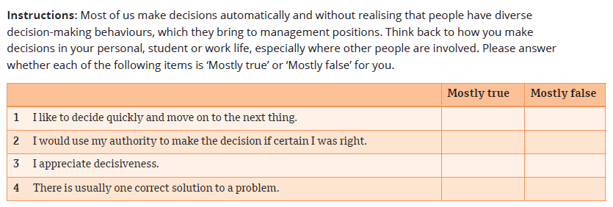
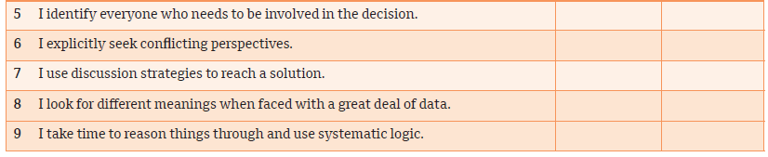
How do you make decisions?

Slide 4
1. Types of decisions and problems
A decision is a choice made from available alternatives.
Decision making is the process of identifying problems and opportunities and then resolving them. It involves effort both before and after the actual choice.
Programmed decisions
A decision made in response to a situation that has occurred often enough to enable decision rules to be developed and applied in the future
Non-programmed decisions
A decision made in response to a situation that is unique, is poorly defined and largely unstructured, and has importance consequences for the organisation
Made in response to recurring organisational problems
Involve strategic planning because uncertainty is great and decisions are complex

Slide 5
1. Types of decisions and problems (cont.)
Programmed and non-programmed decisions
  A primary difference between programmed and non-programmed decisions relates to the degree of uncertainty, risk or ambiguity that managers deal with in making the decision.
  Managers try to obtain information about decision alternatives that will reduce uncertainty.
  Every decision situation can be organised on a scale according to the availability of information and the possibility of failure.

Slide 6
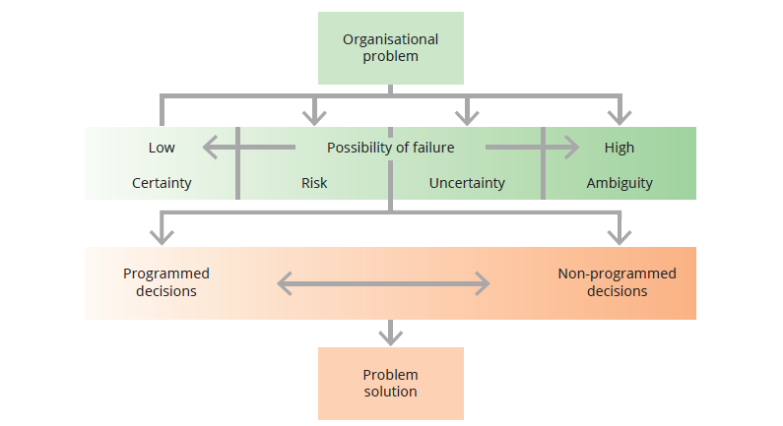
Conditions that affect the possibility of decision failure
1. Types of decisions and problems (cont.)

Slide 7
1. Types of decisions and problems (cont.)
Facing uncertainty and ambiguity
Certainty
All the information the decision maker needs is fully available.
Risk
Clear-cut goals and good information is available, but the future outcomes associated with each alternative are subject to chance
Uncertainty
Managers know which goals they wish to achieve, but information about alternatives and future events is incomplete.
Ambiguity
The goals to be achieved or the problems to be solved are unclear, alternatives are difficult to define and information about outcomes is unavailable.
Managers have information on operating conditions, resource costs or constraints, and each course of action and possible outcome.
Enough information is available to estimate the probability of a successful outcome versus failure.
Managers may have to make assumptions from which to forge the decision even though it may be wrong if the assumptions are incorrect.

Slide 8
2. Decision-making models
The classical model
  A decision-making model based on the assumption that managers should make logical decisions that will be in the organisation’s best economic interests.
  It is normative, which means it defines how a decision maker should make decisions and provides guidelines for reaching an ideal outcome for the organisation.
The administrative model
  A decision-making model that describes how managers actually make decisions in situations characterised by non-programmed decisions, uncertainty and ambiguity.
  It is descriptive, which means it defines how managers actually make decisions rather than how they should.
The political model
  A decision-making model that is useful for making non-programmed decisions when conditions are uncertain, information is limited and there is disagreement among managers.
  Managers often engage in coalition building when making complex organisational decisions. A coalition is an informal alliance among managers who support a specific goal.

Slide 9
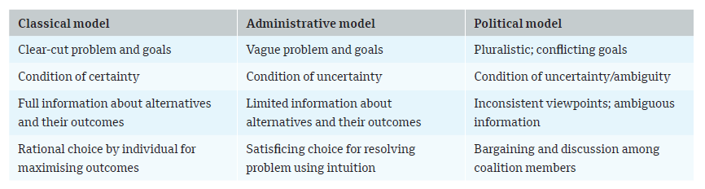
Characteristics of classical, administrative and political decision-making models
2. Decision-making models (cont.)

Slide 10
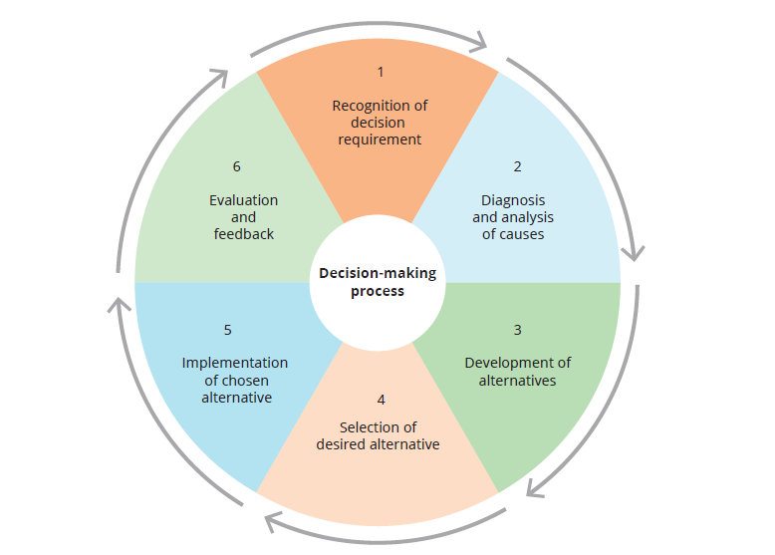
3. Decision-making steps
Whether a decision is programmed or non-programmed – and regardless of managers’ choice of the classical, administrative or political model of decision making – six steps typically are associated with effective decision processes.
Six steps in the managerial decision-making process

Slide 11
3. Decision-making steps (cont.)
1. Recognition of decision requirement
Managers confront a decision requirement in the form of either a problem or an opportunity.
2. Diagnosis and analysis of causes
Diagnosis is the step in the decision-making process in which managers analyse underlying causal factors associated with the decision situation.
3. Development of alternatives
For a programmed decision, feasible alternatives are easy to identify and in fact usually are already available within the organisation’s rules and procedures.
A problem occurs when performance is less than established goals.
Non-programmed decisions, however, require developing new courses of action that will meet the organisation’s needs.
An opportunity exists when managers see a potential accomplishment that exceeds specified current goals and therefore the possibility of enhancing performance beyond current levels.
By looking at a situation from different perspectives, managers can identify the true cause of the problem.
This stage is intended to generate possible alternative solutions that will respond to the needs of the situation and correct the underlying causes.

Slide 12
3. Decision-making steps (cont.)
4. Selection of desired alternatives
The best alternative is one in which the solution best fits the overall goals and values of the organisation and achieves the desired results using the fewest resources.
5. Implementation of chosen alternative
The implementation stage is the step in the decision-making process that involves using managerial, administrative and persuasive abilities to translate the chosen alternative into action.
6. Evaluation and feedback
Choosing among alternatives depends on managers’ willingness to accept risk and uncertainty. Risk propensity is the willingness to undertake risk with the opportunity of gaining an increased pay-off.
The evaluation stage is the step in the decision-making process that involves decision makers gathering information that tells them how well the decision was implemented and whether it was effective in achieving its goals.
Successful implementation may require discussion, trust building, and active engagement with people affected by the decision.
Feedback provides decision makers with information that can precipitate a new decision cycle.

Slide 13
4. Innovative decision making
How managers make bad decisions
  Even the best manager will make mistakes, but managers can increase their percentage of good decisions by understanding some of the factors that cause people to make bad ones.
  Most bad decisions are errors in judgement that originate in the human mind’s limited capacity and in the natural biases managers display during decision-making.
  Awareness of six biases that can cloud judgement can help managers make more enlightened choices.
Six biases that can lead to bad decision making
Being influenced by initial impressions
Justifying past decisions
Seeing what you want to see
Perpetuating the status quo
Being influenced by emotions
Overconfidence

Slide 14
4. Innovative decision making (cont.)
Start with brainstorming:
Use hard evidence:
Engage in rigorous debate:
Brainstorming has been found to be highly effective for quickly generating a wide range of alternative solutions to a problem.
Evidence-based decision making is a process founded on a commitment to examining potential biases, seeking and examining evidence with rigour, and making informed and intelligent decisions based on the best available facts.
Managers practise evidence-based decision making by being careful and thoughtful rather than carelessly relying on assumptions, past experience, rules of thumb or intuition.
Constructive conflict based on divergent points of view can bring a problem into focus, clarify people’s ideas, stimulate creative thinking, limit the role of bias, create a broader understanding of issues and alternatives, and improve decision quality.

Slide 15
4. Innovative decision making (cont.)
Avoid groupthink:
Know when to pull the plug:
Do a pre- and post-mortem:
Groupthink refers to the tendency of people in groups to suppress contrary opinions.
When people slip into groupthink, the desire for harmony outweighs concerns over decision quality.
Research has found that managers and organisations often continue to invest time and money in a solution despite strong evidence that it is not appropriate.
This tendency is referred to as escalating commitment.
When people review the results of their decisions, they learn valuable lessons for how to do things better in the future.
This is sometimes called an after-action review, also called a post-mortem, which is a disciplined procedure in which managers invest time in reviewing the results of decisions on a regular basis and learn from them.

Slide 16
Summary
Decision making is the process of identifying problems and opportunities and then resolving them.
A programmed decision is one made in response to a situation that has occurred often enough to enable managers to develop decision rules that can be applied in the future.
A non-programmed decision is one made in response to a situation that is unique, poorly defined and largely unstructured, and has important consequences for the organisation.
Good decision making is a vital part of good management, but decision making is not easy. Decisions differ according to the amount of certainty, risk, uncertainty or ambiguity in the situation.
The ideal, rational approach to decision making, called the classical model, is based on the assumption that managers should make logical decisions that are economically sensible and in the organisation’s best economic interest.
The political model takes into consideration that many decisions require debate, discussion and coalition building.

Slide 17
Summary
The decision-making process typically involves six steps: recognising the need, diagnosing causes, developing alternatives, selecting an alternative, implementing the alternative and evaluating decision effectiveness.
A manager’s personal decision style influences how they make decisions. Four major decision styles are directive, analytical, conceptual and behavioural.
Most experienced managers use a variety of decision styles depending on the decision situation.
Innovative techniques for decision making include brainstorming, evidence-based decision making, assigning a devil’s advocate and performing after-action reviews.
Most decisions within organisations are made as part of a group, and while managers can’t always see their own biases, they can build in mechanisms and draw upon evidence to prevent bias from influencing major decisions at the organisational level.
Biases to watch out for include being influenced by initial impressions, loss aversion, seeing only what you want to see, perpetuating the status quo, being influenced by emotions and being overconfident.

