Slide 1
MN101 Principles of Management
Lecture 3 (1)
Organizational planning and goal setting

Slide 2
Learning objectives
Define goals and plans, and explain the relationship between them.
Describe the types of goals an organisation should have and how managers use strategy maps to align goals.
Describe the four essential steps in the process of management by objectives (MBO).
Discuss the benefits and limitations of planning.
Describe and explain the importance of contingency planning, scenario building and crisis planning for today’s managers.
Identify innovative planning approaches that managers use in a fast-changing environment.

Slide 3
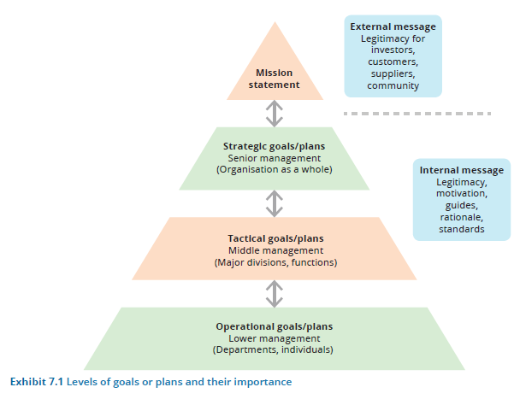
1. Goal setting and planning
Levels of goals or plans and their importance
A goal is a desired future circumstance or condition that the organisation attempts to realise.
    Goals help to define and state an organisation’s purpose.
A plan is a blueprint for goal achievement and specifies the necessary resource allocations, schedules, tasks and other actions.
      Goals specify future ends; plans specify today’s means.

Slide 4
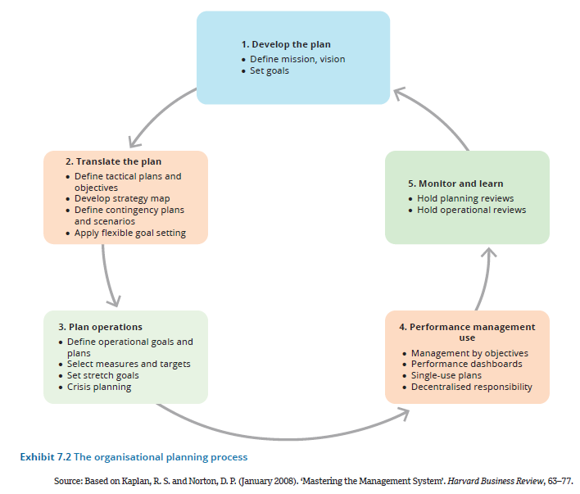
The organisational planning process
1. Goal setting and planning (cont.)

Slide 5
Messages and values contained in goals and plans
1. Goal setting and planning (cont.)
Legitimacy
An organisation’s mission describes what the organisation stands for and its reason for existence.
To external audiences such as investors, customers and suppliers, it helps to establish legitimacy.
The mission gives external stakeholders an opportunity to look on the organisation in a favourable light and thus accept its existence without prior direct contact.
A strong mission also has an impact on employees, enabling them to become committed to the organisation because they can identify with its general purpose and reason for existence.
Source of motivation and commitment
Goals and plans facilitate employees’ identification with the organisation and help to motivate them by reducing uncertainty and clarifying what they should accomplish.
The lack of a clear goal can damage employee motivation and commitment.
A goal provides the ‘why’ of an organisation or subunit’s existence, while a plan tells the ‘how’.
Resource allocation
Goals help managers decide where they need to prioritise the allocation of resources, such as employees, money and equipment.
An essential component of strategic planning includes consideration of the capabilities and capacities of the people, technologies and assets held by an organisation.
When a shortfall in capacity and/or capability exists, it can create a roadblock that must be navigated by the organisation in order to achieve its goal.
Common remedies to resource shortfalls include hiring and/or upskilling staff, upgrading equipment and leasing new office space.
Guides to action
Goals and plans provide a sense of direction.
They focus attention on specific targets and direct employees’ efforts towards important outcomes, as well as giving shorter-term plans a sense of place within a broader set of long-term goals.
Rationale for decisions
Through goal setting and planning, managers learn what the organisation is trying to accomplish.
They can make decisions to ensure that internal policies, roles, performance, structure, products and expenditures will be made in accordance with desired outcomes.
Decisions throughout the organisation will be in alignment with the plan.
Standard of performance
Because goals define desired outcomes for the organisation, they also serve as performance criteria. They provide a standard of assessment.
The overall planning process prevents managers from thinking merely in terms of day-to-day activities.
When organisations drift away from goals and plans, they typically get into trouble.

Slide 6
2. Goal setting in organisations
Organisational mission
The mission is the high-level summary statement of the reason for existence of the organisation and its formal desired purpose.
  The formal mission statement is a broadly stated definition of basic business scope and operations that distinguishes the organisation from others of a similar type.
  Its content focuses on the market and customers, and identifies desired fields of endeavour.

Slide 7
2. Goal setting in organisations (cont.)
Strategic goals: Broad statements of where the organisation wants to be in the future (2+ years),
  strategic goals pertain to the organisation as a whole, rather than to specific divisions or departments.
Strategic plans are the action steps by which an organisation intends to attain its strategic goals. They form the blueprint that defines the organisational activities and resource allocations for meeting these targets.

Slide 8
2. Goal setting in organisations (cont.)
Tactical goals define the outcomes that major divisions and departments must achieve over the next year or so in order for the organisation to reach its overall goals. They also help top managers implement their overall strategic plan.
Tactical plans are designed to help execute major strategic plans and to accomplish a specific part of the organisation’s strategy.
Organisational goals are specific, measurable results expected from departments, work groups and individuals within the organisation.
Organisational plans are plans developed at the organisation’s lower levels that specify action steps towards achieving operational goals and that support tactical planning activities.
  Such plans are the department manager’s tool for daily and weekly operations.

Slide 9
Managing goal conflict
2. Goal setting in organisations (cont.)
Build a coalition
Coalitional management involves building an alliance of people who support a manager’s goals and influencing other people to accept and work towards those goals.
When certain goals are highly important to a manager’s team, the manager works to build a coalition to support them.
Building a coalition requires talking to many people both inside and outside the organisation.
Modify goals by time or location
Since organisations pursue many goals simultaneously, managers must often deal with two conflicting goals that are both highly important to the organisation.
In such a case, they must find ways to balance the goals rather than fighting for one over the other.
An effective approach is to overcome conflicts by adapting the goals across space or time.
Address conflicts with debate and dialogue
Good managers don’t let conflicts over goals simmer and detract from goal accomplishment or hurt the organisation.
Break down barriers and promote cross-silo cooperation
An effective way to resolve conflict is to break down boundaries and get people to cooperate and collaborate across departments, divisions and levels.
Managers can arrange face-to-face meetings or task forces across departments, develop conflict resolution procedures, and walk the talk of values of collaboration.
Understanding and cooperation across the enterprise are essential so that the entire organisation will be aligned towards accomplishing desired goals.
Manager departures
Sometimes, conflicts are lessened or resolved when managers who support a particular goal leave the organisation.
They may feel so strongly about an issue, perhaps based on personal conviction, that they are not able to compromise.

Slide 10
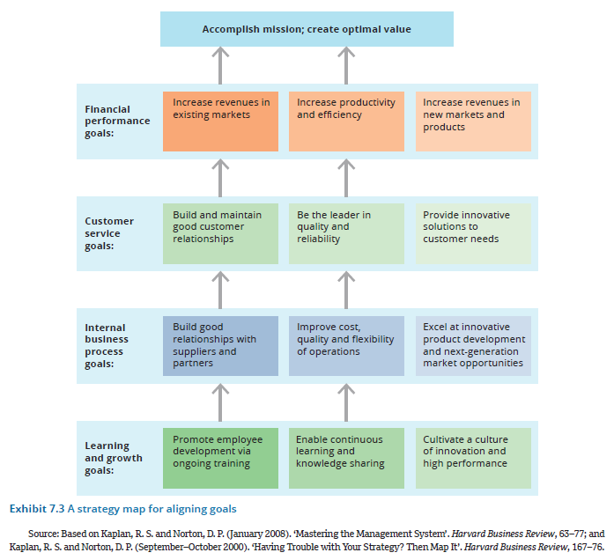
Aligning goals with strategy maps
2. Goal setting in organisations (cont.)
Strategy map
A popular technique for achieving goal alignment is the strategy map.
It offers a visual representation of the key drivers of an organisation’s long-term success, showing the cause-and-effect relationships among goals and plans.
  It includes learning and growth, internal processes, customer service and financial performance – and how the various goals and plans in each area link to others.

Slide 11
3. Performance management
Criteria for effective goals
Specific and measurable
When possible, operational goals should be expressed in quantitative terms, such as increasing profits by 2 per cent.
Not all goals can be expressed in numerical terms, but vague goals have little motivating power for employees.
By necessity, goals are qualitative as well as quantitative. The important point is that the goals be precisely defined and allow for measurable progress.
Defined time period
This specifies the date on which goal attainment will be measured.
When a goal involves a two- to three-year time horizon, setting specific dates for achieving parts of it is a good way to keep people on track towards the goal.
Key result areas
Goals cannot be set for every aspect of employee behaviour or organisational performance; if they were, their sheer number would render them meaningless.
Instead, managers establish goals based on the idea of measurement and clarity.
Key performance indicators (KPIs) assess what is important to the organisation and how well the organisation is progressing towards attaining its strategic goal, so that managers can establish lower-level goals that drive performance towards the overall strategic objective.
Challenging but realistic
When goals are unrealistic, they set employees up for failure and lead to a decrease in employee morale.
However, if goals are too easy, employees may not feel motivated.
Linked to rewards
Goals should also be linked to rewards that employees feel are important – that is, a monetary bonus is not always the most effective reward.
The ultimate impact of goals depends on the extent to which salary increases, promotions and awards are based on goal achievement.
Employees pay attention to what gets noticed and rewarded in the organisation.

Slide 12
3. Performance management (cont.)
Management by objective (MOB):
Management by objectives describes a method of management whereby managers and employees define goals for every department, project and person, and use them to monitor subsequent performance.
Step 1: Set goals
Setting goals involves employees at all levels and looks beyond day-to-day activities to answer the question, ‘What are we trying to accomplish?’
Managers should heed the criteria of effective goals and make sure to assign responsibility for goal accomplishment.
Mutual agreement between employee and supervisor creates the strongest commitment to achieving goals. In the case of teams, all team members may participate in setting goals.
Step 2: Develop action plans
An action plan defines the course of action needed to achieve the stated goals.
Action plans are made for both individuals and departments.
Step 3: Review progress
A periodic progress review is important to ensure that action plans are working.
KPIs often provide the data for the review. These reviews can occur informally between managers and employees where the organisation may wish to conduct three-, six- or nine-month reviews during the year.
This periodic check-up allows managers and employees to see whether they are on target or whether corrective action is necessary.
Managers and employees should not be locked into predefined behaviour and must be willing to take whatever steps are necessary to produce meaningful results.
The point of MBO is to achieve goals. The action plan can be changed whenever goals are not being met.
Step 4: Appraise overall performance
The final step in MBO is to carefully evaluate whether annual goals have been achieved for both individuals and departments.
Success or failure to achieve goals can become part of the performance appraisal system and the designation of salary increases and other rewards.
The appraisal of departmental and overall corporate performance shapes goals for the next year.
The MBO cycle repeats itself annually.

Slide 13
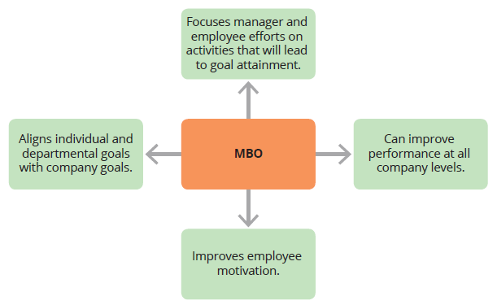
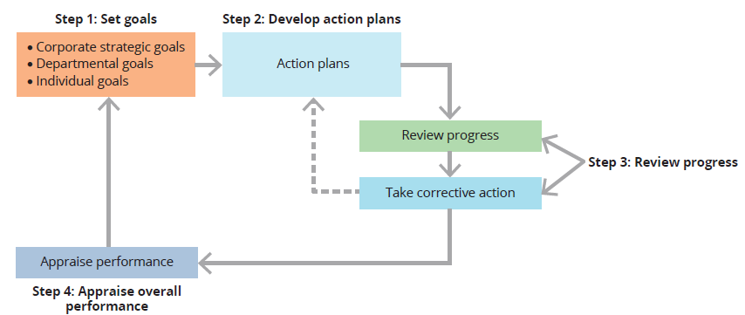
Models of the MOB process
3. Performance management (cont.)
MOB benefits

Slide 14
Management by objectives (cont.)
3. Performance management (cont.)
Management by means (MBM)
  MBM focuses attention on the methods and processes used to achieve goals.
    MBM is based on the idea that when managers pursue their activities in the right way, positive outcomes will result.
    MBM focuses people on considering the means rather than just on reaching the goals.
Single-use and standing plans
Single-use plans are developed to achieve a set of goals that are not likely to be repeated in the future.
Standing plans are ongoing plans that provide guidance for tasks or situations that occur repeatedly within the organisation.

Slide 15
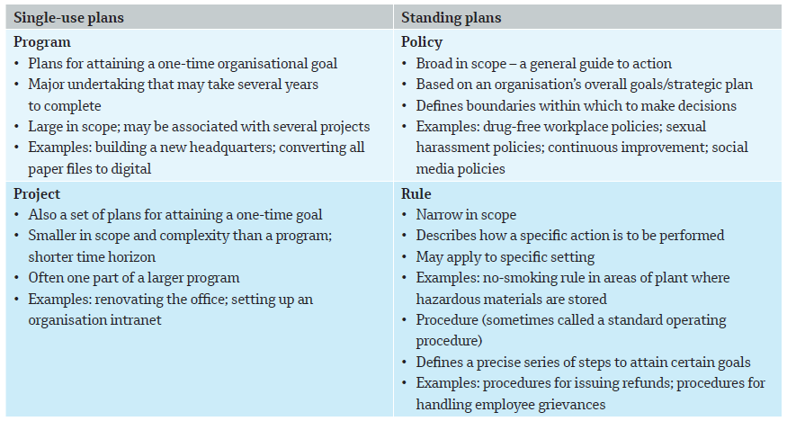
Major types of single-use and standing plans
3. Performance management (cont.)

Slide 16
4. Benefits and limitations of planning
Benefits of planning
Source of motivation and commitment
Planning can reduce uncertainty for employees and clarify what they should accomplish.
The lack of a clear goal hampers motivation because people don’t understand what they’re working towards.
Guide to resource allocation
Planning helps managers decide where they need to allocate resources, such as employees, money and equipment.
Guide to action
Planning focuses attention on specific targets and directs employee efforts towards important outcomes.
Planning helps managers and other employees know what actions they need to take to achieve the goal.
Standard of performance
Because planning and goal setting define desired outcomes, they also establish performance criteria so managers can measure whether things are on- or off-track.
Goals and plans provide a standard of assessment.

Slide 17
4. Benefits and limitations of planning (cont.)
Limitations of planning
Too much pressure
If too much pressure is put on managers and employees to meet overly ambitious goals, they may resort to dysfunctional or unethical behaviour in order to meet their targets.
False sense of certainty
Having a plan can give managers a false sense that they know what the future will be like.
However, all planning is based on assumptions, and managers can’t know what the future holds for their industry or for their competitors, suppliers and customers.
Rigidity in a turbulent environment
A related problem is that planning can lock the organisation into specific goals, plans and timeframes that may no longer be appropriate.
Managing under conditions of change and uncertainty requires a degree of flexibility.
Barrier to intuition and creativity
Success often comes from creativity and intuition, which can be hampered by too much routine planning.
Managers who believe in ‘staying the course’ will often stick with a faulty plan even when conditions change dramatically.

Slide 18
5. Planning for a turbulent environment
Contingency planning
Contingency plans define organisation responses to be taken in the case of emergencies, setbacks, uncontrollable factors or unexpected conditions such as recession, surging supply costs, technological developments or safety accidents.
  To minimise the impact of these potential factors, a planning team can forecast the worst-case scenarios and develop responses to minimise or negate their impact.
  Scenario planning
Scenario building involves looking at current trends and discontinuities and visualising future possibilities.
  Managers think about what could be (rather than just focusing on what has been/historical trends) and how they will respond.
  Crisis planning
Crisis planning enables firms to cope with unexpected events that are so sudden and devastating that they have the potential to destroy the organisation if managers aren’t prepared with a quick and appropriate response.
  Stages include pre-event, response and recovery, post-event, and ‘near miss’ (a potential threat is identified but the crisis is avoided through serendipity or prevention.

Slide 19
Crisis planning
5. Planning for a turbulent environment (cont.)
Pre-event stage
This covers all activities managers undertake to try to prevent crises from occurring and to detect warning signs of potential crises, as well as detailed planning to handle a crisis when it occurs.
The manager must designate a crisis management team and spokesperson, create a detailed crisis management plan, and set up an effective communications system that is regularly practised and assessed to ensure the organisation is capable of implementing its plans effectively.
A major part of the plan is a communications plan that designates a crisis command centre and sets up a complete communications and messaging system.
Response and recovery stage
This focuses on the organisation’s response to an actual crisis and involves the activation of pre-planned response routines, coordinating actions with stakeholders and focusing on the ability of the organisation to recover from the disturbance.
After ensuring people’s physical safety in a crisis, the next focus should be on responding to the emotional needs of employees, customers and the public.
Post-event stage
Once an organisation is considered to have recovered and be back to its normal operational capabilities (or as close as is possible after the disturbance), this stage aims to review the identified causes of the disturbance and evaluate the organisation’s ability to respond to and recover from the disturbance.
Near miss
This refers to a scenario where an organisation identifies a potential threat but, through prevention or serendipity, avoids a disturbance escalating to become a crisis for the organisation.
It also ensures that any critical learnings are embedded back into the organisation’s pre-event routines, such as developing new monitoring processes or adjusting crisis response protocols to improve prevention and response capabilities.

Slide 20
6. Innovative approaches to planning
Decentralised planning
  Decentralised planning involves planning experts working directly with front-line managers in major divisions or departments to develop their own strategic goals and plans.
  This helps to develop dynamic plans that meet fast-changing needs.
Set stretch goals for excellence
  Stretch goals are reasonable yet highly ambitious goals that are so clear, compelling and imaginative that they fire up employees and engender excellence.
Use performance dashboards
  Useful to keep track of key performance metrics, such as sales in relation to targets, number of products on back order, or percentage of customer service calls resolved within specified time periods.
Apply flexible goal setting
    Good managers know that plans must be based on a solid set of principles. They must also change as conditions change and managers learn more about the environment and their organisation’s products or services.
    Flexible planning can help an organisation weather difficult times.

Slide 21
Summary
A goal is a desired future circumstance or condition that the organisation wants to realise.
A plan is a blueprint specifying the resource allocations, schedules and other actions necessary for attaining goals.
Planning is the act of determining goals and defining the means of achieving them.
Goals and plans need to be in alignment so that they are consistent and mutually supportive.
Planning and goal setting can provide a source of motivation and guide effective decision making for performance and resource allocation.
They can also provide a sense of false security and reduce the organisation’s ability to navigate turbulent times if they are not flexible or responsive.
Managers use innovative planning approaches to cope with today’s turbulent environment.
Contingency planning and scenario building allow managers to look at trends and discontinuities in the environment in order to identify solutions before problems arise for the organisation.
Approaches to planning change with the times.
In many companies today, planning leverages the use of performance dashboards and continually revises challenging stretch goals to remain adaptive.

Slide 22
Lecture 3(2)
Strategy formulation and implementation

Slide 23
Learning objectives
Define the components of strategic management and discuss the three levels of strategy.
Explain the strategic management process and summarise how SWOT analysis can be used to evaluate an organisation’s strengths, weaknesses, opportunities and threats.
Explain three approaches to corporate-level strategy: portfolio; the Boston Consulting Group (BCG) matrix; and diversification.
Describe Michael Porter’s competitive forces and strategies.
Discuss emerging models of strategy and their benefits for business growth.
Compare and contrast the globalisation, multidomestic and transnational strategies for global business.
Explain the organisational dimensions used for implementing strategy.

Slide 24
1. Thinking strategically
What is strategic management?
  Strategic management refers to the set of decisions and actions used to formulate and implement strategies that will provide a competitively superior fit between an organisation and its environment so as to achieve organisational goals.
Purpose of strategy
  The first step in strategic management is to define an explicit strategy, which is the plan of action that describes resource allocation and activities for dealing with the environment, achieving a competitive advantage and attaining the organisation’s goals.

Slide 25
1. Thinking strategically (cont.)
Areas of strategic thinking
Define and identify target customers
    Defining customers and identifying which of their needs are to be served by the organisation.
    A target market can be defined geographically and/or demographically.
Exploit core competence
    A core competence is something the organisation does especially well in comparison to its competitors.
    It represents a competitive advantage because the company posses expertise that competitors do not have.
Build synergy
    When organisational parts interact to produce a joint effect that is greater than the sum of the parts acting alone, synergy occurs.
    The firm may attain a special advantage with respect to cost, market power, technology or management skill.
Deliver value
    Delivering value to the customer is at the heart of strategy.
    Value can be defined as the combination of benefits received and costs paid.
    Managers help their companies create value by devising strategies that exploit core competencies and attain synergy.

Slide 26
1. Thinking strategically (cont.)
Levels of strategy
Corporate-level strategy
What business are we in?
This pertains to the organisation as a whole and the combination of business units and product lines that make up the corporate entity.
Strategic actions at this level usually relate to: the acquisition of new businesses; additions or divestments of business units, plants or product lines; and joint ventures with other corporations in new areas.
Business-level strategy
How do we compete?
This pertains to each business unit or product line.
Strategic decisions at this level concern the amount of advertising, direction and extent of R&D, product changes, new-product development, equipment and facilities, and expansion or contraction of product and service lines.
Functional-level strategy
How do we support the business-level strategy?
This pertains to the major functional departments within the business unit.
Functional strategies involve all of the major functions, including finance, research and development, marketing and manufacturing.

Slide 27
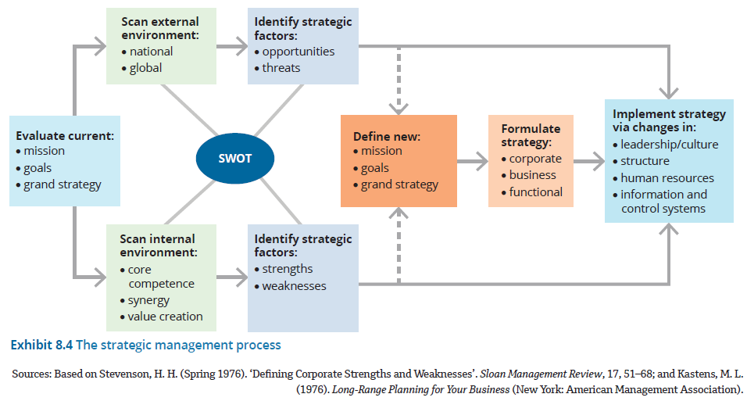
2. The strategic management process

Slide 28
2. The strategic management process (cont.)
Strategy formulation versus implementation
  Strategy formulation
    Includes the planning and decision making that lead to the establishment of the firm’s goals and the development of a specific strategic plan
      May include assessing the external environment and internal problems, and integrating the results into goals and strategy
      Contrasts with strategy implementation
    Strategy implementation
    Strategy implementation refers to the use of managerial and organisational tools to direct resources towards accomplishing strategic results.
      Managers may use persuasion, new equipment, changes in organisational structure or a reward system to ensure that employees and resources are used to make formulated strategy a reality.

Slide 29
2. The strategic management process (cont.)
SWOT (situation) analysis
  SWOT (situation) analysis describes a search for strengths, weaknesses, opportunities and threats that affect organisational performance.
      Managers obtain external information about opportunities and threats from a variety of sources, including customers, government reports, professional journals, suppliers, bankers, friends in other organisations, consultants or association meetings.
SWOT components
Strengths
(S)
Positive internal characteristics that the organisation can exploit to achieve its strategic performance goals
Weaknesses
(W)
Internal characteristics that may inhibit or restrict the organisation’s performance
Opportunities
(O)
Characteristics of the external environment that have the potential to help the organisation achieve or exceed its strategic goals
Threats
(T)
Characteristics of the external environment that may prevent the organisation from achieving its strategic goals

Slide 30
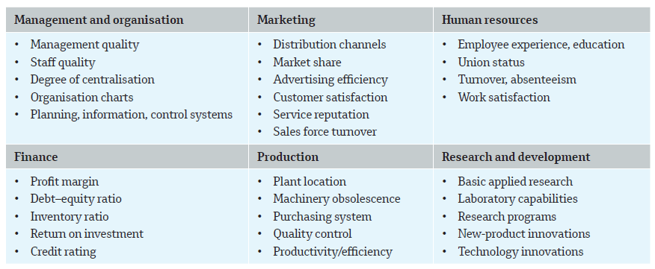
SWOT (situation) analysis
Checklist for analysing organisational strengths and weaknesses
2. The strategic management process (cont.)

Slide 31
3. Formulating corporate-level strategy
Portfolio strategy
This is a type of corporate-level strategy that relates to the organisation’s mix of strategic business units and product lines that fit together in such a way as to provide the organisation with synergy and competitive advantage.
    Individual investors often wish to diversify in an investment portfolio with some high-risk stocks, some low-risk stocks, some growth stocks and perhaps a few income bonds.
  Strategic business units (SBUs)
  Corporations like to have a balanced mix of business divisions, called strategic business units (SBUs).
  An SBU has a unique business mission, product line, competitors and markets relative to other SBUs in the corporation.

Slide 32
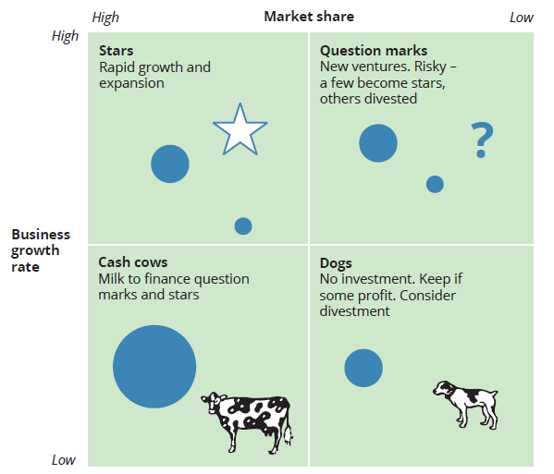
3. Formulating corporate-level strategy (cont.)
Evaluating business units
The BCG matrix
  The BCG matrix evaluates strategic business units with respect to the dimensions of business growth rate and market share:
    Business growth rate relates to how rapidly the entire industry is increasing.
    Market share defines whether a business unit has a larger or smaller share than competitors.
    The combinations of high and low market share and high and low business growth provide four categories for a corporate portfolio.

Slide 33
The BCG matrix (cont.)
3. Formulating corporate-level strategy (cont.)
Stars
The star has a large market share in a rapidly growing industry.
The star is important because it has additional growth potential, and profits should be ploughed into this business as investment for future growth and profits.
The star is visible and attractive, and it will generate profits and a positive cash flow even as the industry matures and market growth slows.
Cash cows
The cash cow exists in a mature, slow-growth industry but is a dominant business in the industry with a large market share.
Because heavy investments in advertising and plant expansion are no longer required, the company earns a positive cash flow. It can milk the cash cow to invest in other, riskier businesses.
Question marks
The question mark exists in a new, rapidly growing industry with only a small market share.
The question mark business is risky. It could become a star, or it could fail. The company can invest the cash earned from cash cows in question marks with the goal of nurturing them into future stars.
Dogs
The dog is a poor performer.
It has only a small share of a slow-growth market.
The dog provides little profit for the company and may be targeted for divestment or liquidation if turnaround is not possible.

Slide 34
3. Formulating corporate-level strategy (cont.)
Diversification strategy
The purpose of diversification is to expand the organisation’s business operations to produce new kinds of valuable products and services.
  Related diversification - when the new business is related to the company’s existing business activities.
  Unrelated diversification - when the company’s lines of business aren’t logically associated with one another; therefore, it can be difficult to make the strategy successful.
  Vertical integration
  Vertical integration means that the company expands into businesses that either produce the supplies needed to make products or that distribute and sell those products to customers.

Slide 35
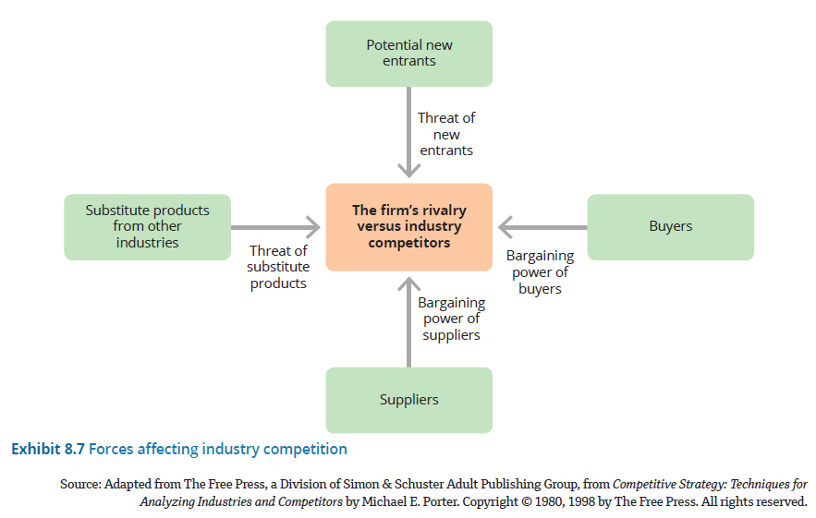
Forces affecting industry competition
4. Formulating business-level strategy

Slide 36
4. Formulating business-level strategy (cont.)
Porter’s five competitive forces
Threat of new entrants
Capital requirements and economies of scale are examples of two potential barriers to entry that can keep out new competitors.
In general, internet technology has made it much easier for new companies to enter an industry by curtailing the need for such organisational elements as an established sales force, physical assets such as buildings and machinery, or access to existing supplier and sales channels.
Informed customers become empowered customers.
The internet provides easy access to a wide range of information about products, services and competitors, thereby greatly increasing the bargaining power of consumers.
Bargaining power of suppliers
The concentration of suppliers and the availability of substitute suppliers are significant factors in determining supplier power.
The impact of the internet in this area can be both positive and negative.
That is, procurement over the web tends to give a company greater power over suppliers, but the web also gives suppliers access to a greater number of customers, as well as the ability to reach end users.
Overall, the internet tends to raise the bargaining power of suppliers.
Threat of substitute products
The power of alternatives and substitutes for an organisation’s product may be affected by cost changes or trends such as increased health consciousness that will deflect buyer loyalty.
The internet created a greater threat of new substitutes by enabling new approaches to meeting customer needs.
Rivalry among competitors
This is influenced by the preceding four forces as well as by cost and product differentiation.
With the levelling force of the internet and information technology, it has become more difficult for many organisations to find ways to distinguish themselves from their competitors, which intensifies rivalry.
Bargaining power of buyers

Slide 37
4. Formulating business-level strategy (cont.)
Porter’s competitive strategies
Differentiation
This involves an attempt to distinguish the firm’s products or services from others in the industry.
The organisation may use advertising, distinctive product features, exceptional service or new technology to achieve a product perceived as unique.
Differentiation can reduce rivalry with competitors and fight off the threat of substitute products because customers are loyal to the company’s brand.
It requires a number of costly activities, such as product research and design and extensive advertising.
Companies need a robust marketing department and creative employees who are given the time and resources to seek innovation.
Cost leadership
The organisation aggressively seeks efficient facilities, pursues cost reductions and uses tight cost controls to produce products more efficiently than competitors.
The aim is to keep internal costs low so that they can provide products and services to customers at lower prices and still make a profit.
The company can undercut competitors’ prices and still offer comparable quality and earn a reasonable profit.
This strategy is concerned with maintaining stability rather than pursuing innovation and growth.
Focus
The organisation concentrates on a specific regional market or buyer group.
The organisation will use either a differentiation or cost leadership approach, but only for a narrow target market.

Slide 38
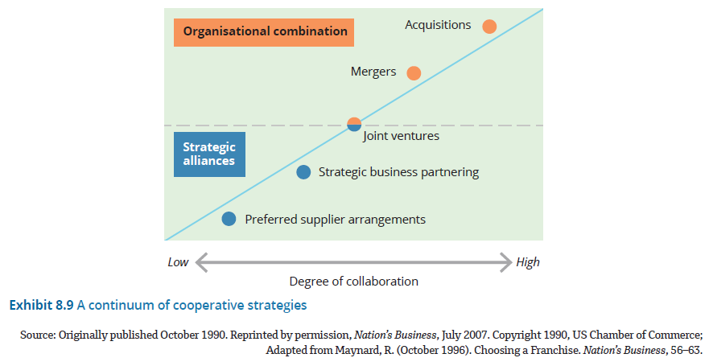
5. Contemporary trends in strategy
(2) Strategic partnerships
(1) Innovation from within (dynamic capabilities)
managers focus on leveraging and developing more from the firm’s existing assets, capabilities and core competencies in a way that will provide a sustained competitive advantage.

Slide 39
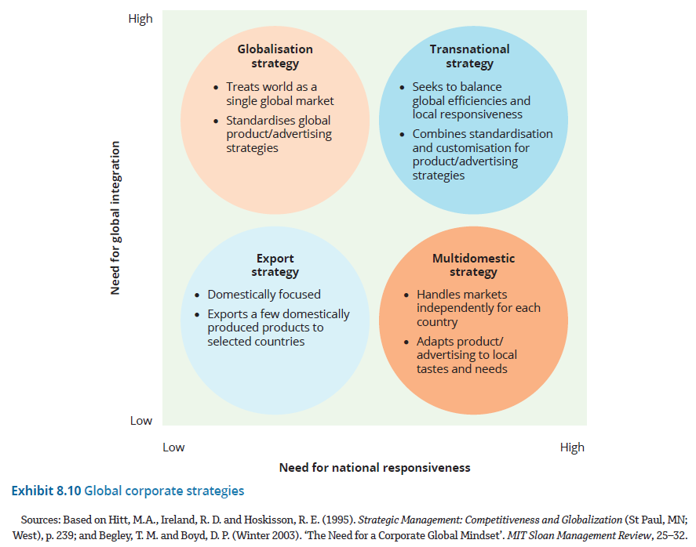
6. Global strategy

Slide 40
6. Global strategy (cont.)
Globalisation strategy
When an organisation chooses a strategy of globalisation, product design and advertising strategies are standardised throughout the world.
This approach is based on the assumption that a single global market exists for many consumer and industrial products.
The theory is that people everywhere want to buy the same products and live the same way.
Globalisation enables marketing departments alone to save millions of dollars.
Multidomestic strategy
When an organisation chooses a multidomestic strategy, it means that competition in each country is handled independently of industry competition in other countries.
Thus, a multinational company is present in many countries, but it encourages marketing, advertising and product design to be modified and adapted to the specific needs of each country.
While working from a standard product design, many companies that want to work internationally have found it necessary to adjust their offerings because of the varying requirements and preferences of consumers around the world.
Transnational strategy
A transnational strategy, sometimes referred to as a ‘glocalisation strategy’ (‘Think global, act local’), seeks to achieve both global integration and national responsiveness.
A true transnational strategy is difficult to achieve, because one goal requires close global coordination while the other goal requires local flexibility.
Many industries are finding that, although increased competition means they must achieve global efficiency, growing pressure to meet local needs demands national responsiveness.
Although most multinational companies want to achieve some degree of global integration to hold costs down, even global products may require some customisation to meet government regulations in various countries or some tailoring to fit consumer preferences.
In addition, increased competition means many organisations need to take advantage of global opportunities as well as respond to the heterogeneity of the international marketplace.

Slide 41
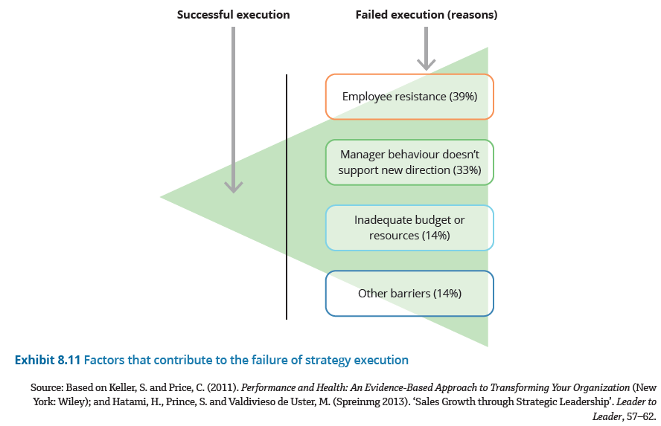
7. Strategy implementation
Turning plans into action by prioritising goals, informing and resourcing those affected by the new strategy, and supporting managers throughout the organisation to turn strategic plans into actions.
Factors that contribute to the failure of strategy execution

Slide 42
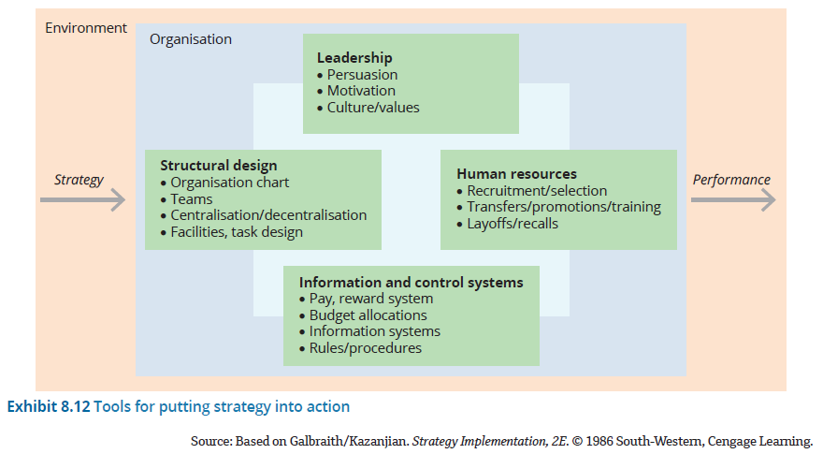
Tools for putting strategy into action
7. Strategy implementation (cont.)

Slide 43
Primary tools that managers use to implement strategy effectively
7. Strategy implementation (cont.)
Visible leadership
The primary key to successful strategy execution is good leadership.
Leadership is the ability to influence people to adopt the new behaviours needed for putting the strategy into action.
Leaders actively use persuasion, motivation techniques and cultural values that support the new strategy.
They might make speeches to employees, build coalitions of people who support the new strategic direction, and persuade middle managers to go along with their vision for the company.
Most importantly, they lead by example.
Clear roles and accountability
People need to understand how their individual actions can contribute to achieving the strategy. Managers spell out not just what needs doing but the specifics of getting it done.
A technique known as ‘if–then’ planning, in which people have clarity about exactly when, where and how they will accomplish a goal, has been found to significantly improve implementation.
Managers also make sure strategy doesn’t conflict with structural design, particularly in relation to managers’ roles, authority and accountability.
Candid communication
Managers openly and avidly promote their strategic ideas, but they also listen to others and encourage disagreement and debate.
They create a culture based on openness and honesty, which encourages teamwork and collaboration across hierarchical and departmental boundaries.
Candid communication supports the cascading of the strategy from the top to the bottom of the organisation.
When everyone feels free to be open and speak frankly, more people get involved in discussing the strategy so that ideas get debated, adapted and acted upon more quickly.
Effective strategy implementation also requires candid communication with shareholders, customers and other stakeholders.
Appropriate human resource practices
The organisation’s human resources are its employees.
The human resource function recruits, selects, trains, compensates, transfers, promotes and lays off employees to achieve strategic goals.
Managers make sure human resource practices are aligned with the strategy.
Leaders of organisations often publicly thank employees for the successes experienced by the organisation in recognition that the best strategy on paper is worthless if the people of the organisation can’t or won’t implement them effectively.

Slide 44
Summary
To think strategically means to take the long-term view and see the big picture.
Strategic management refers to the set of decisions and actions used to formulate and implement strategies that will provide a competitively superior fit between the organisation and its environment, so as to achieve organisational goals.
The three levels of strategy are corporate-level strategy, business-level strategy and functional-level strategy.
Strategy formulation is the stage of strategic management that includes the planning and decision making – using tools such as the SWOT analysis – to establish the organisation’s goals and a specific strategic plan.
Strategy execution is the stage of strategic management that involves the use of managerial and organisational tools to direct resources towards achieving strategic outcomes.
Frameworks for corporate-level strategy include portfolio strategy, the BCG matrix and diversification strategy.
These frameworks help managers make sense of their current competitive position and identify a desired pathway for the future of the organisation.
Portfolio strategy seeks to establish a mix of strategic business units (SBUs) and product lines that fit together in a logical way to provide synergy and competitive advantage.
The strategy of moving into new lines of business is called diversification.
The BCG matrix is a concept developed by the Boston Consulting Group that evaluates SBUs with respect to two dimensions – business growth rate and market share – and classifies them as cash cows, stars, question marks or dogs.

Slide 45
Summary
Business-level strategy focuses on how the organisation will compete with others, and uses Porter’s competitive forces and strategies to evaluate the opportunities and threats facing the organisation.
Managers analyse the competitive environment and adopt one of three types of strategy: differentiation, cost leadership or focus.
Managers can focus on developing and using the dynamic capabilities of their organisation to innovate and generate new sources of value and competitive advantage employing strategic partnerships, mergers, acquisitions and alliances to tap into desired skills, resources and information that they otherwise wouldn’t have on their own.
When formulating a strategy as the focus for global operations, managers face a dilemma between the need for global standardisation and the need for local responsiveness.
Most large organisations use a combination of strategies (including globalisation, multidomestic and transnational strategies) to maximise gains from economies of scale, local preferences and talent.
Managers use visible leadership, clear roles and accountability, candid communication and appropriate human resource practices to execute strategy effectively.

