Slide 1
MN101 Principles of Management
Lecture 2 (1)
Managing in a global environment

Slide 2
Learning objectives
Explain globalisation and why a global mindset is so important for managers working internationally.
Discuss how the international landscape is changing, including the growing influence of China and India.
Describe the characteristics of multinational corporations and how they might employ the bottom-of-the-pyramid concept.
Define outsourcing and the market entry strategies of exporting and partnerships
Explain how to interpret the economic environment and its impact on organisations.
Define legal–political risk and give an example of how it can affect an international corporation.
Explain differences in social values and communication challenges across country cultures.
Identify today’s international trade alliances and discuss how they affect international companies.

Slide 3
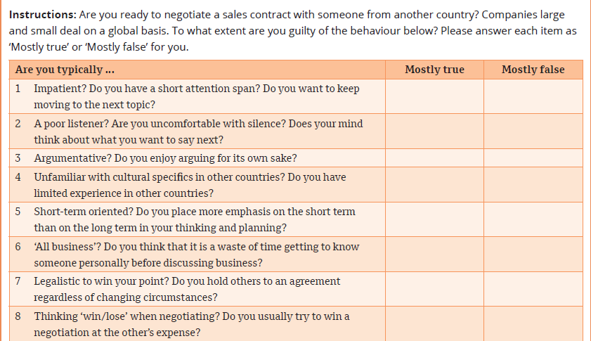
Are you ready to work internationally?
Notes:
NOTES:
Western managers often display cross-cultural ignorance during business negotiations compared to counterparts in other countries. Western habits can be disturbing, such as emphasising areas of disagreement rather than agreement, spending little time understanding the views and interests of the other side, and adopting an adversarial attitude. Westerners often like to leave a negotiation thinking they won, which can be embarrassing to the other side. For this quiz, a low score shows better international presence. If you answered ‘Mostly true’ to three or fewer questions, then consider yourself ready to assist with an international negotiation. If you scored six or more ‘Mostly true’ responses, it is time to learn more about other national cultures before participating in international business deals. Try to develop a greater focus on other people’s needs and an appreciation of different viewpoints. Be open to compromise and develop empathy for people who are different to you.

Slide 4
1. Globalisation: A borderless world
Globalisation refers to the extent to which trade and investments, information, social and cultural ideas, and political cooperation flow between countries.
One result is that countries, businesses and people become increasingly interdependent.
The process of globalisation
Domestic stage
International stage
Exports increase and the organisation usually adopts a multidomestic approach, probably using an international division to deal with the marketing of products in several countries individually.
Market potential is limited to the home country, with all production and marketing facilities located at home.
Managers may be aware of the global environment and may want to consider foreign involvement.
Multinational stage
The organisation has marketing and production facilities located in many countries, with more than one-third of its sales outside the home country.
Organisations typically have a single home country, although they may opt for a bi-national approach, whereby two parent organisations in separate countries maintain ownership and control.
Global stage (or stateless stage)
Any single home country is transcended.
These organisations operate in true global fashion, making sales and acquiring resources in whatever country offers the best opportunities and lowest cost.
At this stage, ownership, control and top management tend to be dispersed among several nationalities.

Slide 5
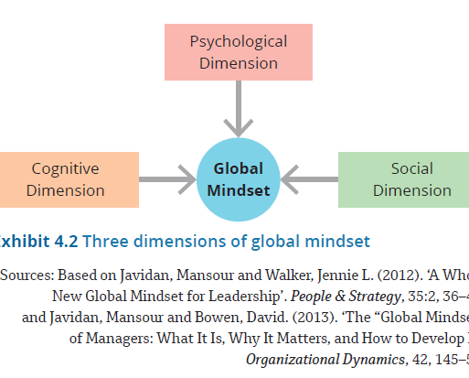
1. Globalisation: A borderless world (cont.)
Three dimensions of a global mindset
Developing a global mindset
  Succeeding on a global level requires a global mindset.
  A global mindset is the ability to appreciate and influence individuals, groups, organisations and systems that represent different social, cultural, political, institutional, intellectual and psychological characteristics.
  People who have had exposure to different cultures and speak different languages develop a global mindset more easily.

Slide 6
2.The changing international landscape
China rising
  It is likely that China will soon dominate global big business.
  Many entrepreneurs who once viewed China as a place with endless opportunities are now exiting the country or drastically scaling back their plans there.
  New regulations, increased taxes and other costs, and tighter government control are making life hard for foreign companies in all industries.
  India, the service giant
    Whereas China is strong in manufacturing, India is a rising power in software design, services and precision engineering.
    Numerous companies see India as a major source of technological and scientific brainpower, and the country’s large English-speaking population makes it a natural choice for Western companies wanting to outsource services.

Slide 7
3. Multinational corporations
  A multinational corporation (MNC) is an organisation that receives more than 25 per cent of its total sales revenues from operations outside the parent company’s home country.
  It is also known as a global company or transnational company.
Characteristics of MNCs
  An MNC is managed as an integrated worldwide business system in which foreign affiliates act in close alliance and cooperation with one another.
  An MNC is ultimately controlled by a single management authority that makes key strategic decisions relating to the parent and all affiliates.
  MNC top managers are presumed to exercise a global perspective.

Slide 8
3. Multinational corporations (cont.)
Distinctions of MNCs
In a few cases, the MNC management philosophy may differ:
Ethnocentric companies (placing emphasis on their home countries)
Polycentric companies (oriented towards the markets of individual foreign host countries)
Geocentric companies (world oriented and favour no specific country)

Slide 9
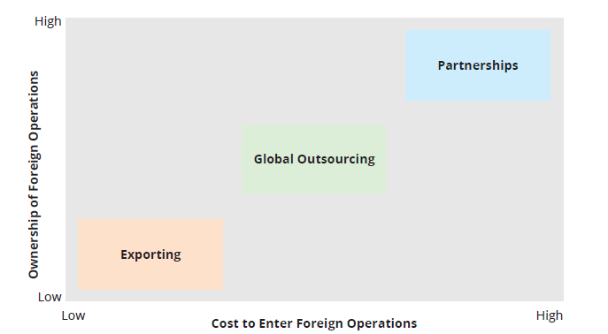
4. Getting started internationally
Three strategies for entering the international arena

Slide 10
4. Getting started internationally (cont.)
Exporting
An entry strategy, in which the organisation maintains its production facilities within its home country and transfers its products for sale in foreign markets
Global outsourcing (offshoring)
Engaging in the international division of labour so as to obtain the cheapest sources of labour and supplies regardless of country
Partnerships
Represents a higher level of involvement of international trade
Often the least risky way to get into the global game, e.g. joint venture, where one company shares costs and risks with another firm, typically in the host country, to develop new products, build a manufacturing facility, or set up a sales and distribution network

Slide 11
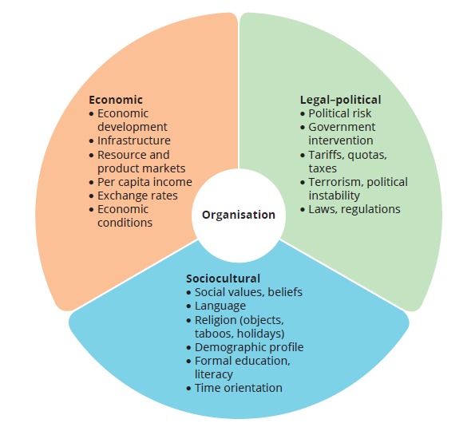
4. The international business environment
Key factors in the international environment
International management
  International management is the management of business operations conducted in more than one country.
  The fundamental tasks of business management do not change in any substantive way when a firm is operating internationally.
    However, managers will experience greater difficulties and risks when performing these management functions on an international scale.

Slide 12
5. The economic environment
Economic development
  Economic development differs widely among the countries and regions of the world.
  Countries can be categorised as either developed or developing/emerging/less-developed countries (LDCs).
    Developing countries have low per-capita incomes (income generated by the nation’s production of goods and services divided by total population).
  Infrastructure
    Infrastructure describes a country’s physical facilities that support economic activities, including:
      transportation facilities, e.g. airports, highways and railways
      energy-producing facilities, e.g. utilities and power stations
      communication facilities, e.g. telephone lines and radio stations.
    Firms operating in LDCs must contend with lower-quality infrastructure.

Slide 13
5. The economic environment (cont.)
Resource and product markets
  When operating in another country, managers must evaluate the market demand for their products.
    If market demand is high, managers may choose to export products to that country.
  To develop plants, however, resource markets for providing raw materials and labour must also be available.
Exchange rates, inflation, interest rates and economic growth
  The exchange rate is the rate at which one country’s currency is exchanged for that of another country.
    Changes in the exchange rate can have major implications for the profitability of international operations that make daily exchanges into other currencies.
  Inflation rates measure the annual rate of growth of prices in the economy, and interest rates measure the cost of borrowing money.

Slide 14
6.The legal–political environment
Dealing with foreign governments
  Differing laws and regulations make doing business a challenge for international organisations.
  Host governments have myriad laws concerning libel statutes, consumer protection, information and labelling, employment and safety, and wages.
  International managers must learn these rules and regulations, which likely differ from those in the company’s home country, and abide by them.
Political risk and instability
  Political risk is the risk of loss of assets, earning power or managerial control due to political changes or instability in a host country.
  This includes conflicts, e.g. social unrest, ethnic violence, social activism, and politically motivated terrorism and cyberthreats, as well as government actions, e.g. changes in laws, taxes and other regulations.
  Political instability includes riots, revolutions, civil disorder and frequent changes in government.

Slide 15
7. The sociocultural environment (cont.)
Social values
Ethnocentrism refers to a natural tendency of people to regard their own culture as superior and to downgrade or dismiss other cultural values.
    Many managers fail to realise that the values and behaviour that typically govern how business is done in their own country don’t always translate to the rest of the world.
    This is particularly the case with Western managers.
GLOBE Project value dimensions
Assertiveness
A high value on assertiveness means a society encourages toughness, assertiveness and competitiveness.
Low assertiveness means that people value tenderness and concern for others over being competitive.
Future orientation
This dimension refers to the extent to which a society encourages and rewards planning for the future over short-term results and quick gratification.
Gender differentiation
This dimension refers to the extent to which a society maximises gender role differences.
In countries with low gender differentiation, such as Denmark, women typically have a higher status and play a stronger role in decision making.
Countries with high gender differentiation accord men higher social, political and economic status.
Performance orientation
A society with a high-performance orientation places high emphasis on performance and rewards people for performance improvements and excellence.
A low performance orientation means people pay less attention to performance and more attention to loyalty, belonging and background.
Humane orientation
This refers to the degree to which a society encourages and rewards people for being fair, altruistic, generous and caring.
A country high on humane orientation places great value on helping others and being kind.
A country low on this orientation expects people to take care of themselves. Self-enhancement and gratification are of high importance.

Slide 16
7. The sociocultural environment (cont.)
High-context and low-context cultures
High-context culture
People are sensitive to circumstances surrounding social exchanges.
They use communication primarily to build personal social relationships.
Low-context culture
People use communication primarily to exchange facts and information.
German, Swiss and Scandinavian cultures are low-context cultures.
Chinese, Korean and Japanese cultures are high-context cultures.
Meaning is derived from context – setting, status and non-verbal behaviour – more than from explicit words; relationships and trust are more important than business; and the welfare and harmony of the group are highly prized.
Meaning is derived primarily from words; business transactions are more important than building relationships and trust; and individual welfare and achievement are more important than the group.
Implicit communication
Implicit communication means that people send and receive unspoken cues, such as tone of voice or body language, in addition to the explicit spoken words when talking with others.

Slide 17
7. The sociocultural environment (cont.)
Cultural intelligence (CQ)
  Understanding the subtle contextual differences among cultures requires cultural intelligence.
  Cultural intelligence (CQ) refers to a person’s ability to use reasoning and observation skills to interpret unfamiliar gestures and situations, and devise appropriate behavioural responses.
CQ includes three components that work together
  The cognitive component involves a person’s observational and learning skills, and the ability to pick up on clues to understanding.
  The emotional aspect concerns one’s self-confidence and self-motivation.
  The physical component refers to a person’s ability to shift their speech patterns, expressions and body language to be in tune with people from a different culture.

Slide 18
8. International trade alliances
The General Agreement on Tariffs and Trade (GATT)
  The GATT was signed by 23 nations in 1947.
  It started as a set of rules to ensure non-discrimination, clear procedures, the negotiation of disputes and the participation of less-developed countries in international trade.
      The WTO represents the maturation of GATT into a permanent global institution.
World Trade Organization (WTO)
  The WTO can monitor international trade and has legal authority to arbitrate disputes on some 400 trade issues.
  There are 164 member countries.
  As a permanent membership organisation, the WTO is bringing greater trade liberalisation in goods, information, technological developments and services; stronger enforcement of rules and regulations; and greater power to resolve disputes among trading partners.

Slide 19
8. International trade alliances (cont.)
European Union (EU)
The European Union (EU) began in 1957 and counts 27 nations among its members.
    Its goal is to create a powerful single-market system for Europe’s millions of consumers, allowing people, goods and services to move freely.
    The increased competition and economies of scale within Europe enable companies to grow large and efficient, and to become more competitive in world markets.
    The EU also introduced a single currency (the euro).

Slide 20
8. International trade alliances (cont.)
United States–Mexico–Canada Agreement
  A 2020 revision of the 1994 North American Free Trade Agreement (NAFTA) that merged the United States, Canada and Mexico into a single market
    Intended to spur growth and investment, increase exports and expand jobs in all three nations by breaking down tariffs and trade restrictions
    Led to a quadrupling of trade among the three countries and connected supply chains across North America

Slide 21
8. International trade alliances (cont.)
Association of South-East Asian Nations (ASEAN)
  Began in 1967 to jointly accelerate economic growth, social progress and cultural development; promote regional peace and stability; and actively collaborate on technical, scientific and economic matters
    Initially only involved five countries
    Australia recognised in 1977 as one of the ASEAN group’s important trading partners and was given ‘dialogue partner’ status

Slide 22
8. International trade alliances (cont.)
ASEAN–Australia and New Zealand Free Trade Area (AANZFTA)
  For Australia and New Zealand, the AANZFTA (ASEAN–Australia and New Zealand Free Trade Area) agreement came into existence in 2010.
  It aims to make trading more efficient across these regions and countries by reducing tariffs, freeing up investment rules, and making the transfer of goods, services, people and money more efficient and effective across the signatory countries.

Slide 23
Summary
Globalisation refers to the extent to which trade and investments, information, ideals and political cooperation flow between countries.
Succeeding on a global level requires managers at all levels to have a global mindset, which is the ability to appreciate and influence individuals, groups, organisations and systems that represent different social, cultural, political, institutional, intellectual and psychological characteristics.
China’s economic power is growing rapidly, and it will likely soon become the dominant country in global big businesses.
China is strong in manufacturing, whereas India is a major provider of services.
A multinational corporation (MNC) is an organisation that receives more than 25 per cent of its total sales revenues from operations outside the parent company’s home country and has a number of distinctive managerial characteristics.
The bottom-of-the-pyramid (BOP) concept proposes that multinational corporations can alleviate poverty and other social ills, as well as make significant profits, by selling to the world’s poor.
Two major alternatives for engaging in the international arena are to seek cheaper resources via global outsourcing, exporting, and partnerships and joint ventures, and to develop markets outside the home country.

Slide 24
Summary
The international economic environment includes factors such as economic development and resource and product markets.
Countries vary widely in terms of economic development and are classified as either developed countries or less-developed countries (LDCs).
Complicated legal and political forces can create huge risks for international managers and organisations.
Political risk refers to a company’s risk of loss of assets, earning power or managerial control due to politically based events or actions by host governments or other groups.
Managers must understand and follow the differing laws and regulations in the various countries where they do business.
The potential for communication breakdowns increases when managers are interacting with people from different countries and varied cultural backgrounds.
Managers working internationally should guard against ethnocentrism, which is the natural tendency among people to regard their own culture as superior to others.
Managers who develop cultural intelligence are more successful in international assignments.
Regional trade alliances and international trade agreements are reshaping global business. They aim to benefit economies by prompting efficient trading, but these aren’t always successful.
The World Trade Organization (WTO) is a permanent membership organisation that monitors trade and has the authority to arbitrate disputes among 164 member countries.

Slide 25
MN101 Principles of Management
Lecture 2 (2)
Ethics and Social Responsibility

Slide 26
Learning objectives
Describe how ethical behaviour relates to behaviour governed by law or free choice.
Explain the utilitarian, individualism, moral rights, justice and practical approaches for making ethical decisions.
Identify various factors that shape a manager’s ethical decision making, including levels of moral development.
Describe how the new purpose of a corporation as defined by the Business Roundtable differs from the previously defined corporate purpose.
Discuss how managers can create a more ethical organisation using techniques from both a values approach and a structure approach.
Explain particular issues of ethical behaviour and sustainable development applicable in Australia.

Slide 27
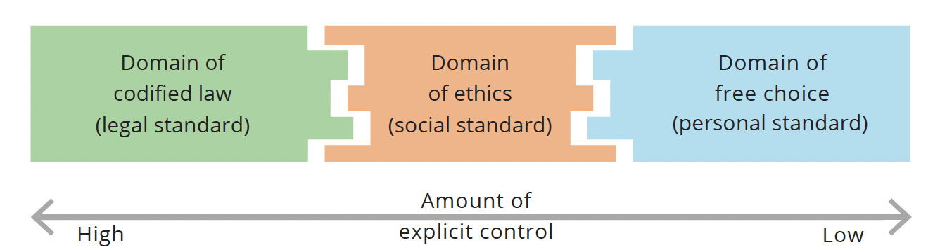
1. Introduction: what is managerial ethics?
Ethics is the code of moral principles and values that governs the behaviours of a person or group with respect to what is right or wrong.
  Ethics sets standards as to what is good or bad in conduct and decision making.
  An ethical issue is present in a situation when the actions of a person or organisation may harm or benefit others.
  Ethics can be more clearly understood when compared with behaviours governed by law and by free choice.
  Three domains of human action

Slide 28
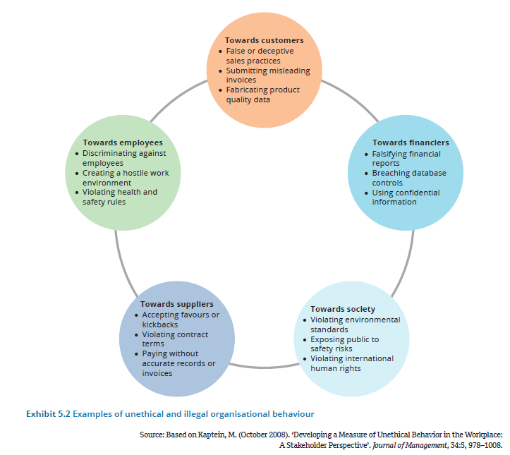
Introduction: the business case for ethics and social responsibility

Slide 29
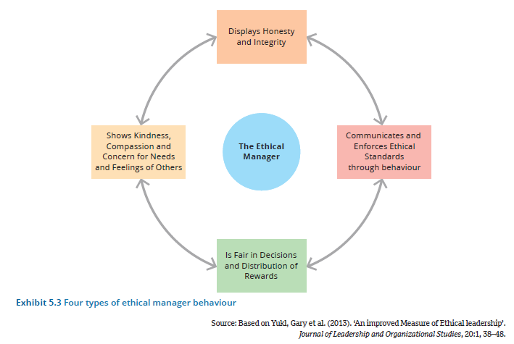
Introduction: the business case for ethics and social responsibility (cont.)

Slide 30
Introduction: Ethical dilemmas – what would you do?
Ethical dilemma
  An ethical dilemma describes a situation that arises when all alternative choices or behaviours have been deemed undesirable because of potentially negative ethical consequences, making it difficult to distinguish right from wrong.
  The individual who must make an ethical choice in an organisation is the moral agent.
Ethical judgements everywhere
  Managers in all industries and sectors make ethical judgements on an ongoing basis every day.
  They make decisions about the positive and negative factors, outcomes and trade-offs between competing interests (including their own interests) of a variety of stakeholders.

Slide 31
2. Frameworks for ethical decision making
The utilitarian approach
    Uses the ethical concept that moral behaviour produces the greatest good for the greatest number.
    Under this approach, a decision maker is expected to consider the effect of each decision alternative on all parties and select the one that optimises the benefits for the greatest number of people.
  The Individualism approach
    Uses the ethical concept that acts are moral when they promote the individual’s best long-term interests, which ultimately leads to the greater good (honesty and integrity).
    Lying and cheating for immediate self-interest only causes business associates to lie and cheat in return. Thus, proponents say, individualism ultimately leads to behaviour towards others that fits standards of behaviour that people want towards themselves.
Moral rights approach
    This approach uses the ethical concept that moral decisions are those that best maintain the rights of those people affected by them.
    To make ethical decisions, managers need to avoid interfering with the fundamental rights of others, such as the right to privacy, the right of free consent or the right to freedom of speech.

Slide 32
2. Frameworks for ethical decision making (cont.)
Justice approach
Distributive justice
Different treatment of people should not be based on arbitrary characteristics.
Procedural justice
Rules should be clearly stated, and consistently and impartially enforced.
Compensatory justice
Individuals should be compensated for the cost of their injuries by the party responsible.
In the case of substantive differences, people should be treated differently in proportion to the differences among them.
Individuals should not be held responsible for matters over which they have no control.

Slide 33
2. Frameworks for ethical decision making (cont.)
Practical approach
  This approach bases decisions on the prevailing standards of the profession and larger society, taking the interests of all stakeholders into account.
    With the practical approach, a decision would be considered ethical if it is one that would be considered acceptable by the professional community, one that the manager would not hesitate to publicise on the evening news, and one that a person would typically feel comfortable explaining to family and friends.

Slide 34
2 Frameworks for ethical decision making (cont.)
Managers can ask themselves the following five questions to help resolve ethical dilemmas:
What’s in it for me?
What decision would lead to the greatest good for the greatest number?
What rules, policies or social norms apply?
What are my obligations to others?
What will be the long-term impact for myself and important stakeholders?

Slide 35
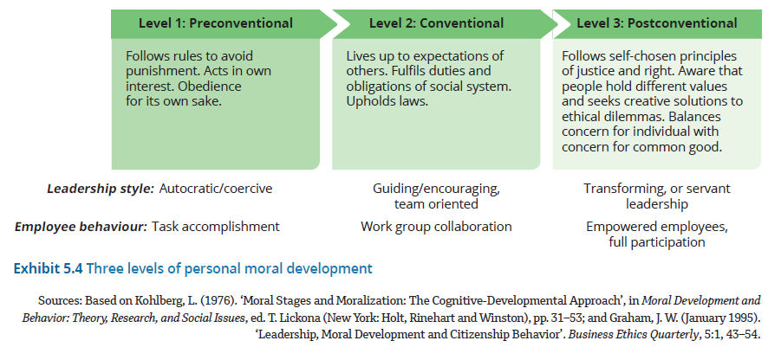
3. The individual manager and ethical choices

Slide 36
3. The individual manager and ethical choices (cont.)
Preconventional level
Individuals are concerned with external rewards and punishments, and obey authority to avoid detrimental personal consequences.
In an organisational context, this level may be associated with managers who use an autocratic or coercive leadership style, with employees oriented towards dependable accomplishment of specific tasks.
Conventional level
People learn to conform to the expectations of good behaviour as defined by colleagues, family, friends and society.
Meeting social and interpersonal obligations is important.
Work-group collaboration is the preferred manner of accomplishing organisational goals, and managers use a leadership style that encourages interpersonal relationships and cooperation.
Postconventional, or principled, level
Individuals are guided by an internal set of values based on universal principles of justice and will even disobey rules or laws that violate these principles.
Internal values become more important than the expectations of significant others.

Slide 37
3.The individual manager and ethical choices (cont.)
Givers versus takers
  Putting others’ interests and needs above your own
    When managers operate from a higher level of development, they may use a form of servant leadership, focusing on the needs of followers and encouraging others to think for themselves.
    Research has shown that people will work harder and more effectively for people who put others’ interests and needs above their own.

Slide 38
3.The individual manager and ethical choices (cont.)
Givers versus takers
  Help and support is key
    The single biggest predictor of a team’s effectiveness is the amount of help and support that members give to one another.
      The shift towards admiring and rewarding givers over takers can bring significant positive changes within organisations.
      The simple categories of giver and taker help people understand how they might contribute to or detract from an organisation’s ethical culture.

Slide 39
4. What is corporate social responsibility (CSR)?
CSR is management’s obligation to make choices and take actions that will contribute to the welfare and interests of society, not just the organisation.
  It means distinguishing right from wrong and doing right.
A company's CSR strategy can be assessed and measured alongside environmental, social and governance (ESG) dimensions.
Environment
Social capital
Human capital
Business innovation
Leadership and governance
e.g. water use, fuel management
e.g. customer privacy, community development
e.g. diversity opportunities, compensation and benefits
e.g. product societal value, quality and safety
e.g. business ethics, executive compensation

Slide 40
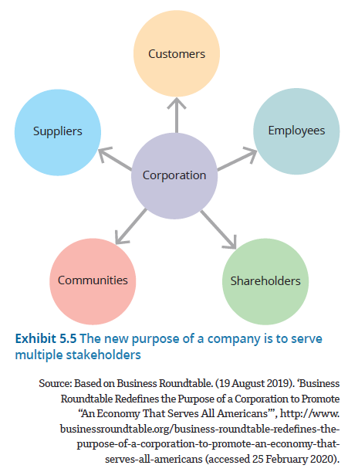
4. What is corporate social responsibility? (Cont’d)
A new purpose for the company: organisational stakeholders
  A stakeholder is any group or person within or outside the organisation that has some type of investment or interest in the organisation’s performance and is affected by the organisation’s actions (employees, customers, shareholders and so forth).
    Stakeholder mapping provides a systematic way to identify the expectations, needs, importance and relative power of various stakeholders.
Serving multiple stakeholders

Slide 41
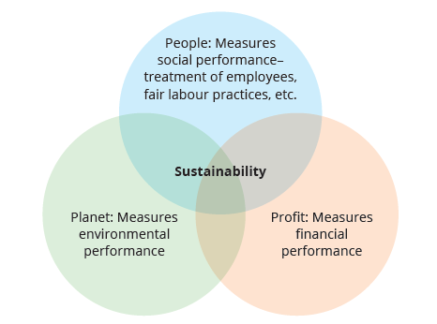
4. What is corporate social responsibility? (Cont’d)
Sustainability and the triple bottom line
  Sustainability refers to economic development that generates wealth and meets the needs of the current generation while preserving the environment and society so future generations can meet their needs as well.
  With sustainability philosophy, managers weave environmental and social concerns into every strategic decision so that financial goals are achieved in a way that is socially and environmentally responsible.

Slide 42
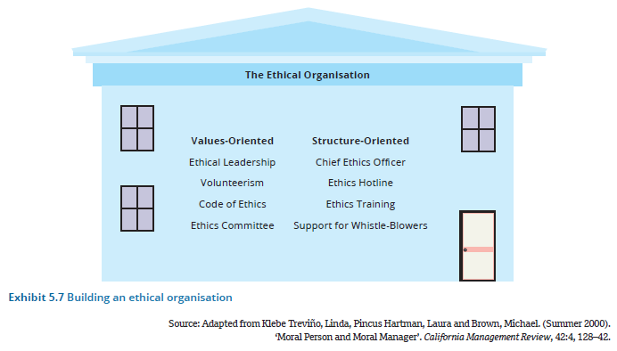
5. Managing company ethics and social responsibility

Slide 43
5. Managing company ethics and social responsibility
Values-oriented approach
  A values-oriented approach directly targets individuals’ internal desire to be ethical. Relating to an employee’s personal values brings individual and organisational values into congruence.
  Making sure decisions and practices are anchored in solid ethical values helps to create an ethical culture throughout the organisation.
  Ethical leadership and volunteerism
  Ethical leadership means that managers are models of honesty and trustworthiness, are fair in their dealings with employees and customers, and behave ethically in both their personal and professional lives.
  They achieve this, for example, by encouraging employee volunteerism, which refers to actively giving time and skills to a volunteer or charitable organisation.

Slide 44
5. Managing company ethics and social responsibility
Values-oriented approach …
  Code of ethics
A code of ethics is a formal statement of the company’s values concerning ethics and social issues – it communicates to employees what the company stands for.
General statements of principle are often called corporate credos.
  Codes of ethics tend to exist in two types
Principle-based statements are designed to affect corporate culture; they define fundamental values and contain general language about company responsibilities, quality of products and treatment of employees.
Policy-based statements generally outline the procedures to be used in specific ethical situations. These situations include marketing practices, conflicts of interest, observance of laws, proprietary information, political gifts and equal opportunity.

Slide 45
5. Managing company ethics and social responsibility
Values-oriented approach …
  Whistleblowing
Employee disclosure of illegal, unethical or illegitimate practices by an employer is called whistleblowing.
No organisation can rely exclusively on codes of conduct and ethical structures to prevent all unethical behaviour.
Some firms have instituted innovative programs and confidential hotlines to encourage and support internal whistleblowing.
  Ethical structures
Ethical structures represent the various systems, positions and programs that a company can implement to encourage and support ethical behaviour.
A structure-oriented approach, rather than acting on individuals’ internal ethical desires, instead uses structures, incentives, choices, task groupings and policies to reduce the temptation to act unethically.

Slide 46
5. Managing company ethics and social responsibility
Values-oriented approach …
  Ethics committees
An ethics committee is a group of executives (and sometimes lower-level employees as well) appointed to oversee company ethics.
  The committee provides rulings on questionable ethical issues and assumes responsibility for disciplining wrongdoers.
  These offices are often headed by a chief ethics officer, a company executive who oversees all aspects of ethics and legal compliance.

Slide 47
6. Managerial ethics and sustainable development in Australia
Sustainable development in practice
Sustainable development practices manage technology and social organisation to make balanced and equitable progress on economic, environmental and social needs so that meeting these needs in the present does not compromise the ability of future generations to meet their own needs.

Slide 48
The ‘why’ of sustainable development
6. Managerial ethics and sustainable development in Australia (Cont’d)
Breadth of vision
This stakeholder approach goes far beyond a response model.
Leading companies value highly the respect of an extended array of their stakeholders and understand that they need to earn a community leadership position by establishing a reputation for trust and integrity that endures in the long term.
Companies view this role as providing the opportunity for business to strive for performance beyond compliance, with the aim of generating sustainable futures for both the business and its stakeholders.
Stakeholder empowerment
Stakeholder empowerment describes businesses’ active and consistent efforts to build, lengthen and strengthen relationships with their stakeholders.
Where stakeholder empowerment differs from more traditional approaches to stakeholder relations is in the profound degree to which power and influence become shared between the two parties.
It is this sharing of power that underpins the shared future described by the principle ‘breadth of vision’ and is the objective of stakeholder empowerment.
Being progressive
In keeping with their long-term vision and enthusiasm for change and new opportunities, leading companies also shared a commitment to progress through models such as excellence, best practice and high performance.
How businesses operationalise the ‘being progressive’ principle depends on their business strategy.

Slide 49
The ‘what’ of sustainable development
6. Managerial ethics and sustainable development in Australia (Cont’d)
Stakeholder support
This refers to all the stakeholders in the business.
Their support as shareholders and debt-holders may be increased by an improved organisational risk profile; recognition by socially responsible investment indices; or improved communication.
Efficiency
This refers to the range of sustainable development practices that makes a direct or indirect contribution to the company’s financial performance.
Areas of practice that are less commonly associated with efficiency gains, but which do have the potential to generate them, are multiskilling and other forms of workforce training and support, and life-cycle analysis of products, whereby the costs of product maintenance and disposal are internalised to the business rather than being shifted to consumers and governments
Market edge
This describes those practices that contribute to the company’s market opportunities in terms of new markets, market share and profit opportunity.
Research and development, innovation and supply chain improvements are all examples of practices that can have a sustainable development component and can open up new markets for a company or assist it to be more responsive to existing ones.

Slide 50
Kinds of stakeholder support
6. Managerial ethics and sustainable development in Australia (Cont’d)
Employee support
Employee support may be increased not only through programs directly related to their employment, such as training and wage negotiation, but also by support programs, such as childcare and health and fitness provisions, and further by involvement in philanthropic programs, such as charitable donations from wages matched by the company, special leave for charity work and so on.
Supplier support
The support of suppliers may be increased through evidence of mutuality or partnering in the supply chain, whereby the company promotes, supports and brokers their efforts to improve efficiency or standards and agrees to share the benefits.
Customer support
Customer support may be increased by efforts that recognise their needs and preferences, such as environmentally friendly products, health information, and product security and quality control.
Regulator support
Finally, the support of regulators may be increased by evidence of responsible and consistent adherence to required performance and reporting, support for international relations such as inter-country aid programs, and support for local programs such as community liaison committees and customer training and support.

Slide 51
6. Managerial ethics and sustainable development in Australia (Cont’d)
  Sustainable development practices give businesses a greater opportunity for long-term success when they are
The ‘when’ of sustainable development
  Businesses derive long-term success from sustainable development practices that they are well placed to broker and benefit from.
strategically congruent with the business – specifically, by contributing to the business strategic requirements of stakeholder support, efficiency and market edge
deep practices that achieve genuine improvements in sustainable development outcomes, rather than superficial tick-a-box efforts
mature, leading-edge approaches that offer the best available value proposition for the business on the scale from comply through to transform
well-integrated with other business practices, thus promoting efficiency and effectiveness in implementation.

Slide 52
Summary
Ethics is the code of moral principles and values that governs the behaviours of a person or group with respect to what is right or wrong.
Managers often employ normative strategies to guide ethical decision making.
Five approaches that are relevant to managers are the utilitarian approach, individualism approach, moral rights approach, justice approach and practical approach.
Organisational and personal factors can influence a manager’s ability to make ethical choices.
One important factor is whether a manager is at a preconventional, conventional or postconventional level of moral development.
In 1997, the Business Roundtable (BRT) identified shareholder value as the primary corporate purpose.
The BRT’s recent ‘Statement on the Purpose of a Corporation’ outlines an up-to-date standard for corporate social responsibility that focuses on five primary stakeholders: employees, customers, suppliers, the community and shareholders.
Different stakeholders have different interests in the organisation and thus different criteria for social responsiveness.
Managers are role models.
One of the most important ways that managers create ethical and socially responsible organisations is by practising ethical leadership.
Managers can use both a values-oriented approach (including codes of ethics) and ethical structures (such as ethics committees) to create an ethical organisation.
Australian organisations face a wide range of ethical challenges.
Australian stakeholders are increasingly requiring higher standards of ethical and responsible behaviour from managers than ever before.

