Slide 1
MN101 Principles of Management
Lecture 1
Innovative management for a changing world and
The evolution of management thinking

Slide 2
Learning objectives
Describe the four management functions and the type of management activity associated with each.
Describe conceptual, human and technical skills, and their relevance for managers and employees.
Define the management types and roles that managers perform in organisations.
Understand the particular challenges and opportunities faced by managers in small businesses and not-for-profit organisations.
The influence of historical forces on management
Describe major components of classical and humanistic perspectives of management.
Explain the major concepts of systems thinking and the contingency view.
Recognize the impact of AI in management

Slide 3
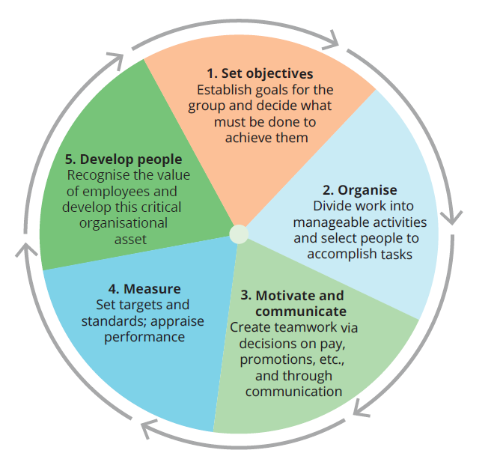
1. The basic functions of management
How do you define management?
What does it involve?
Page 13 –eBook)
Notes:
Management is defined as the attainment of organisational goals in an effective and efficient manner through planning, organising, leading and controlling organisational resources.

Slide 4
1. The basic functions of management…
Planning
Defining goals for future organisational performance and deciding on the tasks and resources needed to attain them
Organising
Assigning tasks and allocating resources to achieve strategic goals
Leading
Using influence to motivate employees to achieve the organisation’s goals
Controlling
Monitoring activities and making corrections as needed
Page 13-14
Notes:
Planning is the management function concerned with defining goals for future organisational performance and deciding on the tasks and resource use needed to attain them.
Organising is assigning tasks to groups or departments, allocating resources and the deployment of organisational resources to achieve strategic goals.
Leading is the management function that uses influence to motivate employees to achieve the organisation’s goals.
Controlling is the management function concerned with monitoring the business and employee activities, keeping the organisation on track towards its goals and making corrections as needed.

Slide 5
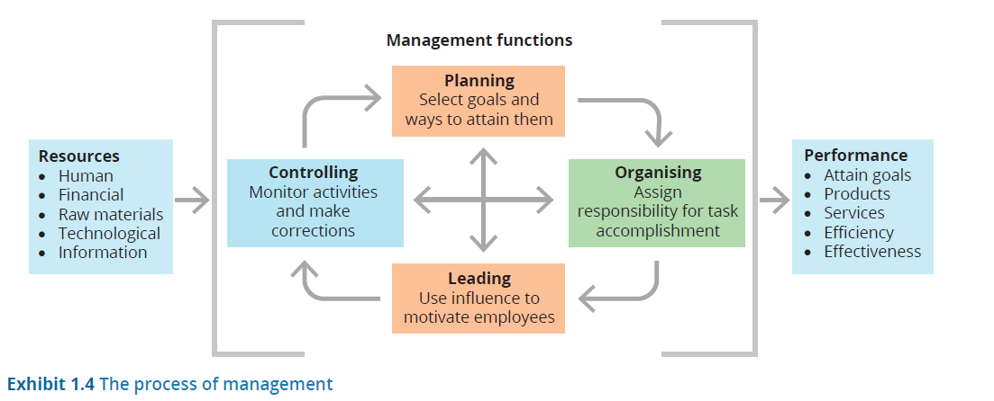
1. The basic functions of management…
Notes:
An organisation is a social entity (made up of two or more people) that is goal-directed (being designed to achieve some outcome, such as making a profit) and deliberately structured (tasks are divided and responsibility for their performance is assigned to organisation members).
The manager’s responsibility is to coordinate resources in an effective (the degree to which the organisation achieves a stated goal) and efficient (the use of minimal resources – raw materials, money and people – to produce a desired volume of output) manner to accomplish the organisation’s goals.

Slide 6
2. Management skills
  A manager’s job requires a range of skills:
Conceptual skills
The cognitive ability to see the organisation as a whole and the relationships among its parts
Human skills
The ability to work with and through other people, and to work effectively as a group member
Technical skills
The understanding of and proficiency in the performance of specific tasks
Page 16-19
Notes:
Good management skills are not automatic or guaranteed.
Everyone has flaws and weaknesses, and these shortcomings become most apparent under conditions of rapid change, uncertainty or crisis.
Some managers fail to listen to customers, are unable to motivate employees or can’t build a cohesive team.

Slide 7
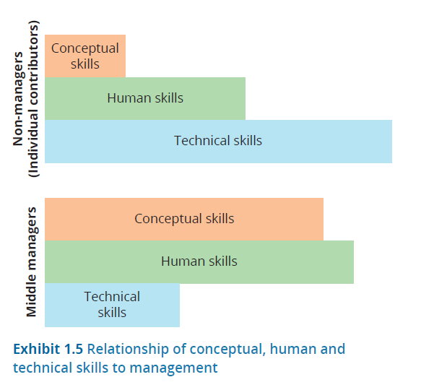
2. Management skills…
Relationship between conceptual, human, and technical skills
Page 16-19

Slide 8
2. Management skills…
Manager types
First-level or supervisory manager
Directly supervises people doing work, often a team of 5-15 people
Middle manager
Supervises several first-level managers, often a departmental leader
Top manager
Leads and manages a whole division or functional area of an organisation
General manager
Has full financial and other responsibilities for a significant part of an organisation
Functional manager
Manages a specific functional area of an organisation (e.g., marketing, production, finance or IT)
Project manager
Leads and delivers one or more specific projects or initiatives in an organisation
Line manager
Directly manages the creation of core work outcomes, such as sales or production
Staff manager
Manages support functions in an organisation, such as legal, accounting or HR

Slide 9
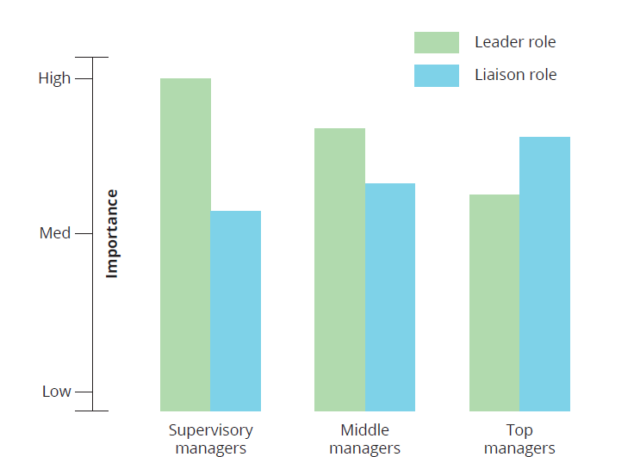
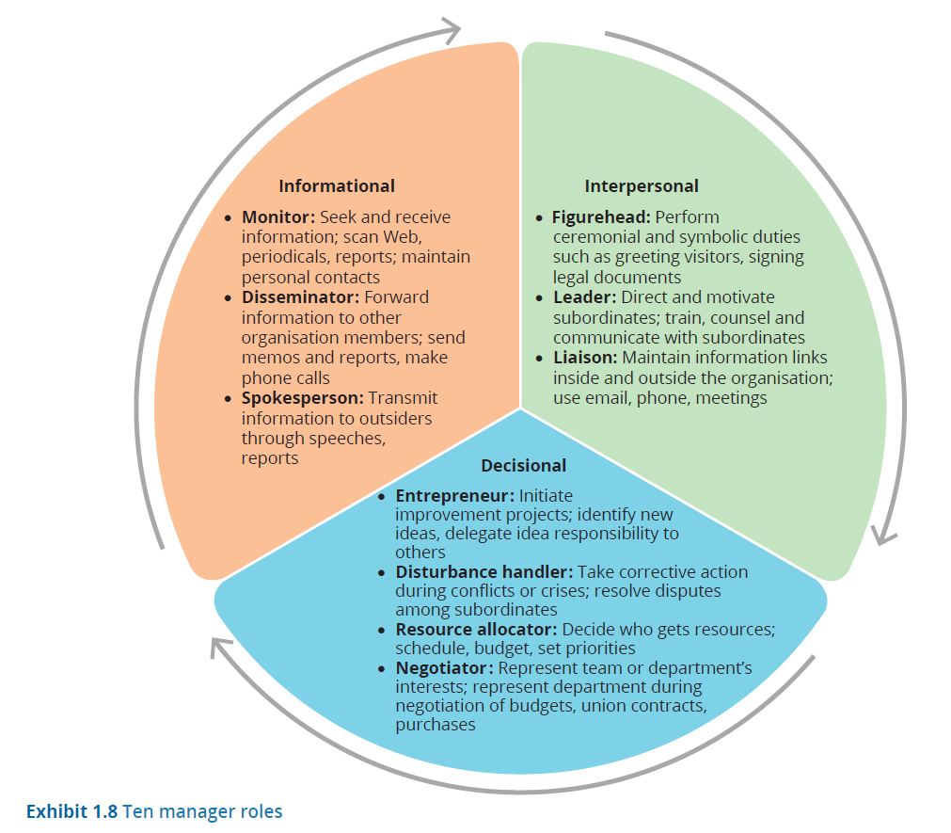
Ten manager roles
2. Management skills…

Slide 10
3. Managing in small businesses and not-for-profit organisations
Small business is growing in importance.
All organisations need effective and efficient management practices.
Not-for-profit (NFP) organisations focus on less tangible aspects that improve society in some way. They need to place more emphasis on the roles of:
  spokesperson (to ‘sell’ the organisation to donors and the public)
  leader (to build a mission-driven community of employees and volunteers)
  resource allocator (to distribute government resources or grant funds that are often assigned top-down).
Notes:
Not-for-profit organisations:
While profit-making organisations direct efforts towards earning money, NFPs focus on less tangible aspects that improve society in some way.

Slide 11
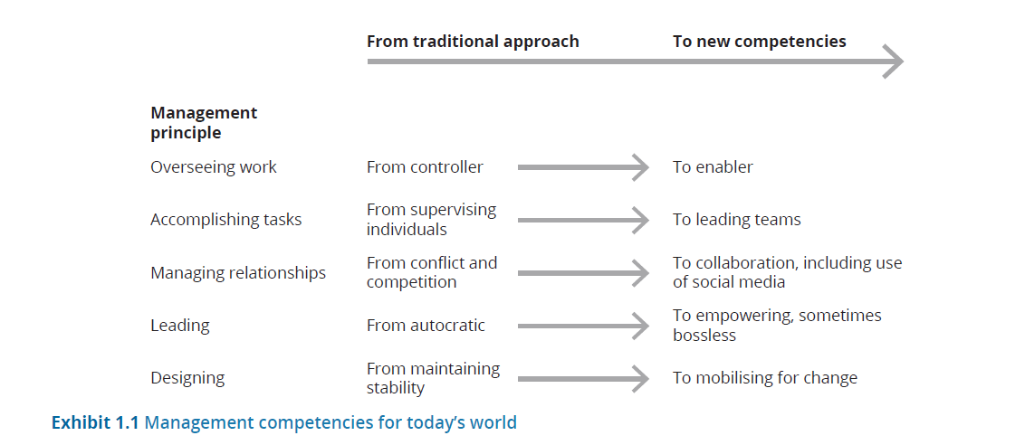
4. Management competencies for today’s world
Are you ready to be a manager (page 1 eBook)

Slide 12
Current challenges in the workplace
4. Management competencies for today’s world…
Challenges for government
Making and implementing laws
Interpreting and implementing policies
Challenges for business
Transitioning to 'working from home’
Buying and selling raw materials and products and services
Generating enough revenue to pay costs
Complying with relevant laws
Challenges for the individual employee
Sustainable development
Producing a profit
Establishing operations outside Australia
Individual competitiveness
Planning for the next job
Getting and keeping a job:
Adding value to the organisations that employ them
Page 9-11
Notes:
Challenges for government include:
making and implementing laws against:
unfair trading
paying below minimum wage levels
unsafe workplaces or practices
pollution
non-disclosure of information
monopolistic practices and cartel behaviours
misinforming consumers
interpreting and implementing policies.
Challenges for business include:
transitioning to 'working from home’ (and back again) during the COVID-induced lockdowns
pollution control and sustainable development
buying and selling raw materials and products and services, and establishing operations outside Australia
continually generating enough revenue to pay all the firm’s costs for labour, rent, materials, energy, advertising and other expenses
producing a profit for the business owner that will be a sufficient return on investment
complying with relevant laws: these include tax laws, labour standards, reporting of information, environmental regulations, consumer protection and many others.

Slide 13
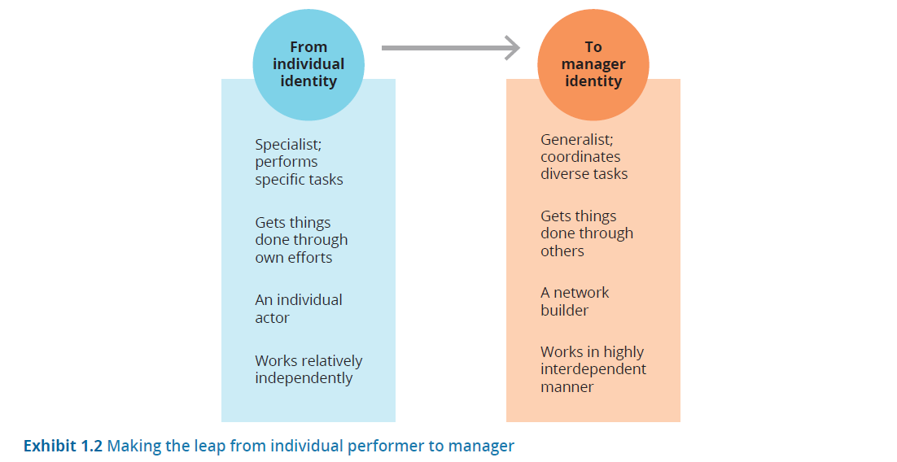
Becoming a new manager
4. Management competencies for today’s world…
  Becoming a manager means becoming a new person and viewing yourself in a completely different way.
  Being a successful manager means thinking in terms of building teams and networks, and becoming a motivator and organiser within a highly interdependent system of people and work.

Slide 14
Do you really want to be a manager?
4. Management competencies for today’s world…
Increased workload
It isn’t unusual for managers to work 70–80 hours per week, and some work even longer hours.
A manager’s job always starts before a shift and ends hours after the shift is over.
Challenge of supervising former peers
The transition from a peer-to-peer relationship to a manager-to-subordinate one is challenging and stressful.
Some new managers try too hard to remain ‘one of the gang’ while others assert their authority too harshly.
Responsibility for other people
New managers are often astonished at the amount of time it takes to handle employees’ problems, in addition to their responsibilities of hiring, supervising and disciplining others.
Being caught in the middle
Managers find themselves acting as a backstop, caught between upper management and the workforce.
One key to being happy as a manager may be carefully evaluating whether you can answer yes to the question, ‘Do I really want to be a manager?’

Slide 15
Time-management tips for new managers
4. Management competencies for today’s world…
Keep a to do list
A to do list identifies all the things you need to do during the day.
Remember your ABCDs
A: Highly important tasks that must be done or you’ll face serious consequences
B: Tasks you should do but the consequences will be minor if you don’t get them done
C: Tasks that would be nice to get done but there are no consequences at all if you don’t accomplish them
D: Tasks that you can delegate to someone else
Do a daily review and look-ahead
Reviewing what worked well and what didn’t will increase your awareness of your behaviour and reduce your bad habits the next time.
Do one thing at a time
Research has shown that multitasking reduces rather than enhances productivity.
Give each task your full attention; you’ll get more done and get it done better, too.
Then, look ahead and plan what you want to accomplish the next day.

Slide 16
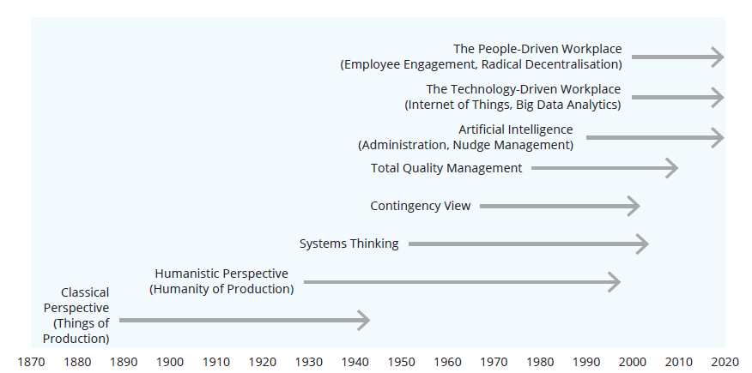
      Management practices and perspectives vary in response to social, political and economic changes in the larger society.
5. Management and organisation
Page 38
Are you a new style manger? Page 35

Slide 17

The tension between historical forces in management thinking
5. Management and organisation
Management perspectives
Classical perspective
Humanistic perspective
Notes:
The dilemma – the scientific, numbers-driven push for greater productivity and profitability, and the call for more humanistic, people-oriented management – has continued to the present day.

Slide 18
The four subfields of the classical perspective
5.1 Classical Management Perspective
The classical management perspective emerged during the 19th and 20th centuries.
It emphasises a rational, scientific approach to the study of management and sought to make organisations efficient operating machines.
Scientific management
Bureaucratic organisations
Administrative principles
Management science
Page 39
https://www.youtube.com/watch?v=d1jOwD-CTLI&ab_channel=OrganizationalCommunicationChannel
Notes:
https://www.youtube.com/watch?v=d1jOwD-CTLI&ab_channel=OrganizationalCommunicationChannel

Slide 19
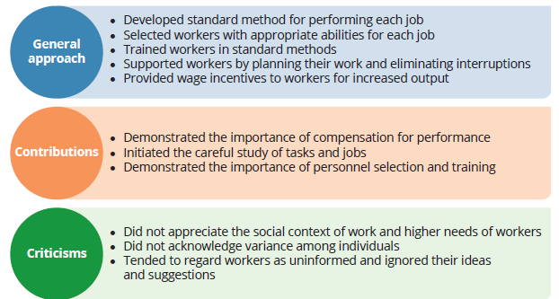
5.1 Classical Management Perspective: Scientific Management
emphasises scientifically determined changes in management practices as the solution to improving labour productivity.
Frederick Winslow Taylor is known as the father of scientific management.
Henry Gantt and Frank B. and Lillian M. Gilbreth were other important pioneers in the field.
Characteristics of Scientific Management
Discuss the strengths and limitations of the scientific management
Page 40

Slide 20
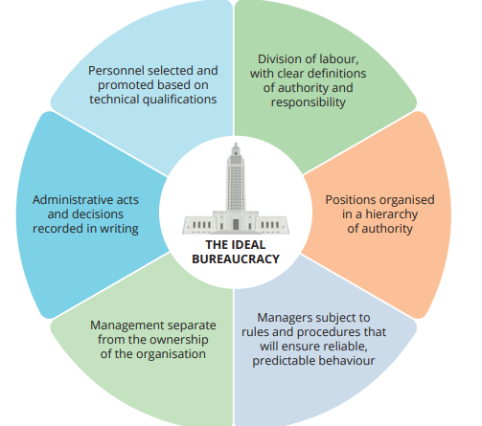
5.1 Classical Management Perspective: Bureaucratic organisations
Managing through clearly defined authority and responsibility, formal record keeping, and separation of management and ownership.
Rational: an organisation based on rational authority is more efficient and adaptable to change because continuity is related to formal structure and positions rather than to a particular person, who may leave or die. (Max Weber)
Page 41
Characteristics of a Weberian bureaucracy
Discuss the strengths and limitations of the Bureaucratic organisations

Slide 21
Characteristics of Fayol’s general principles of management
5.1 Classical Management Perspective: Administrative principles
This approach focuses on the total organisation rather than the individual worker, delineating the management functions of planning, organising, commanding, coordinating and controlling.
The major contributor to this approach was Henri Fayol.
He also identified the five basic functions or elements of management: planning, organising, commanding, coordinating and controlling.
Unity of command
Each subordinate receives orders from one – and only one – superior.
Division of work
Managerial work and technical work are amenable to specialisation to produce more and better work with the same amount of effort.
Unity of direction
Similar activities in an organisation should be grouped together under one manager.
Scalar chain
A chain of authority extends from the top to the bottom of the organisation and should include every employee.
Page 41

Slide 22
5.1 Classical Management Perspective: Administrative principles
Ethical challenge (page 62).
Read the ethical challenge on page 62, which relates to problems of bureaucracy.
What would it be like for you to be a manager in a bureaucratic organisation?
Would you thrive in that environment?

Slide 23
The three subsets of management science
5.1 Classical Management Perspective: Management science
This approach, also called quantitative perspective, applies mathematics, statistics and other quantitative techniques to managerial problems.
Qualitative techniques is the use of mathematics, statistics and computer technology to facilitate management decision making.
Operations research
Consists of mathematical model building and other applications of quantitative techniques to managerial problems
Operations management
Specialises in the physical production of goods or services
Information technology
The hardware, software, telecommunications, database management and other technologies used to store, process and distribute information
Used to solve manufacturing problems

Slide 24
The three subfields of the humanistic perspective
5.2 Humanistic Management perspective
The humanistic perspective on management emerged around the late 19th century.
It emphasised the importance of understanding human behaviours, needs and attitudes in the workplace, as well as social interactions and group processes.
  Two early advocates of a more humanistic approach were Mary Parker Follett and Chester Barnard.
Human relations movement
Human resources perspective
Behavioural sciences approach

Slide 25
5.2 Humanistic Management perspective: The human relations movement
Emphasises satisfaction of employees’ basic needs as the key to increased worker productivity.
Based on the idea that truly effective control comes from within the individual worker rather than from strict, authoritarian control.
The Hawthorne Studies were a series of experiments on worker productivity, begun in 1924 at the Hawthorne plant of Western Electric Company in Illinois, which attributed employees’ increased output to managers’ better treatment of them during the study.
Worker productivity increased partly as a result of the increased feelings of importance and group pride that employees felt by virtue of being selected for this important project.
Page 45 New Manager Self-Assessment

Slide 26
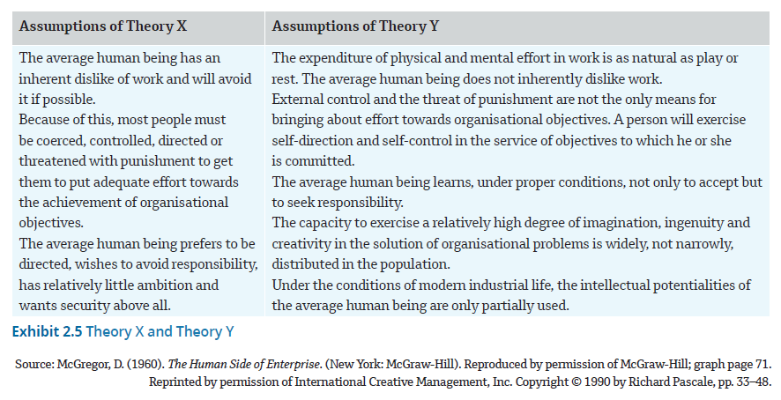
Theory X and Theory Y
5.2 Humanistic Management perspective: The human resources perspective
The human resources perspective suggests jobs should be designed to meet higher-level needs by allowing workers to use their full potential.
Two of the best-known contributors to the human resources perspective were Abraham Maslow and Douglas McGregor.

Slide 27
5.2 Humanistic Management perspective: The behavioral sciences approach
This approach applies social science in an organisational context, drawing from
  economics,
  psychology,
  Sociology, and other disciplines.
Concepts that grew out of the behavioural sciences approach include
  organisational development,
  matrix organisations,
  self-managed teams,
  corporate culture, and
  management by wandering around.

Slide 28
Subsets of systems thinking
5.3 Recent historical trends: Systems thinking
The ability to see both the distinct elements of a system or situation, and the complex and changing interaction among those elements
An extension of the humanistic perspective that describes organisations as open systems that are characterised by entropy, synergy and subsystem interdependence
System
A set of interrelated parts that function as a whole to achieve a common purpose
Subsystems
Parts of a system that depend on one another for their functioning
Synergy
The concept that the whole is greater than the sum of its parts

Slide 29
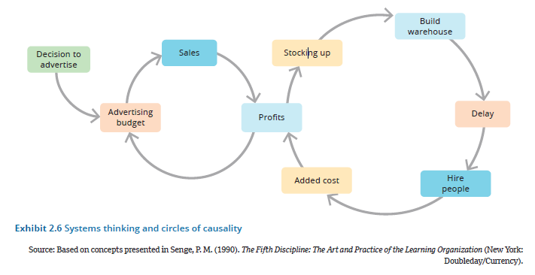
Systems thinking and circles of causality
5.3 Recent historical trends: Systems thinking…
The events in the circle on the left are caused by the decision to increase advertising.
The advertising promotions increase sales, which increase profits, which provide money to further increase the advertising budget.
This decision will have consequences for the operations department (circle of causality on the right).
Circles of influence for increasing a retail business’ profits

Slide 30
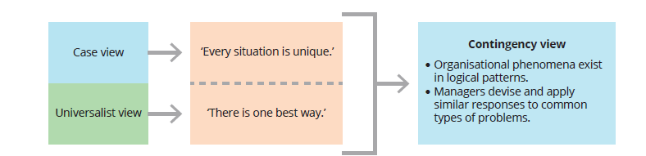
5.3 Recent historical trends: Contingency view
The contingency view is an extension of the humanistic perspective.
  The successful resolution of organisational problems depends on managers’ identification of key variables (or contingencies) in the situation at hand.

Slide 31
5.3 Recent historical trends: Innovative management thinking into the future
Big data analytics
Platform-based organisations
Technologies, skills and processes for searching and examining massive, complex sets of data that traditional data-processing applications cannot handle to uncover hidden patterns and correlations
Driven by the jump from the internet that connects people to the Internet of Things (IoT) – impersonal ‘things’ are connected and can themselves generate and receive data by communicating with each other
A business model that creates value by facilitating exchanges (connections) between people in two or more interdependent groups, usually consumers and producers
Encourages exchanges by creating communities that allow users to interact directly with one another via their digital media devices
Used by platform businesses such as TikTok, Facebook, and Uber

Slide 32
5.3 Recent historical trends: Innovative management thinking into the future…
Managing the new people-driven workplace
Ideas central to radical decentralisation
  Radical decentralisation means that decentralisation of authority is radical rather than incremental.
  Instead of delegating some authority to employees, the hierarchical reporting relationship between the manager and the subordinate is almost completely eliminated, and employees have full authority to make key decisions about their work.
People tend to flourish when they are given more responsibility.
It makes sense to give decision-making authority to the people who are closest to the work being done.
People will bring higher levels of energy, passion and creativity to their work when they feel free to fully express themselves.
People are happier when they have control over their own work.

Slide 33
Using engagement to manage
5.3 Recent historical trends: Innovative management thinking into the future…
Employee engagement means that people are:
  emotionally involved in their jobs
  satisfied with their work conditions
  able to contribute enthusiastically to meeting goals
  feeling a sense of belonging and commitment to the organisation and its mission.
Millennial and Gen Z employees want to work for a clear, meaningful purpose in a flexible, collaborative work environment that is challenging and supportive, with access to cutting-edge technology, opportunities to learn and further their careers and personal goals, and the power to make substantive decisions in the workplace.

Slide 34
6. The historical struggle: is AI the answer?
Artificial intelligence (AI)
Nudge management
AI encompasses techniques used to teach computer systems to learn, reason, perceive, infer, communicate, and make decisions similar to or better than human beings can.
Human workers tend to focus on the work of which machines and AI are not capable.
Nudge management provides positive reinforcement and indirectly influential suggestions in order to achieve non-forced compliance to behaviour and decision making.
New AI-fostered, digital technology can be used to nudge people towards desired behaviours.

Slide 35
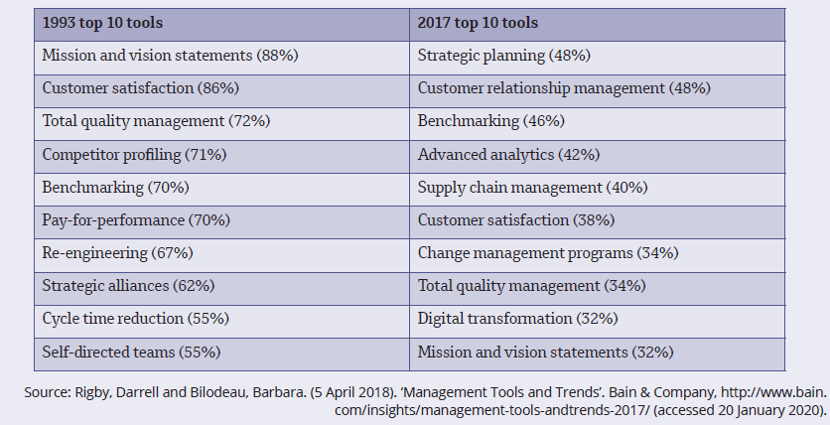
7. Management in practice: Current use of management tools and trends

Slide 36
Summary
Management is defined as the attainment of organisational goals in an effective and efficient manner through planning, organising, leading and controlling organisational resources.
There are many different types of managers, depending on their purpose and location within an organisation.
Managers at every level perform 10 roles, which are grouped into informational, interpersonal and decisional roles.
Good management is just as important for small businesses and not-for-profit organisations as it is for large corporations
Managers are required to posses technical, human and conceptual skills.
Becoming a new manager requires a shift in thinking from being an individual performer to playing an interdependent role of coordinating and developing others.
The study of modern management began in the late 19th century with the classical perspective, which took a rational, scientific approach to management and sought to turn organisations into efficient operating machines. The four subfields are scientific management, bureaucratic organisations, administrative principles and management science.

Slide 37
Summary…
The humanistic management perspective emphasises understanding human behaviour, needs and attitudes in the workplace.
Systems thinking describes organisations as open systems characterised by entropy, synergy and subsystem interdependence.
The contingency view posits that the successful resolution of organisational problems depends on managers’ identification of key variables (or contingencies) in the situation at hand.
Modern management is a mix of ideas and techniques from varied historical perspectives.
New concepts continue to emerge, including the transition to a more technology-driven workplace and a corresponding emphasis on a people-driven workplace.
Two popular uses of new technology are big data analytics and platform-based organisations.
Two ideas related to a people-driven workplace are radical decentralisation and employee engagement.
Artificial intelligence is rapidly growing as an increasingly pervasive way to help people to do more interesting and challenging creative work, while the routine work is partly or completely automated.

