Slide 1
Week 13 Study week
Review, review, review.

Slide 2
Chapter one
1.1
What is Semantics?
“Semantics is the study of meaning communicated through language” p3
Term was coined by Michel Breal (late 1800s)

Slide 3
Kinds of questions semanticists ask (Riemer):
What are meanings—definitions? Ideas in our heads? Sets of objects in the world?
Can all meanings be precisely defined?
What explains relations between meanings, like synonymy, antonymy, and so on?
How do the meanings of words combine to create the meanings of sentences?
What is the difference between literal and non-literal meanings?

Slide 4
More…
How do meanings relate to the minds of language users, and to the things words refer to?
What is the connection between what a word means, and the contexts in which it is used?
How do the meanings of words interact with syntactic rules and principles?
Do all languages express the same meanings?
How do meanings change?

Slide 5

1.2 Semantics and Semiotics
What is semiotics?
“Linguistic meaning is a special subset of the more general human ability to use signs.”
(Umberto Eco)
Charles Peirce
Ferdinand de Saussure

Slide 6
Signification
Ferdinand de Saussure
(song by Magnetic Fields)
“…the study of linguistic meaning is a part of this general study of the use of sign systems…”
Signifier
Signified
C. S. Peirce: icon, index, and symbol

Slide 7
Compositionality and productivity
“All human languages have the property of productivity. This is simply the fact that the vocabulary of any given language can be used to construct a theoretically infinite number of sentences…” (Riemer 19)
Probably you have never heard this sentence before:
My golden guitar was foot crafted by the ancient turtles of Dimension B.
But you understand it! (Sort of) How?
Because meaning is compositional (made up of constituent lexemes), just like every other domain of linguistics (phonology, syntax etc).
But this is not always so. What is an example of a non compositional English phrase?
(Construction Grammar, CxG)

Slide 8
Challenge 1 (with definitions)
Circularity
Ferret, cat, book, chair, etc.
Does it ever end?

Slide 9
Challenge 2 (with definitions)
Is our definition exact? Is it accurate. Meaning is a kind of knowledge.
Whale
Guangzhou
Volts, Amps,
Do our words then have different meaning?
God/Allah
God/God
Linguistic knowledge vs encyclopedic knowledge

Slide 10
Challenge 3 (with definitions theory)
Meaning in context
Marvelous weather you have here in Ireland.
He’s dying.
It’s getting late
Would you like another cup of coffee?
MORE examples…

Slide 11
1.4 meeting the challenges
1. Circularity– semantic metalanguage. But is it possible?
2. Encyclopedic knowledge—how much is needed in order to use a word? Representation, concepts, categories…
3. Context—conventional/literal meaning vs contextual meaning, figurative meaning etc.
Is this even possible?
Leads to pragmatics

Slide 12
A central issue
The relationship between word meaning and sentence meaning
What is productivity?
“speakers regularly create sentences that they have never used or heard before” p9
Make one right now:
According to Generative Grammar, with “a relatively small number of combinatory rules… speakers use a finite set of words to create a very large, perhaps infinite number of sentences”

Slide 13
Sentence formation is recursive
So we cannot list the meanings of sentences like we list meaning of words in a lexicon or dictionary
Sentence meaning is compositional
So in a Model of Grammar, meaning is in two places:
  1. a more stable body of word meanings (in the lexicon)
  2. the limitless composed meanings of sentences

Slide 14
A well known example
English French
Sheep mouton
Animal animal
*meat meat
From different systems so they have different ranges (semantic range or semantic domain)

Slide 15
Words defined by differences and similarities between other words within the language system
Chair
Stool
Red
Brown, Orange, Yellow etc.
Also grammatical terms like plural don’t always “mean” the same thing in other languages. (dual, honorific pronouns etc.)

Slide 16
3 terms for levels of language
Utterance, sentence, proposition
Utterance: an instance created by speaking (or writing). “My name is Mike.” “My name is Mike.”
Sentence: abstract grammatical elements obtained from utterances. Above is two utterances of the same sentence.
Proposition: the truth value of “My name is Mike”. Some grammatical or sentence level differences may be irrelevant.
If one is true, all are true, if one is false, all are false.

Slide 17
That hat is ridiculous!
I had a holiday in Albany
Picking out or identifying words is called referring/denoting
Referent/denotum
Sometimes denote is between linguistic expression and the world
And refer is the action of the speaker in picking out entities
Referring is what speakers do
Denoting is the property of words.

Slide 18
“Book” denotes things in the world with pages and writing etc.
“This book” refers to my Semantics book right here…

Slide 19
Referential (or denotational) approach
Vs
Representational approach
REFERENTIAL: Words are meaningful because they denote entities in the world, and sentences denote situations and events.
REPRESENTATIONAL “our ability to talk about the world depends on our mental models of it.”

Slide 20
Examples 2.6 ff.
Also Tibetan TAM
Japanese pronouns etc.
Representational theories: “emphasize the way that our reports about reality are influenced by the conceptual structures conventionalized in language”
Referential theories: “meaning derives from language being attached to, or grounded in, reality.
Representational theories: meaning derives from language being a reflection of our conceptual structures

Slide 21
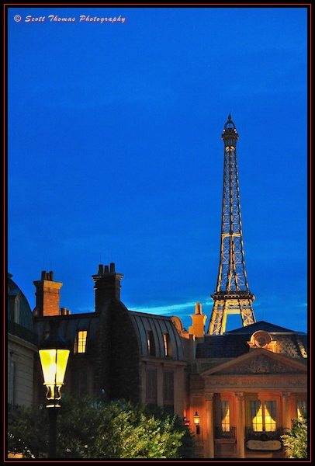
reference
Referring and non-referring expressions
  I gave him some apples.
  Apples are good for you.
Constant vs variable reference
  (draw one)
Referents and extensions
  (extensions show the denotations—
  That is, the set of things it could refer to)

Slide 22
Names
What does your name mean?
What does your full name mean?
What do you know about that person?
I know less. But I understand the meaning…
Description theory: “a name is taken as a label or shorthand for knowledge about the referent, or in the terminology of philosophers, for or more more definite descriptions.”
But this is dependent on associating the name with the right description.

Slide 23
Nouns and NPs
Indefinite and definite
Known to listener or not
Whoever fits the description
An account of reference has to deal with cases where there is no referent:
The King of France is bald.
Groups– either distributively or descriptively
Substances or abstract ideas

Slide 24
Think about this tautology (of Frege)
The morning star is the evening star.
And
Venus is Venus.
SO, (read the summary, page30), there is more to meaning than reference!

Slide 25
Frege’s Sense and reference
Sinn and Bedeutung
Sense is primary because it allows reference
The President of the USA→ we understand the sense
But who is it referring to?
Obama? Trump? Biden? (These are the references)

Slide 26
What is this mental representation?
So it can’t just be an image, not purely visual, but a more abstract element: a concept.
Triangle
But unless we have a good idea of what “concept” is, we can get very empty definitions like “The sense of the word dog is the concept DOG.”
All this does is replace the term “meaning” with the term “concept”.

Slide 27
Concepts
So, if we use both theories and say “the meaning of a noun is a combination of its denotation and a conceptual element” then we have two qs:
1. What form can we assign to concepts
2. How do children acquire them, along with linguistic labels

Slide 28
Concepts with a single word: lexicalized
But there are also concepts which need a phrase or phrases.
Why?
Utility
New words like…
Words our family uses… why we even get new words in the first place.

Slide 29
Children’s concepts can differ from adults’ concepts
Underextending
Or
Overextending
give examples
Dog→Fido, Daddy→all adult males

Slide 30
Necessary and sufficient conditions
Using sets of conditions to define a word. Just the right amount.
Woman
OK
Let’s try with zebra or bird.
If we can’t establish a definition we agree with how can we label it linguistically?
Or words that we don’t really know the meaning of: hawk and falcon?

Slide 31
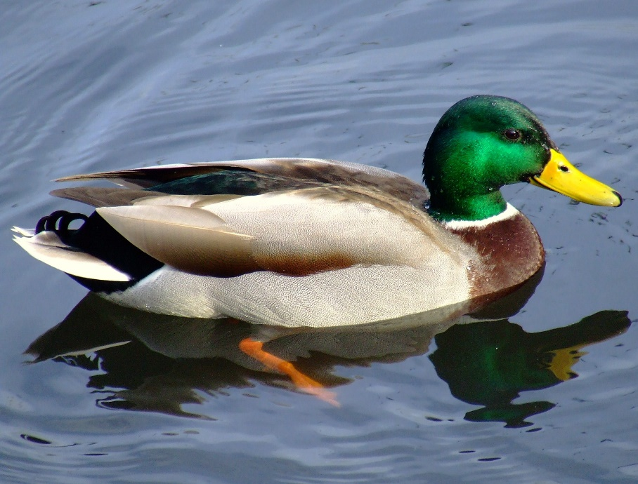
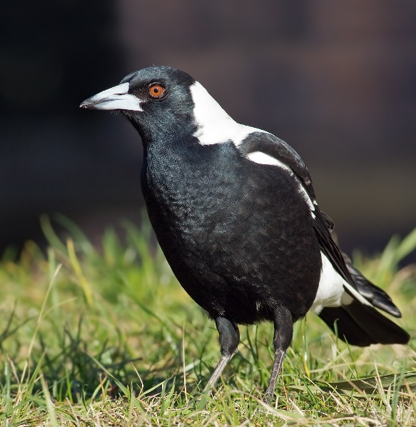

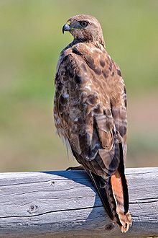
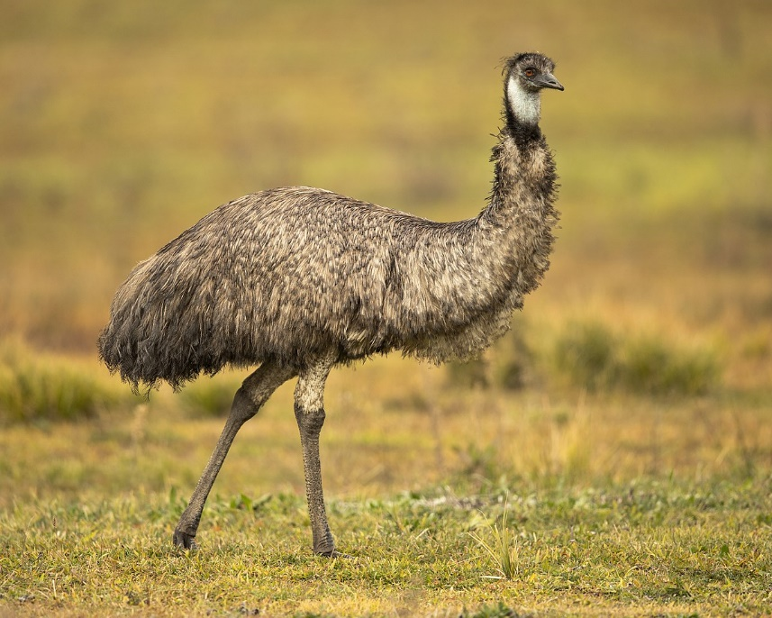
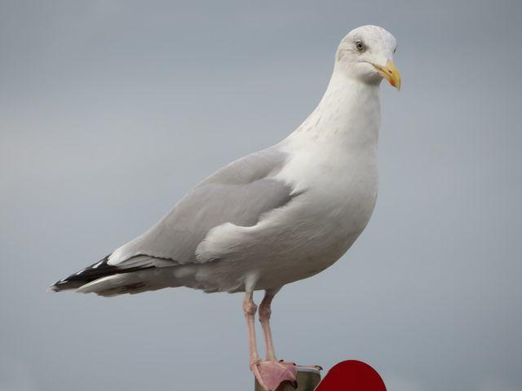
Which is the most “bird”?

Slide 32
Which is the most “Language”? “Country”?
Which is the most “mammal”?
The most “coffee”?
Tall?
Hot?
Jump?
Hit?

Slide 33
Prototypes
Mammal or fish test:
Characteristic features
Exemplars (memories to compare to)

Slide 34
Fillmore and Lakoff
“speakers have folk theories about the world, based on their experience and rooted in their culture.
Frames (Fillmore)
Idealized cognitive models (ICMs) (Lakoff).
Not scientific
Or logically consistent definitions
But collections of cultural views

Slide 35
Relationships between concepts
Words are in a network of semantic links with other words
The same goes for concepts
Sometimes all you know about a word is that it is related to a greater concept
“your knowledge of these concepts “inherits” knowledge you have” p36
So how much knowledge about a word do you have to have in order to use it?
Suggests “the crucial element is not the amount of knowledge but its integration into existing knowledge”

Slide 36
Conceptual hierarchies
Animal
Bird
Sparrow

Slide 37
Linguistic relativity
Associated with Sapir and Whorf
Check out the movie “Arrival”
Colors
“semantic gaps”
Put on/don
Single word with a long translation (Wayne’s World)
Familial relationships
etc.

Slide 38
Speakers compress thoughts
Hearers fill out their own version
Fits with idea that speakers are putting their thoughts into a language
(translation!)
This ‘language of thought’ is sometimes called Mentalese
It is proposed that the language of thought is universal.
Sum: “Human beings have essentially the same cognitive architecture and mental processes, even though they speak different languages.” p41

Slide 39
Summary
Language can identify or refer to real world entities
BUT this isn’t a sufficient theory of meaning
Semantic knowledge includes both reference and sense
Two approaches for our ability to talk about the world:
Denotational—emphasizes links between language and external reality
Representational—emphasizes links between language and conceptual structure
Three linguistic Positions

Slide 40
Chapter Three: Word Meaning
Lexical Semantics
A) to represent the meaning of each word in the language
B) to show how the meanings of words in a language are related
  Related to other words in the sentence
  Related to other words NOT in the sentence

Slide 41
Entailment examples (more in book)
My bank manager has been murdered.
My bank manager is dead.
My bank will be getting a new manager.
I drove my car to work.
I own a car.
I have a job.
I bought a car.
I have a drivers license.

Slide 42
What are words? (for that matter what are the other “blocks” of language?
Are there any tests you can think of?
Consider the different levels of linguistic research…
Phonological word tests?
Syntactic word tests?
Semantic word tests?
Try to come up with a test for each and give an example.

Slide 43
Word meaning is slippery!
Context helps
Collocations
Strong vs powerful
Fossilization (and grammaticalization, bleaching)
Fixed expressions
Contextual effects go both ways
Ambiguity and vagueness
If it is a different “sense” then it is is ambiguous, but if same sense it is just vague.

Slide 44
One test (Zwicky and Sadock)
Do so, so do, etc.
Only works if the words have the same sense!
Duffy discovered a mole and so did Clark.
These senses are ambiguous
He’s our publicist/She’s our publicist (unspecified or vague)

Slide 45
Ambiguous or vague
A network of relations
Run
3.21
This is called the sense relations test
Another test: zeugma! (This one is like conjoining test)

Slide 46
Homonymy
Unrelated senses of the same phonological word
Homographs
Homophones
Sometimes depends on dialects/linguistic varieties (contrast reduction, rhyme change).

Slide 47
Polysemy
If the homonyms are related in sense.
But
Such decisions are not always clear cut

Slide 48
Synonymy
Different phonological words that have the same (ha!) or very similar meanings.
True synonyms are very rare!
Could have different distributions
Different dialectically
Etc.
Some euphemisms are synonymous (words about sex, death and the body).

Slide 49
Registers
Colloquial, formal, informal, literary etc.
Honorifics and even humilifics
Even across syntactic categories
Changes across contexts (distributional effects, and collocational effects)

Slide 50
Antonymy (opposites)
Several types of these oppositional words
COMPLEMENTARY ANTONYMS
Contradictory, binary, simple
=not __________, dead, alive, dead= not alive
GRADABLE ANTONYMS
There are usually intermediate terms
Hot or cold or ______
Relative terms

Slide 51
More antonym types
REVERSE
Push and pull, knit and unravel
CONVERSE
Employer and employee, above and below
I’m the husband of Kelly. Kelly is my wife.
TAXONOMIC SISTERS
Those at the same level of a taxonomy (a hierarchical classification system)
Closed and open taxonomies

Slide 52
Hyponymy
A relation of inclusion
Trumpet and tuba are hyponyms of ______
Superordinate or hypernym (or hyperonym)
Taxonomy pictures…
“such classifications are of interest for what they tell us about human culture and mind.”
Folk classifications of plants and animals and kinship terms
Similar is the ADULT-YOUNG relation and MALE FEMALE
Lots of missing terms (lexical gaps)

Slide 53
Meronymy
Part to whole relationship.
Greater term is sometimes called holonym
Similar to taxonomies
Some are necessary
Some are not obligatory
Optional
Differs from hyponymy in terms of transitivity
Member-Collection
Portion-Mass

Slide 54
Chapter Four: Sentence Relations and Truth
We will look at semantic relations between sentences of a language
These are the result of:
Sometimes because of particular words in the sentences
Other times because of the syntactic structure.

Slide 55
Truth, entailment, presupposition
What is meaning?
What is a number? (in mathematics)
What is grammaticality (in syntax)
The only true answers are whole theories

Slide 56
What is logic?
The study of valid reasoning and inference.
It is important.
It is old.
“It provides an enlightening point of contrast with natural language.” Riemer.
It is a kind of metalanguage.

Slide 57
Logic and Truth
The tools of logic can help us represent sentence meaning
Modus ponens
  a. If John did some exercise, then he’ll be sore.
  b. John did some exercise.
  ----------------
  c. John will be sore.

Slide 58
Modus Tollens
Hypothetical syllogism
Disjunctive syllogism
“Truth”: a correspondence with facts, correct description of affairs in the world.
A sentence has a “truth-value.”
“not” reverses the truth-value

Slide 59
Logic symbols in (propositional logic)
Basic logic symbols
¬
^
V
V
→
≡

Slide 60
Logic symbols in (propositional logic)
Basic logic symbols
NEGATION (not) ¬
LOGICAL CONJUNCTION (and)(&) ^
INCLUSIVE DISJUNCTION (or) V
EXCLUSIVE DISJUNCTION (or) (XOR) V
MATERIAL IMPLICATION →
BI-CONDITIONAL ≡

Slide 61
Propositional logic (ch. 10)
Logical operators
Logical conjunctions
Disjunction (inclusive or)
Exclusive or (XOR)
Material implication
Antecedent and consequent
Sufficient condition
Necessary condition

Slide 62
Necessary Truth, A Priori Truth, and Analyticity
Sentences can be “true” (internally) without having to refer to facts about the world.
Truth that is known before or without experience has been traditionally called “A Priori.”
A posteriori truth: can only be known on the basis of empirical testing.
Grammatical evidentials
Necessary truths and
Contingent truths (Leibniz)
Comes at truth from not what the speaker knows but what the world is like.

Slide 63
My father is my father
is
A priori
Necessary
analytic

Slide 64
Tautologies (tautos—same)
Analytic sentences
Those where the truth follows from the meaning relations within the sentence
Synthetic statements
Those where the truth follows from the facts of the world

Slide 65
Same Same
Adequate enough
Please RSVP
Close proximity
It is what it is.
First and foremost.
You gotta do what you gotta do
I am what I am.
The Bible is true because it says it is true

Slide 66
Three related truth distinctions
Closely related but not the same
1.
2.
3.
A priori/a posteriori
Necessary/contingent
Analytic/synthetic

Slide 67
Quantifiers
All
Every
Each
Some
One
This is usually called predicate logic
Other logical words: and, or, if…then, (connectors), not (negative word), and quantifiers (above)

Slide 68
Identify these examples (4.51)
My bachelor brother is an unmarried man.
Synonymy
If Elvis is dead then he is not alive.
Antonymy
If she’s his sister then he’s her brother.
Converse pair
A cat is an animal.
Hyponymy

Slide 69
Sentences can be analytically true because of the behavior of logical words (connectors, quantifiers)
Or because of the meanings of individual nouns and verbs

Slide 70
Entailment
Some semanticists have “claimed that there are fixed truth relations between sentences which hold regardless of the empirical truth of the sentences”
Assassinated→ dead
The first entails the second
If we learn the first we automatically know the second
It is impossible to affirm the first and not the second
It is more than reasoning or inference. We know it automatically because of our knowledge of the language.

Slide 71
Entailment defined by truth
4.53
Adapted truth table
An entailment relation is given to us by linguistic structure:
We do not have to check any facts
The source may be lexical or syntactic
Hyponymy (lexical)
Active passive (syntactic)
Entailment allows us to paraphrase (they mutually entail)

Slide 72
Presupposition
A little different to ordinary usage (narrower and more technical)
4.5.1
Semantic and pragmatic approaches
How is it different to entailment?
“negating the presupposing sentence does not affect the presupposition, whereas, as we saw, negating an entailing sentence destroys the entailment” p99

Slide 73
Entailment and presupposition
P. The 40th pope was German.
Q. There was a 40th pope.
P. entails Q.
But notice that Q can still be true even if P was negated.
So, P actually presupposes Q.
A proposition P presupposes another proposition Q if both P and the negation of P entail Q.

Slide 74
Edward VII has abdicated the throne in order to marry Wallis Simpson.
Edward VII is no longer the King.
(Kroeger, 38)

Slide 75
Today is the first day of the rest of your life.
Que sera sera. ‘What will be, will be.
Is this bill all that I want? Far from it. Is it all that it can be? Far from it. But when history calls, history calls.

Slide 76
I broke your Ming dynasty jar.
Your Ming dynasty jar broke.
#I broke your Ming dynasty jar, but the jar didn’t break.
#I broke your Ming dynasty jar, but I’m not sure whether the jar broke.
#I broke your Ming dynasty jar, and the jar broke.

Slide 77
Triggers
“Take some more tea,” the March Hare said to Alice, very earnestly.
“I’ve had nothing yet,” Alice replied in an offended tone, “so I can’t take more.”
(Alice in Wonderland, Chapter 7)
Many presupposition triggers have been identified in English (such as factive predicates).

Slide 78
Presupposition triggers
Cleft and pseudo cleft constructions
Subordinate clauses
Lexical triggers and factive verbs with complement clauses
Also aspectual verbs

Slide 79
Pragmatic theories of presupposition
Two types?
Semantic presupposition
Pragmatic presupposition
Or presupposition is essentially pragmatic (assumptions between speakers called “common ground”)
Principle of accommodation, new information
Pragmatic view: given, new and focus.
The preceding context will naturally lead a speaker to choose one of the sentences.

Slide 80
Propose as many entailments as possible for…
Michelangelo painted ceiling of the Sistine Chapel.
Switzerland makes no great wines.
Grandpa finds love in all the wrong places and Loretta doesn’t deal with it well.
Someone will be punished.
In Antarctica no one deserves to be happy.
A team of scientists search beneath the waves for shipwrecks.

Slide 81
Presupposition, entailment, truth…
The sixth Monday in September is a holiday.

Slide 82
Chapter Five: Sentence Semantics 1, Situations
We’ve already looked at aspects of word meaning.
Now we will look at aspects of sentence meaning.
One such aspect is tense.
Marking varies from language to language
Situation type
Tense
Aspect
Mood (modality)
Evidentiality

Slide 83
3 important dimensions
Situation type
Tense
Aspect

Slide 84
Situation types
Situation type is label for the typology of situations encoded in the semantics of a language.
Example: states
Mike likes sushi.
Contrasted with dynamic situations
Joe is learning Tae Kwon Do.
Reflected in choice of lexical items. (English → adjectives for ____, verbs for _____)

Slide 85
But there are also stative verbs
Be, have, remain, know, love etc.
Adjectives and stative verbs are inherently static.
It is a part of their lexical semantics to portray a static situation type.
SLPs and ILPs
Tense– in relation to now.
Aspect—more the internal temporal nature of situation, how it is/was happening.
Eg. completed, ongoing process, unfinished etc.

Slide 86
Riemer, 314
Tenses are about the event IN time.
(whether it is located in the past, present or future)
Where it is in time…
Aspect are about time moving through the event.
They’re about time IN the event.

Slide 87
Verbs and situation types
So, we see that certain lexical categories (verbs) inherently describe situation types (states or dynamic processes or events)

Slide 88
Stative Verbs
Steady state
No internal phases or changes
Speaker does not focus overtly on the beginning or end of the state
Mike hated speaking in public
Mike learned to speak in public

Slide 89

Two helpful tests…

Slide 90
Some grammatical differences
I am learning Dutch
*I am knowing Dutch
But …
I’m loving it.

Slide 91
That was with –ing also with imperatives
Learn Dutch!
?Know Dutch!
?Hate Dutch!
but
Love me!
Realize ___
Know the author’s ____
Fear the lord!

Slide 92
Dynamic Verbs
Durative—lasts for a period of time
  John slept
Punctual—instantaneous, almost no time, also semelfactive
  John coughed. Flash, shoot, knock, sneeze, blink
  Semelfactive verb + durative adverbial= iterative interpretation
  Fred coughed all night.
  Cf. Fred slept all night.
Telic (bounded)
Atelic (unbounded)

Slide 93
Telic (bounded) vs atelic (unbounded)
Telic– processes that are seen as having a natural completion.
Harry was building a raft.
Harry was gazing at the sea.
  Interrupt these processes
  Harry gazed at the sea.
  OK
  Harry built a raft. MAYBE.
  We don’t know if he finished.

Slide 94
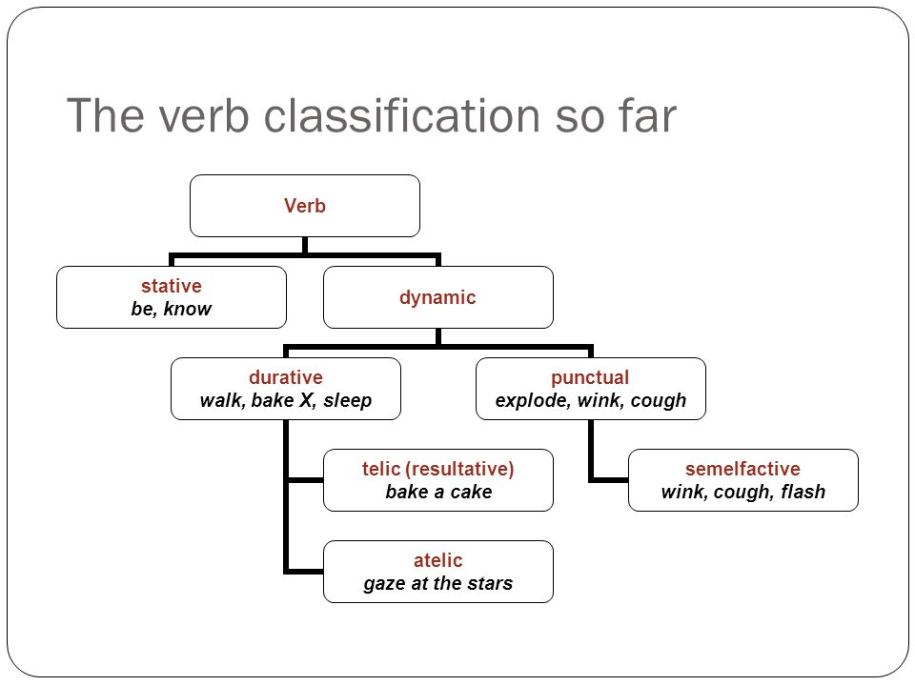
Compare to table 5.41

Slide 95
Vendler, 1967
States
Activities (unbounded processes)
Accomplishments (bounded processes)
Achievements (point events)
  Smith made this distinction:
Semeltfactives
Acievements

Slide 96
Tests for situation types
Or diagnostics (thesis)
Statives:
Only non-statives occur in the progressive
Similarly imperatives
Simple present verb forms (refer to current time of speaking with statives, but have habitual reading with non-statives)
Frame “what happened was…”
Less effective is the stative + complement “finish”.

Slide 97
More tests…
Duratives:
Between Achievement (telic) and activity (atelic) use “in + time period”
Similarly “for + time period”
Finish naturally occurs with accomplishments, not activity or achievement.
“almost” test for accomplishment will give two readings: the described event occurred but was not completed, and it has not occurred at all. Whereas activity and achievement types only have one reading.

Slide 98
“situation type is a characteristic of clauses rather than individual verbs.”
This can be seen in verbs shifting situation types.
  The soup cooled for ten minutes
  (Activity)
  The soup cooled in ten minutes
  (Accomplishment)

Slide 99
Tense
Tense locates a situation relative to some reference in time.
Tense is a deictic system (because the reference point is usually the act of speaking, the utterance).
Deictic systems show relation of space or time to “here and now”
Before… Over there…
3 common tenses in reference to “now”
Also possible to reference those times to a different point in time.

Slide 100
Relative past to past event
Relative past to future event
Tense systems vary from language to language
5.71 Chibemba
Reichenbach’s SRE system

Slide 101
Aspect
Tense and aspect are similar and interact in various ways but while tense shows when something happened, aspect shows various ways to view the event.
“Aspects have to do, not with the location of an event in time, but with its temporal distribution or contour.” (Hockett)
  John was eating a donut last night.
  John ate a donut last night.
Compare.

Slide 102
Comparing aspect across languages
Aspect is a feature of sentences, BUT
It’s usually marked on verbs
Perfective/imperfective is very common.
Comrie
C. S. Smith
Perfective focuses on the completed action (beginning and end)
Complete
Imperfective focuses on the middle leaving the end unspecified
Incomplete

Slide 103
Modality and Evidentiality
Modality is also sentence level
Lets a speaker express commitment to or belief in a proposition
Shannon has eaten the cake
“to the best of my knowledge” guarantee
Modal systems allow speakers to modulate this guarantee.
  The sentence can be embedded under higher clause with adj or adv of modality
  The verb itself can be changed (propositional attitude)
  Employ and auxiliary verb (or two in some dialects of English!) Modal verbs.

Slide 104
The modal verbs can show:
Epistemic modality (how certain you are about something)
  About the way the world is
Deontic modality (speaker’s attitude regarding social factors, obligation, responsibility, permission etc)
  About the speakers judgment
Deontics are tied up with speaker’s belief system.
Speakers can even use “epistemic modal to imply deontic” use
  You could have finished your homework on time.

Slide 105
“modality in general allows us to compare the real world with hypothetical versions of it.”
From possible world semantics (David Lewis)
This shows both epistemic and deontic modalities setting up hypothetical situations to varying degrees of certainty.
Relates to conditional sentences
Hypothetical and real
Many languages mark this grammatically: realis/irrealis
Which is called→ Mood

Slide 106
Mood
Indicative, conditional, potential, subjunctive, imperative, optative, jussive, concessive etc.

Slide 107
From Kroeger
Deontic vs. epistemic modality. Identify the type of modality in the following statements:
1. You must leave tomorrow.
2. You must have offended the Prime Minister very seriously.
3. You must be very patient.
4. You must use a Mac.
5. You must be using a Mac.

Slide 108
Evidentiality
Allows the reader to communicate attitude toward source of information
How certain they are about something they are saying.
English doesn’t encode this grammatically
Some languages do.
Some are optional
Some are obligatory
“Accuracy on the part of the speaker is a crucial element in the public reputation of individuals; misuse of data-source is somehow somewhat less than human, or insulting to the listener.” Hardman

Slide 109
Check Riemer
Suggest some criteria for determining parts of speech in English.
Consider the following test-frame for adverbs (Radford, 2004)
He treats her ______________
She behaved ____________
He worded the statement _____________
Does this work for all and only those words which we traditionally classify adverbs?

Slide 110
Two descriptions of future events:
Q: When are you flying/do you fly out?
A: I’m leaving/I leave next week.
Can you discern any regular semantic difference between the simple present and the continuous on the basis of this reply?

Slide 111
Thematic Roles
AGENT (sometimes under ACTOR)
PATIENT
THEME (sometimes these two are argued to be the same)
EXPERIENCER
BENEFICIARY
INSTRUMENT
LOCATION
GOAL
SOURCE
STIMULUS (FORCE)

Slide 112
Examples of thematic roles
AGENT (sometimes under ACTOR)
PATIENT
THEME (sometimes these two are argued to be the same)
EXPERIENCER
BENEFICIARY

Slide 113
Examples
INSTRUMENT
LOCATION
GOAL
SOURCE
STIMULUS (FORCE)

Slide 114
Tests for identifying thematic roles
AG: “deliberately, on purpose”
Frame for AC and PA

Slide 115
Verb “break”, (unlike “raise”) allows all three thematic roles
“This process of different roles occupying the subject position is a hierarchical process” (in many, if not all languages).
6.5
AGENT→ RECIP/BEN→ THEME/PAT → INSTR→ LOCATION
Leftmost elements are preferred/basic/expected
And
Rule of expectation, “if a language allows the LOC role to be subject, we expect it will allow all the rest.”
6.51 ff

Slide 116
Verbs and Thematic Role Grids
Verbs (like raise, rise, drive, put) have particular requirements for their thematic roles.
This is part of a speaker’s knowledge of the language and is expected to be a part of lexical information stored for verbs.
6.58 put V: <AGENT, THEME, LOCATION>
Underlined means typically subject of the verb
6.59 John_{AG} put the book_{TH} on the shelf_{LOC}
Not all nominals are arguments. We can use tests to identify them.
See 6.6 and 6.61

Slide 117
Make theta grids for:
1. receive
2. repair
3. snore

Slide 118
Answers:
John received a message on his phone.
1. receive V: <RECIPIENT, THEME, LOCATION>
Sue repaired the truck.
2. repair V: <AGENT, PATIENT>
Evelyn snored.
3. snore V: <EXPERIENCER>

Slide 119
Verbs form classes, which share the same role grids (theta grid, thematic role grid)
Give, lend, supply, pay, donate, contribute, are in a class of TRANSFER, or GIVING verbs and all follow:
V: <AGENT, THEME, RECIPIENT>
Or verbs like receive, accept, borrow, buy, purchase, rent, hire:
V: <AGENT, THEME, SOURCE>

Slide 120
Problems with Thematic Roles
Disagreement over terminology
Where to delimit theta roles?
Too specific and they lose utility
But if they are too general then how do we describe variations?
Also, what basis do we have for these theta roles? How do we define them?
Dowty defines them as entailments of the predicate
This gives us clusters of similar verbs, which Dowty says are not discrete or bounded but are prototypes with varying degrees of membership.
Proto-Agent and Proto-Patient

Slide 121
Chapter 7: Context and Inference
Speakers and hearers rely on context in constructing and interpreting the meaning of utterances.
Non-linguistic knowledge
Famous people, referent of pronouns (note on a scrap) (who is “her”?)
Pronouns are shorthand devices– point to something– contextually bound
Deictic, (to show or point out)
Moving into pragmatic aspects of meaning

Slide 122
Deixis—spatial deixis
Deictic devices “commit a speaker to set up a frame of reference.”
Every language carries an implicit division of
Space around speaker (adverbs of location)
Time relative to act of utterance (tense)
pronouns

Slide 123
Spatial deixis
English has binary opposition
Still relative to context (actual size of the area) (speaker doesn’t have to be there—maps)
Spanish has 3 terms, Tibetan, etc.
Hausa has 4 (also location of addressee) How would you translate that into English? Japanese also has reference to addressee.
Malagasy (6), Daga (vertical dimension, above, below, and same level)

Slide 124
Grammaticalization of context
If semantic distinctions are obligatory they are said to be grammaticalized.
Difference between ability to communicate these things (all languages) and it being obligatory (some languages)
Arabic—gender of addressee in first person pronouns
Japanese–-pronouns
Tibetan—honorifics (is this deixis? Why?)
We are more interested with “contextualized features grammaticalized in language

Slide 125
Extensions of spatial deixis
Other domains—discourse/textual deixis, time,
Sometimes called localism—general tendency to extend spatial terms to a range of other linguistic domains
Examples
Person deixis—grammaticalizes the roles of participants (speaker and addressee, and 3rd category for neither)
Examples

Slide 126
Social deixis—is when the pronominal system gives information about social identities or relationships.
Polite pronouns, different registers
Honorifics, humilifics etc. (not just pronouns in some languages! Even nouns and verbs can have multiple registers denoting social levels)

Slide 127
Reference and Context
Deictic expressions are dependent on context—but this is nothing special
Much of reference in language is the same
Shorthands
“a characteristic of normal language use: speakers calculate how much information their hearers need to make successful references, and where they can economize.” p196
Metonymy: referent identified by something associated with it.
Have you read Tolkien? Do you like Hayao Miyazaki?
Synecdoche: where the part stands for the whole.
My wheels. All hands on deck!
I want all eyes on me!

Slide 128
Conversational Implicature
H. Paul Grice
Grice’s Co-operative Principle
Make your contribution such as is required, at the stage at which is occurs, by the accepted purpose or direction of the talk exchange in which you are engaged.
A tacit agreement, allows for assumptions about each other’s goals and strategies.
Even when speaker and listener are at odds they usually co-operate on a communicative level.

Slide 129
Yesterday, at my house…
While Gabrielle was in my office playing a game on my phone…
Kelly: “Gabrielle, what are you doing?”
Gabrielle: “I’m in dad’s office.”
Discuss

Slide 130
From Kroeger, 155
A captain and his mate have a long-term quarrel. The mate drinks more rum than is good for him, and the captain is determined not to tolerate this behavior any longer. When the mate is drunk again, the captain writes in his logbook “Today, 11th October, the mate is drunk.” When the mate reads this entry during his next watch, he gets angry. Then, after a short moment of reflection, he writes in the logbook: “Today, 14th October, the captain is not drunk.”

Slide 131
Grice’s maxims of conversational cooperation
They are not rules like ones we see in phonology or syntax, but descriptive statements, phrased as injunctions.
THE MAXIM of QUALITY
Try to make your contribution on that is true, i.e.
1. Do not say what you believe is false
2. Do not say that for which you lack adequate evidence

Slide 132
More maxims…
MAXIM of QUANTITY
    1. Make your contribution as informative as is required (for the current purposes of the exchange)
    2. Do not make your contribution more informative than is required.
MAXIM of RELEVANCE (RELATION)
    Make your contributions relevant.

Slide 133
MAXIM of MANNER
Be perspicuous, and specifically:
    1. Avoid ambiguity
    2. Avoid obscurity
    3. Be brief
    4. Be orderly

Slide 134
These are all just assumptions that the listener has about the speaker, and may be wrong, but they are a baseline.
7.83
These implicatures are cancellable, or defeasible. More information may change their meaning.
This is quite different from entailments!
Who ate all the pizza? I ate one piece.

Slide 135
These implicatures are reinforcible without causing redundancy.
But entailments can seem redundant if reinforced.
I came first in the race and I won!
Particularized Conversational Implicatures (PCIs)
Where implicature is entirely context dependent
Generalized Conversational Implicatures (GCIs)
Implicature is more predictable and less context dependent. Can be overridden in context.

Slide 136
These maxims are basic assumptions, not rules, and can be broken.
If done so secretly, this is violating.
If done so overtly, for linguistic effect, this is flouting.
Irony can be seen as a flouting of the maxim of quality.
7.90, 7.91

Slide 137
Relevance Theory
Is a unification of Grice’s maxims into a single principle of relevance that motivates hearer’s inferential strategy
PRINCIPLE of RELEVANCE
Every act of ostensive communication communicates the presumption of its own optimal relevance. (Sperber and Wilson)
Ostensive communication is an interaction where the communicator wants to create a mutual environment of communication and this is understood by the hearer.

Slide 138
Lexical Pragmatics
“The linguistic form UNDERDETERMINES meaning
Contextual processes are REQUIRED to derive explicit content” p217
LP investigates how the meanings of words reflect or are adjusted to specific contexts.
Words have a basic semantic specification which is clarified by the context
Broadening examples
Narrowing examples

Slide 139
From Riemer
P118
A: Have you read Sebald?
B: I haven’t read the back of the cereal packet.
A: Do you know how to get to rue du Pasteur Wagner?
B: I’ve got a map in my bag.
A: Do you like anchovies?
B: Does a hippo like mud?

Slide 140
From Kroeger
What is the implicature?
I walked into a house.
Arthur is meeting a woman tonight.
I broke a finger yesterday.

Slide 141
Chapter 8: Functions of Language: Speech as Action
“Part of the meaning of an utterance is its intended social function.” p229
What do we use language for?
Ask questions
Give information
Make suggestions. Greet
Show social identity or register
Even enter binding agreements! Etc.

Slide 142
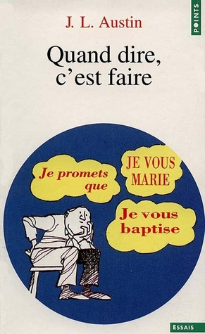

Slide 143

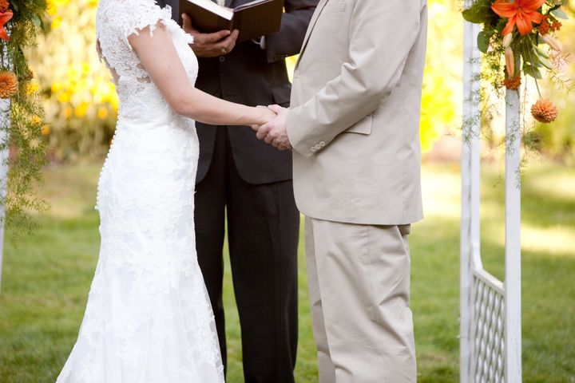

Slide 144
Speech acts
Those (and other) functions of language are called “speech acts”
From J. L. Austin’s famous lectures and text “How to do things with words.”
Study of speech acts is borderline (semantics/pragmatics) because:
Sometimes the function is linguistically encoded
And sometimes the function relies on other kinds of knowledge (social, general, etc.). So:
“hearer’s have to coordinate linguistic AND non-linguistic knowledge to interpret a speaker’s intended meaning.” p230

Slide 145
Two Important Characteristics (of SAs)
1. Interactivity
“communicating functions involves the speaker in a coordinated activity with other language users.”
Even in English many phrases have a conventional part A and a part B. In some languages it is more rigid.
What are some examples you can think of?
Betting, etc. Conversation Analysis (in discourse analysis)
2. Context dependence

Slide 146
Two Important Characteristics (of SAs)
1. Interactivity, failure results in a response (compensatory behavior).
2. Context dependence (also two parts)
  1. many SAs rely on social conventions (institutional facts)
  Can you think of any examples?
  I sentence you to…
  I now pronounce you…
  Only done by right people in correct situation
  2. context dependence depends on local context. Meaning may change from situation to situation. 8.3
  Video of Ron Swanson only answering your questions with questions…

Slide 147
Austin’s Speech Act Theory
J.L. Austin’s lectures made into “How to Do Things with Words” (1975).
Other important names: John R. Searle, Zwicky, Wierzbicka
Austin reacted to commonly held traditional ideas about language:
  A. Basic sentence type in language is declarative
  B. principle use of language is to describe how things are
  C. meaning of utterances is found in their truth or falsity.

Slide 148
Austin makes two observations
1. (Obviously) not all sentences are statements. Many are questions, exclamations, commands, expressions of wishes etc.
8.8
2. Even in sentences using the declarative form, they aren’t always just making statements.
8.9

Slide 149
Saying these kinds of sentences is arguably doing something! It is a kind of action.
Think about promises. You don’t just describe one. You do it. You make a promise.
Austin called these performatives.
We can insert the adverb “hereby” to make them even more explicit.
8.10, 8.11

Slide 150
Evaluating performative utterances
It isn’t useful to talk about whether these kinds of statements are true or false.
Austin used the terms felicitous or infelicitous to describe if they work.
So naming a ship that I don’t own that has already been named would be infelicitous.
Austin’s felicity conditions: 8.12

Slide 151
Explicit vs implicit performatives
Regular descriptions he called “constatives” but later said these are also a speech act, “stating”
No theoretical way to distinguish them,
So ALL utterances constitute speech acts (p 236)
This leads to 2 basic parts of meaning:
  1. conventional meaning of the sentence (proposition)
  2. speaker’s intended speech act

Slide 152
Three elements of speech acts
1. Speaker says something
  Locutionary act. The act of saying something which makes sense in a language
2. speaker signals an associated speech act
  Illocutionary act. This is what Austin and others mostly concerned with. The uses of language. The actual speech act.
3. speech act causes an effect on her listeners or the participants
  Perlocutionary act. Concerned with what follows the speech act. The effect.

Slide 153
Categorizing speech acts
Representatives
Directives
Commissives
Expressives
Declarations
8.19 (Searle, 1976)

Slide 154
From Riemer p 109
Locutionary act: the act OF saying something;
Illocutionary act: the act performed IN saying something;
Perlocutionary act: the act performed BY saying something.

Slide 155
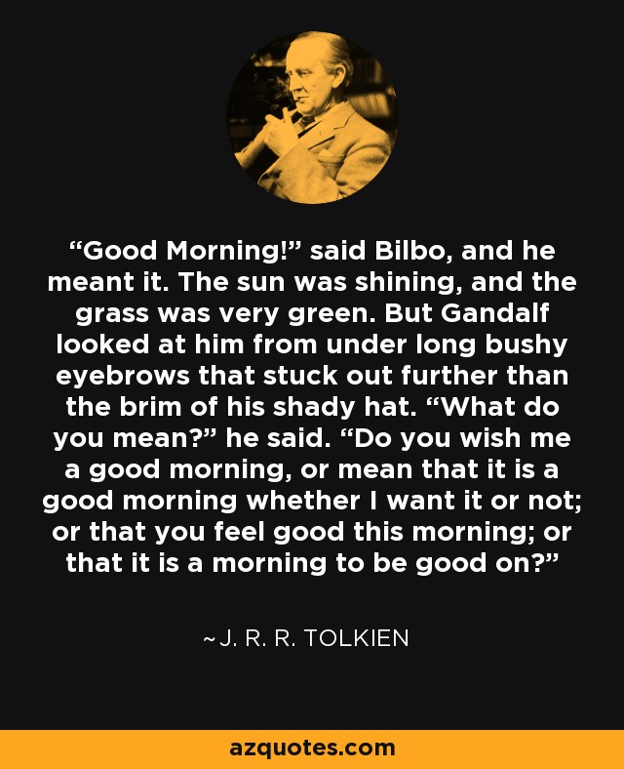
Direct and indirect speech acts
8.22
“good morning”
The Hobbit

Slide 156
Your blue pen is on the table.
You have many phone numbers on your cell phone.
Look at 8.23 ff.
How is it that these but not all nonliteral acts will work, that is, why is it that stating “Salt is made of sodium chloride” will not work as a request like “Can you pass the salt?”

Slide 157
Searle argues that other sentence types can only work as indirect requests when they address one of the conditions for requests.

Slide 158
Searle says we combine
1. the felicity conditions of direct speech acts
2. the context of the utterance
3. principles of conversational cooperation (such as Gricean maxims of relevance, quality etc.).

Slide 159
Face
“The public self image that every member of society wants to claim for himself.” (Brown and Levinson)
Two components:
Positive face (individual’s desire to seem worthy and deserving of approval)
Negative face (desire to be autonomous and unimpeded by others)
Threats to positive and negative face.

Slide 160
Sentence types
So how to we decide whether markers mark sentence type or some semantic category like mood?
8.5
OR, Does every classifier and negative morpheme in table 8.1 mark a distinct sentence type?
Only when it is regularly and conventionally matches a corresponding speech act.

Slide 161
Consider the following sentences. What illocutionary acts could they realize?
I’m glad you’re here.
Take your time.
I’m allergic to milk.
Was that the doorbell?
Don’t worry about putting away the rubbish.

