Slide 1
Semantics:
Translation (Loebner, Ch 8)
Week 10 (Loebner, Chapter 8)

Slide 2
Romans 8:15
For you did not receive the spirit of slavery to fall back into fear, but you have received the Spirit of adoption as sons, by who we cry, Abba! Father!”
Or
The verb “to dip”

Slide 3
Research Assignment
Due in 2 weeks! Have you done any work on it?
It is 25% of your grade
Look on your course outline

Slide 4
Ideas for things you could reference in your assignment
Literal and non-literal meaning
Figurative language (metaphor, irony, metonymy, synecdoche, hyperbole, litotes, etc.
Pragmatics
Compositional meaning
Concepts, mental representations, necessary and sufficient conditions,
Linguistic relativity
Familial terms, referents, prototypes,
Grammatical categories and lexical items, lexemes,
Ambiguity and vagueness,

Slide 5
more
Lexical relations of homonymy, polysemy, synonymy, etc.
Logic
Verbs and situation types
Deixis
Aspectual and tense differences
Evidentiality, honorifics,
Theta roles, voice etc.
Background and context, implicature, etc.
Speech acts and indirect speech acts
etc.

Slide 6
Quiz
1. Give an example of a speech act.
2. Austin called these kinds of sentences __________________.
3. A good test for those is the ________________ test.
4. Instead of calling these true or false they are evaluated as ____________ or _____________.
5. The three facets of a speech act are ___________________, _______________, and _______________________.
6. Positive face is ________________.
7. Negative face is _________________.

Slide 7
How can we explain the differences between languages?
Are languages essentially the same with minor differences?
OR
Are languages essentially different, with coincidental similarities?
RELATED to this:
Are all languages basically the same in level or complexity?
OR
Are some languages more difficult than others? Why? How?

Slide 8
In what ways can languages differ?
Of course vocabulary
Pronunciation (phonology)
Grammar (syntax)
Semantics
Pragmatics (especially how different utterances are interpreted in other cultures)
Writing system
Domain of use
Others?

Slide 9
Translation Problems
Not a 1 for 1 correspondence cross-linguistically.
In fact “semantic equivalence of two lexemes is the exception rather than the rule” (Loebner, 154)
One mismatch is when two words are only one word in the target language or when one word is two words in the target language. Give examples.
Another mismatch is to do with polysemy. It is rare to find a word which matches in all its senses or all its denotations. Give examples.
Most synonyms are partial synonyms.
Can you think of any words which would be exactly the same cross- linguistically?

Slide 10
And the correspondence (or lack of) goes even further…
Consider the differences in ‘eat’ and ‘drink’ in these languages (3)
What other simple difference can you think of?
In all these cases a proper term can be found in the target language to fit the term from the source language.
But…

Slide 11
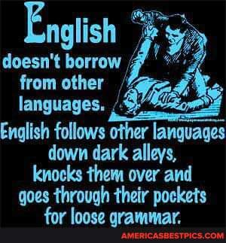

Slide 12
Borrowing in English
What languages has English borrowed from?
Give examples.

Slide 13
Borrowing
Often the term does not even exist in the target language.
Sometimes this is because the thing itself doesn’t exist in the target languages’ culture (and often this is the motivation for new terms being formed and lexical borrowing)

Slide 14
Lexical borrowing
Think of some borrowed words
Plants
Animals
Meals
Artefacts
Institutions etc.

Slide 15
Other kinds of borrowing?
What other kinds of linguistic borrowing are there?
Phonological
Grammatical
Semantic

Slide 16
This problem also happens in shared semantic areas
Discuss ‘work’ and play in English, German and Japanese.
Can you think of other examples?

Slide 17
Switching from sie to du (or other pronouns) in translations
Discuss examples (4) and (5) about Japanese.

Slide 18
Also grammar differences (obviously)
Different syntactic categories
Obligatory vs optional grammatical markings

Slide 19
Headache
Involves E (experiencer)
S (sensation)
B (body part)
English lumps S and B into one concept.
English puts it in a possessive construction.
So the B-S belongs to E.
Compare the cross-linguistic examples.

Slide 20
“Subjective sensations, like the feeling of pain, itch, appetite, grief or longing, only exist for the experiencer” (Loebner, 158)
Three ways to combine these semantic elements.
Examine Fig 8.1

Slide 21
How can you say someone else has a headache (in Japanese)? In Italian?

Slide 22
Evidentials
“The grammar of Japanese strictly distinguishes between statements that we are entitled to make on the basis of first-hand knowledge and statements for which we rely on second-hand evidence” (Loebner, 160)
“One can only say of something that it is oishii if one has actually tasted it.”
70+ adjectives that work this way.
Also related to V + want to construction.
I want to eat.
*Mary wants to eat.

Slide 23
What we can learn
This kind of grammar, in languages that have evidentiality, teaches us about “the nature of knowledge” in a way that we would not know from only studying English semantics.

Slide 24
Relativism and universalism
There are two extremes of the spectrum
The first is (linguistic) universalism
The second is (linguistic) relativism

Slide 25
Universalism
Says:
All languages adhere to the same grammar
This is UG (universal grammar)
Same basic structure at their core
Reflective of biology (basically the same) and cognition (also basically the same)
Part of our genetic makeup
Same kind of concepts and organization
Languages differ within a limited range of variation.

Slide 26
Relativism
Says:
Each language is different
Unique grammar, unique vocab (lexicon) which leads to
Unique way of talking about the world and
Unique set of concepts
So “each language represents AND causes a world view of its own”
Made famous by Edward Sapir and Benjamin Whorf

Slide 27
Look at Whorf’s quote on p162
Do you agree with this extreme?
Do you agree with universalism?
How far would you agree with either sides?

Slide 28
Think about how Japanese evidentials back up Whorf’s quote.
Think about cultural ranking in Japanese culture and linguistic factors that encourage this.
Can you think of other ways language limit or prescribe ways we talk or even think?
Think of western terms for “bra” or other taboo words. Circumlocution and euphemism etc.
However it can go too far. Does grammatical gender limit and prescribe the way Germans think of ‘government’ or ‘bananas’? Of course not.

Slide 29
The question(s) still remain(s)
How different are languages?
And do these differences (or similarities) reflect and limit ways of thinking?

Slide 30
Berlin and Kay’s investigation of color terms
Humans (with normal vision) can all see the same spectrum of colors.
There are no boundaries in the spectrum.
And yet each language has different terms.
Berlin and Kay studied about 100 languages and their respective color terms.
For 20 of those languages native speakers were actually interviewed
It was thought that each language differentiated parts of the color spectrum arbitrarily… but

Slide 31
What are BCTs
B&K investigated how many and which terms languages have, and the range these words cover on the spectrum.
This was limited only to BCTs (basic color terms).
BCTs are “not subordinates of other colour terms”
BCTs are “not compounds or derivations”
BCTs are “not restricted to a narrow class of objects”
BCTs are “psychologically salient” (“tend to occur at the beginning of elicited color lists”)
BCTs are “stable across speakers and situations”
Berlin and Kay also excluded recent loan words, and words derived from object known for that color.

Slide 32
Informants agreed on focal points of the color terms but disagreed on boundary edges.
Cross linguistic variation in number of BCTs (from 2-11)

Slide 33
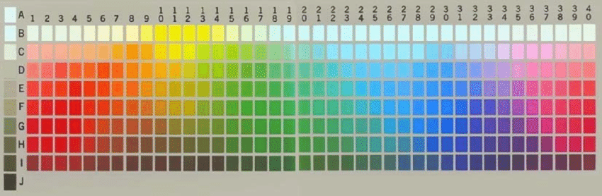
Which are the best representatives?

Slide 34
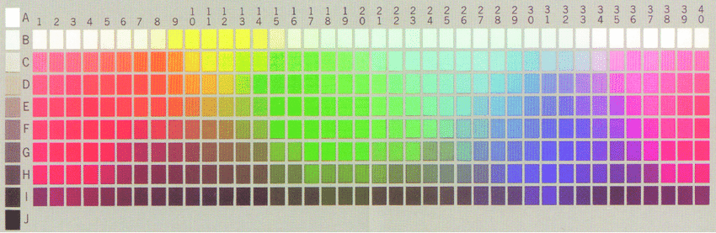
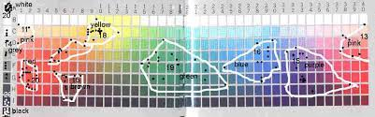
Munsell colour chart used by Berlin and Kay

Slide 35
But is this representative of how we use color terms?
Lucy claims that we rarely use color terms in the context of an abstract exercise in hue naming (1997).
What are some contexts you use color naming?
Lucy criticized B&K saying that their methodology artificially constituted color as a category without thinking about actual context uses and considering other uses of color terms.
Is this a valid criticism?

Slide 36
Informants encircled where they thought the colors were and also chose the focus point of the most prototypical color.
“Findings show the BCT systems are far from arbitrary”
Many subsequent studies slightly revised the results.
For example Russian has 12 BCTs!

Slide 37
What does this prove?
Relativisms or universalism?
Remember that color terms are different from other lexical terms.
Does it prove anything about the larger argument?
“Relativism is certainly right in emphasizing the differences between languages.” Do you agree?
“…trying to satisfy the universalist by finding a common denominator that makes comparison possible. After all, it must exist, because otherwise we would not have been able to grasp the differences with our one and only mind.” Do you agree?

Slide 38
Homework
Do 1 (8pts) 2 (8pts), 3 (4pts), 4 (20pts), and 6 (10pts).
Total 50 (3 percent of grade).

Slide 39
Come and Go
What kind of verbs are these?
Explain how they are deictic.
Does ‘go’ show any non-deictic motion senses in English?

Slide 40
Today is…
NO PANTS DAY…
Define ‘pants’
Compare and contrast ‘pants’ with similar words
Reference the –nyms…
Prototype of ‘pants’
Collocations?
Put ‘pants’ in different theta roles.
Tests? Hereby, zeugma, V easily etc?

Slide 41
Questions to discuss
What is the full set of BCTs of English, according to the criteria we looked at?
Consider and compare cross linguistic variation in body part terms.
When does a specialized color term become a BCT?

