Slide 1
Semantics:
Functions of language
Speech as action
Week 9 (Chapter 8)

Slide 2
Quick Review
Chapter 1: semantics, semiotics, definitions theory, utterance, propositions, reference, sense, pragmatics, sentence vs speaker meaning.
Chapter 2: denoting, referring, non-referring, constant vs variable, referents and extensions, names, Ns and NPs, mental representation, concepts, necessary and sufficient conditions, prototypes, linguistic relativity,
Chapter 3: word meaning, lexemes, wordhood, Zeugma, sense relations, lexical relations of homonymy, polysemy, synonymy, antonymy, hyponymy, meronymy, derivations, color terms, etc.
Chapter 4
Chapter 5
Chapter 6

Slide 3
Quiz
1. Name 3 kinds of deixis.
2. What does it mean to say something is semantically grammaticalized?
3. Give an example of synecdoche.
4. Give an example of metonymy.
5. What does a topicalizer do, and how would you translate it in English?
6. What are “bridging inferences”? Give an example.
7. Name the four Maxims of Conversational Cooperation.
8. What is the difference between violating and flouting (the maxims)?
9. In lexical pragmatics what is broadening?
10. In lexical pragmatics what is narrowing?

Slide 4
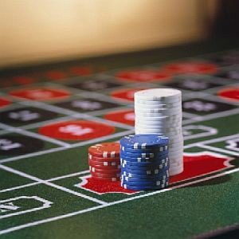

Slide 5
Chapter 8: Functions of Language: Speech as Action
“Part of the meaning of an utterance is its intended social function.” p229
What do we use language for?
Ask questions
Give information
Make suggestions. Greet
Show social identity or register
Even enter binding agreements! Etc.

Slide 6
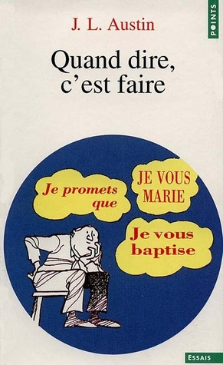

Slide 7

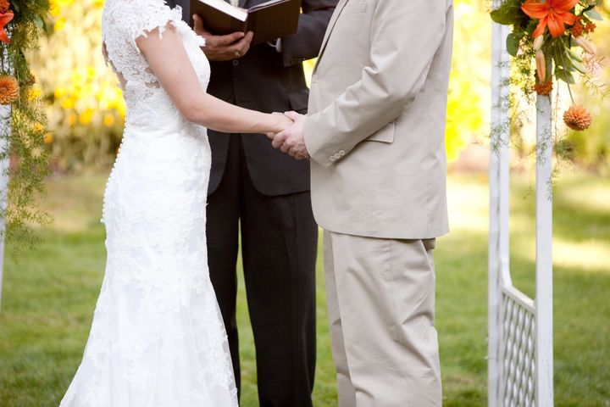

Slide 8
Speech acts
Those (and other) functions of language are called “speech acts”
From J. L. Austin’s famous lectures and text “How to do things with words.”
Study of speech acts is borderline (semantics/pragmatics) because:
Sometimes the function is linguistically encoded
And sometimes the function relies on other kinds of knowledge (social, general, etc.). So:
“hearer’s have to coordinate linguistic AND non-linguistic knowledge to interpret a speaker’s intended meaning.” p230

Slide 9
Two Important Characteristics (of SAs)
1. Interactivity
“communicating functions involves the speaker in a coordinated activity with other language users.”
Even in English many phrases have a conventional part A and a part B. In some languages it is more rigid.
What are some examples you can think of?
Betting, etc. Conversation Analysis (in discourse analysis)
2. Context dependence

Slide 10
Two Important Characteristics (of SAs)
1. Interactivity, failure results in a response (compensatory behavior).
2. Context dependence (also two parts)
  1. many SAs rely on social conventions (institutional facts)
  Can you think of any examples?
  I sentence you to…
  I now pronounce you…
  Only done by right people in correct situation
  2. context dependence depends on local context. Meaning may change from situation to situation. 8.3
  Video of Ron Swanson only answering your questions with questions…

Slide 11
Be careful about terminology and form
Conventional forms may be used for other speech acts (like a question for a positive answer meaning “yes, of course.”
Both the INTERACTIVITY and CONTEXT DEPENDENCE of SAs show the union of linguistic and social behavior.

Slide 12
Austin’s Speech Act Theory
J.L. Austin’s lectures made into “How to Do Things with Words” (1975).
Other important names: John R. Searle, Zwicky, Wierzbicka
Austin reacted to commonly held traditional ideas about language:
  A. Basic sentence type in language is declarative
  B. principle use of language is to describe how things are
  C. meaning of utterances is found in their truth or falsity.

Slide 13
These assumptions were held by a group called the logical positivists.
One important issue for them was “how far the meaning of a sentence is reducible to its verifiability.”
Or, how far can we show a statement is true or false.
Austin objected with common sense, that “language is used for far more than making statements and that for the most part utterances cannot be said to be either true or false.”

Slide 14
Austin makes two observations
1. (Obviously) not all sentences are statements. Many are questions, exclamations, commands, expressions of wishes etc.
8.8
2. Even in sentences using the declarative form, they aren’t always just making statements.
8.9

Slide 15
Saying these kinds of sentences is arguably doing something! It is a kind of action.
Think about promises. You don’t just describe one. You do it. You make a promise.
Austin called these performatives.
We can insert the adverb “hereby” to make them even more explicit.
8.10, 8.11

Slide 16
Evaluating performative utterances
It isn’t useful to talk about whether these kinds of statements are true or false.
Austin used the terms felicitous or infelicitous to describe if they work.
So naming a ship that I don’t own that has already been named would be infelicitous.
Austin’s felicity conditions: 8.12

Slide 17
Explicit vs implicit performatives
Regular descriptions he called “constatives” but later said these are also a speech act, “stating”
No theoretical way to distinguish them,
So ALL utterances constitute speech acts (p 236)
This leads to 2 basic parts of meaning:
  1. conventional meaning of the sentence (proposition)
  2. speaker’s intended speech act

Slide 18
Three elements of speech acts
1. Speaker says something
  Locutionary act. The act of saying something which makes sense in a language
2. speaker signals an associated speech act
  Illocutionary act. This is what Austin and others mostly concerned with. The uses of language. The actual speech act.
3. speech act causes an effect on her listeners or the participants
  Perlocutionary act. Concerned with what follows the speech act. The effect.

Slide 19
Categorizing speech acts
Representatives
Directives
Commissives
Expressives
Declarations
8.19 (Searle, 1976)

Slide 20
From Riemer p 109
Locutionary act: the act OF saying something;
Illocutionary act: the act performed IN saying something;
Perlocutionary act: the act performed BY saying something.

Slide 21
Searle’s criteria
1. illocutionary point: purpose or aim,
2. fit: direction of the relationship between language and the world
3. psychological state: speaker’s state of mind or attitude
4. content: restrictions placed on speech acts by what they are about, their propositional content, promise or threat, beneficial or harmful etc.

Slide 22
Preparatory
Propositional
Sincerity
Essential
8.20
8.21

Slide 23
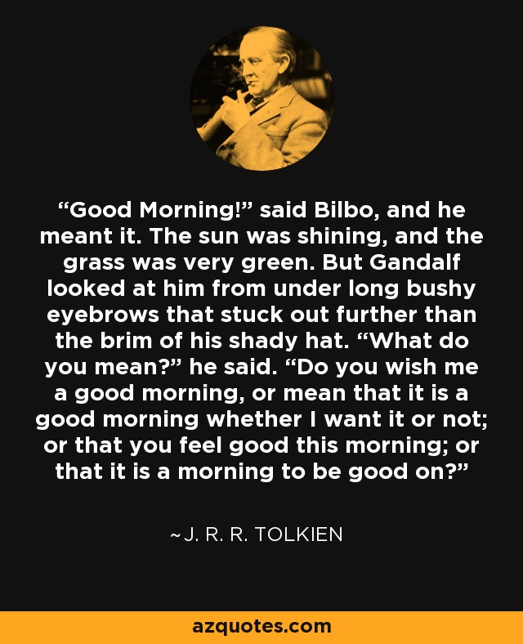
Direct and indirect speech acts
8.22
“good morning”
The Hobbit

Slide 24
Your blue pen is on the table.
You have many phone numbers on your cell phone.
Look at 8.23 ff.
How is it that these but not all nonliteral acts will work, that is, why is it that stating “Salt is made of sodium chloride” will not work as a request like “Can you pass the salt?”

Slide 25
Searle argues that other sentence types can only work as indirect requests when they address one of the conditions for requests.

Slide 26
Searle says we combine
1. the felicity conditions of direct speech acts
2. the context of the utterance
3. principles of conversational cooperation (such as Gricean maxims of relevance, quality etc.).

Slide 27
How does all this relate to politeness?
Indirect speech acts versus direct speech acts AND politeness
What do you think?
“In directives, politeness is the chief motivation for indirectness” (Searle)
“Speakers do calculate issues of social power and politeness in framing speech acts.” (Ervin-Tripp)
Examine page 243

Slide 28
Face
“The public self image that every member of society wants to claim for himself.” (Brown and Levinson)
Two components:
Positive face (individual’s desire to seem worthy and deserving of approval)
Negative face (desire to be autonomous and unimpeded by others)
Threats to positive and negative face.

Slide 29
face
“In the continual interactive balancing of one’s own and other’s faces, politeness serves to diminish potential threats.” p244
One way to do this is to use indirect speech acts.
There is cross cultural variation, but the notion of “face” is universal.
Some systems tend more towards positive while others tend to negative face.

Slide 30
Sentence types
So how to we decide whether markers mark sentence type or some semantic category like mood?
8.5
OR, Does every classifier and negative morpheme in table 8.1 mark a distinct sentence type?
Only when it is regularly and conventionally matches a corresponding speech act.

Slide 31
Summary
The social function of an utterance is an important part of its meaning.
JL Austin’s theory of speech acts
Things like requesting, questioning, promising, thanking, stating (less formalized) and pronouncing sentences, performing ceremonies, baptizing, marrying etc. (more formalized speech acts).
Illocutionary force
Roles of markers in grammar relating to speech acts and sentence types

Slide 32
Homework
8.1-8.4, 8.6-8.8,
Also two phrases/sentences in other languages which are performatives. What is the literal meaning? What do they do? When do people say this sentence. Is the sentence type and the speech act type the same? 3 points each.
Total: /45

Slide 33
In class questions

Slide 34
Your assignment?

Slide 35
From Riemer, p110
Consider the following sentences. Label them performative (P), possibly performative (PP) or never performative (NP)
I resign
I’m resigning
A poet is chairman of the Australian Tax Research Foundation
Bali is not the same as Mali.
I resigned ten minutes ago.

Slide 36
More…
I’m telling you not to try sour herring.
You’re not allowed to smoke here.
We had a lovely time.
The storeroom is out of bounds
There’s nothing more I can do to help you.
I don’t accept that argument.
Bingo!
The audience are asked to turn off their mobile phones.

Slide 37
More…
I believe it’s important to be ethical.
I believe in Hinduism.
I guarantee you’re going to love this!
Can I help you?
For an introduction to Relevance Theory, Blakemore (1992) can be recommended.

Slide 38
Consider the following sentences. What illocutionary acts could they realize?
I’m glad you’re here.
Take your time.
I’m allergic to milk.
Was that the doorbell?
Don’t worry about putting away the rubbish.

Slide 39
Tea
How many ways of asking for tea can you think of? Discuss and order them.

Slide 40
Very good section in Kroeger p179ff

