Slide 1
Semantics
Week 5, Chapter 5

Slide 2
Review Quiz
1. Define logic.
2. What is the difference between entailment and presupposition?
3. What is the difference between a priori and a postiori knowledge?
4. Necessary and contingent truth?
5. Analytic and synthetic truth?
6. All, every, each, some, one are kinds of _______________

Slide 3
Chapter Five: Sentence Semantics 1, Situations
We’ve already looked at aspects of word meaning.
Now we will look at aspects of sentence meaning.
One such aspect is tense.
Marking varies from language to language
Situation type
Tense
Aspect
Mood (modality)
Evidentiality

Slide 4
3 important dimensions
Situation type
Tense
Aspect

Slide 5
Situation types
Situation type is label for the typology of situations encoded in the semantics of a language.
Example: states
Mike likes sushi.
Contrasted with dynamic situations
Joe is learning Tae Kwon Do.
Reflected in choice of lexical items. (English → adjectives for ____, verbs for _____)

Slide 6
But there are also stative verbs
Be, have, remain, know, love etc.
Adjectives and stative verbs are inherently static.
It is a part of their lexical semantics to portray a static situation type.
SLPs and ILPs
Tense– in relation to now.
Aspect—more the internal temporal nature of situation, how it is/was happening.
Eg. completed, ongoing process, unfinished etc.

Slide 7
Riemer, 314
Tenses are about the event IN time.
(whether it is located in the past, present or future)
Where it is in time…
Aspect are about time moving through the event.
They’re about time IN the event.

Slide 8
Verbs and situation types
So, we see that certain lexical categories (verbs) inherently describe situation types (states or dynamic processes or events)

Slide 9
Stative Verbs
Steady state
No internal phases or changes
Speaker does not focus overtly on the beginning or end of the state
Mike hated speaking in public
Mike learned to speak in public

Slide 10

Two helpful tests…

Slide 11
Some grammatical differences
I am learning Dutch
*I am knowing Dutch
But …
I’m loving it.

Slide 12
That was with –ing also with imperatives
Learn Dutch!
?Know Dutch!
?Hate Dutch!
but
Love me!
Realize ___
Know the author’s ____
Fear the lord!

Slide 13
The answer remains the same.
*The answer is remaining the same.
Remain at your posts!
(remember we can learn a lot about the language by strange and also ungrammatical examples! Always try to think this way and come up with good and bad examples).

Slide 14
Of course the verbs may have different meanings (stative or dynamic)
Have 5.23

Slide 15
Dynamic Verbs
Durative—lasts for a period of time
  John slept
Punctual—instantaneous, almost no time, also semelfactive
  John coughed. Flash, shoot, knock, sneeze, blink
  Semelfactive verb + durative adverbial= iterative interpretation
  Fred coughed all night.
  Cf. Fred slept all night.
Telic (bounded)
Atelic (unbounded)

Slide 16
Telic (bounded) vs atelic (unbounded)
Telic– processes that are seen as having a natural completion.
Harry was building a raft.
Harry was gazing at the sea.
  Interrupt these processes
  Harry gazed at the sea.
  OK
  Harry built a raft. MAYBE.
  We don’t know if he finished.

Slide 17
Combinations can change atelic to telic

Slide 18
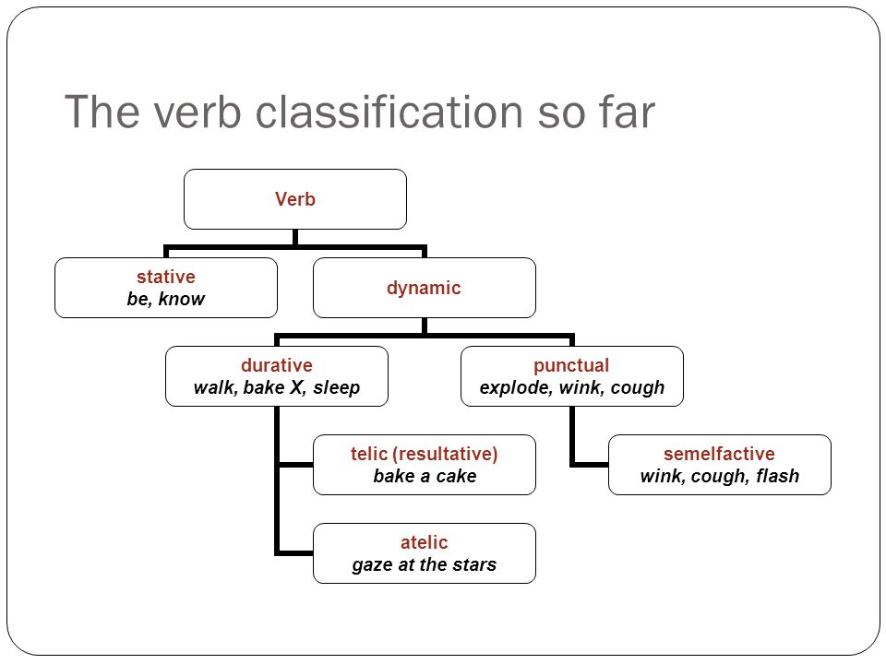
Compare to table 5.41

Slide 19
“Speakers (unconsciously?) use their knowledge of these semantic distinctions… to draw distinctions of situation type.” p118
“The task for semanticists is to show how the inherent semantic distinctions carried by verbs, and verb phrases, map into a system of situation types.” p119

Slide 20
Vendler, 1967
States
Activities (unbounded processes)
Accomplishments (bounded processes)
Achievements (point events)
  Smith made this distinction:
Semeltfactives
Acievements

Slide 21
Smith’s table, 5.44

Slide 22
Frankie cycled IN the park.
Frankie cycled TO the park.
Alexander built a bridge.
Alexander built bridges.

Slide 23
Tests for situation types
Or diagnostics (thesis)
Statives:
Only non-statives occur in the progressive
Similarly imperatives
Simple present verb forms (refer to current time of speaking with statives, but have habitual reading with non-statives)
Frame “what happened was…”
Less effective is the stative + complement “finish”.

Slide 24
More tests…
Duratives:
Between Achievement (telic) and activity (atelic) use “in + time period”
Similarly “for + time period”
Finish naturally occurs with accomplishments, not activity or achievement.
“almost” test for accomplishment will give two readings: the described event occurred but was not completed, and it has not occurred at all. Whereas activity and achievement types only have one reading.

Slide 25
“situation type is a characteristic of clauses rather than individual verbs.”
This can be seen in verbs shifting situation types.
  The soup cooled for ten minutes
  (Activity)
  The soup cooled in ten minutes
  (Accomplishment)

Slide 26
Tense
Tense locates a situation relative to some reference in time.
Tense is a deictic system (because the reference point is usually the act of speaking, the utterance).
Deictic systems show relation of space or time to “here and now”
Before… Over there…
3 common tenses in reference to “now”
Also possible to reference those times to a different point in time.

Slide 27
Relative past to past event
Relative past to future event
Tense systems vary from language to language
5.71 Chibemba
Reichenbach’s SRE system

Slide 28
Aspect
Tense and aspect are similar and interact in various ways but while tense shows when something happened, aspect shows various ways to view the event.
“Aspects have to do, not with the location of an event in time, but with its temporal distribution or contour.” (Hockett)
  John was eating a donut last night.
  John ate a donut last night.
Compare.

Slide 29
Tense/aspect in English
Can you think of more English examples?
126-128

Slide 30
Comparing aspect across languages
Aspect is a feature of sentences, BUT
It’s usually marked on verbs
Perfective/imperfective is very common.
Comrie
C. S. Smith
Perfective focuses on the completed action (beginning and end)
Complete
Imperfective focuses on the middle leaving the end unspecified
Incomplete

Slide 31
It is very difficult to characterize a typical aspectual system.
Different ways of marking aspect
Different kinds of aspect

Slide 32
Combining situation type and aspect
Each language has constraints when combining situation types, tenses and aspects.
“Speakers know the valid combinations and the semanticist’s task is to reflect this knowledge.”
An example: progressive (continuous tense)/imperfective does not combine with stative situation types in English.
In French this is fine.
The semanticist needs to describe what available choices a speaker has and what the differences are.

Slide 33
Differences in terminology
This is a very complex area of linguistics
And differences in terminology make it even harder!
Literature review is important!
Three dimensions:
  1. real situations
  2. the situation types lexically coded in languages
  3. ways of viewing these situation types in terms of their internal structure (focus on beginning, middle or end phases).

Slide 34
Modality and Evidentiality
Modality is also sentence level
Lets a speaker express commitment to or belief in a proposition
Shannon has eaten the cake
“to the best of my knowledge” guarantee
Modal systems allow speakers to modulate this guarantee.
  The sentence can be embedded under higher clause with adj or adv of modality
  The verb itself can be changed (propositional attitude)
  Employ and auxiliary verb (or two in some dialects of English!) Modal verbs.

Slide 35
The modal verbs can show:
Epistemic modality (how certain you are about something)
  About the way the world is
Deontic modality (speaker’s attitude regarding social factors, obligation, responsibility, permission etc)
  About the speakers judgment
Deontics are tied up with speaker’s belief system.
Speakers can even use “epistemic modal to imply deontic” use
  You could have finished your homework on time.

Slide 36
“modality in general allows us to compare the real world with hypothetical versions of it.”
From possible world semantics (David Lewis)
This shows both epistemic and deontic modalities setting up hypothetical situations to varying degrees of certainty.
Relates to conditional sentences
Hypothetical and real
Many languages mark this grammatically: realis/irrealis
Which is called→ Mood

Slide 37
Mood
Indicative, conditional, potential, subjunctive, imperative, optative, jussive, concessive etc.

Slide 38
From Kroeger
Deontic vs. epistemic modality. Identify the type of modality in the following statements:
1. You must leave tomorrow.
2. You must have offended the Prime Minister very seriously.
3. You must be very patient.
4. You must use a Mac.
5. You must be using a Mac.

Slide 39
Evidentiality
Allows the reader to communicate attitude toward source of information
How certain they are about something they are saying.
English doesn’t encode this grammatically
Some languages do.
Some are optional
Some are obligatory
“Accuracy on the part of the speaker is a crucial element in the public reputation of individuals; misuse of data-source is somehow somewhat less than human, or insulting to the listener.” Hardman

Slide 40
How do evidentials (obligatory or optional) relate to Bible translation (or any translation)?

Slide 41
Class Exercises
For homework do the exercises at the end of the chapter.
You can skip 5.4, 5.7 and 5.9
We might do these in class.
It is out of 75

Slide 42
Check Riemer
Suggest some criteria for determining parts of speech in English.
Consider the following test-frame for adverbs (Radford, 2004)
He treats her ______________
She behaved ____________
He worded the statement _____________
Does this work for all and only those words which we traditionally classify adverbs?

Slide 43
Two descriptions of future events:
Q: When are you flying/do you fly out?
A: I’m leaving/I leave next week.
Can you discern any regular semantic difference between the simple present and the continuous on the basis of this reply?

Slide 44
Sometimes the present tense is used for past time situations: “I hear you’re getting married; Glen tells me you’ve been sacked.” Are there other examples like this? Can you explain this use of the present?

Slide 45
More from Riemer
The following sentences seem to be exceptions to the principle that states do not occur in the progressive. Can we explain them in some way?
A. You’re looking well today.
B. I’m living in Australia now.
C. I was feeling good that morning.
D. Jones is sitting on his horse right in front of her.
E. Another week passed and even the missionaries were enjoying the voyage.
F. I’m hoping you’ll be able to join us for dinner tonight.
G. I’m wondering what to do about the twins.

Slide 46
Epistemic vs deontic modality. (Kroeger)
For each of the sentences below, describe two contexts: one where the modal would most likely have an epistemic reading, the other where the modal would most likely have a deontic reading:
1. Arnold must not recognize me.
2. Henry ought to be in his office by now.
3. Baxter may support Suharto.
4. George should be working late tonight.
5. You have to know how to drive.

