Slide 1
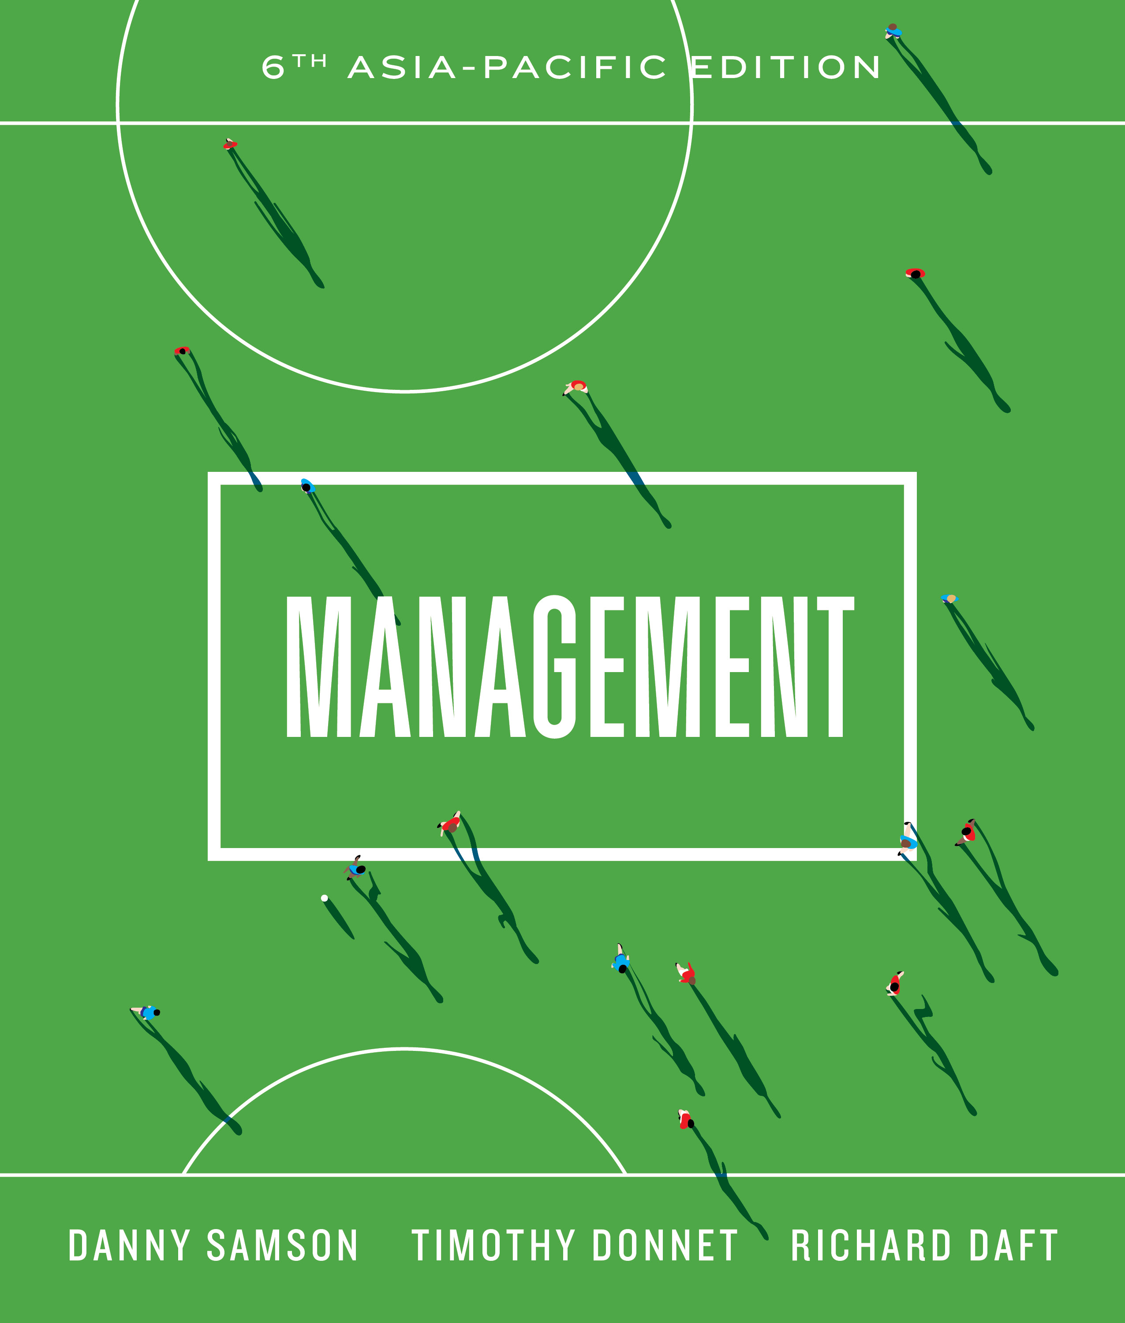

Slide 2
_{Chapter} ₅
Ethics, social responsibility and sustainable development

Slide 3
WHAT IS Managerial ethics?
Refers to the code of moral principles and values that governs managerial behaviour and decision making
Economic pressures can muddy ethical waters for managers
Simply acting within the law does not constitute ethical behaviour

Slide 4
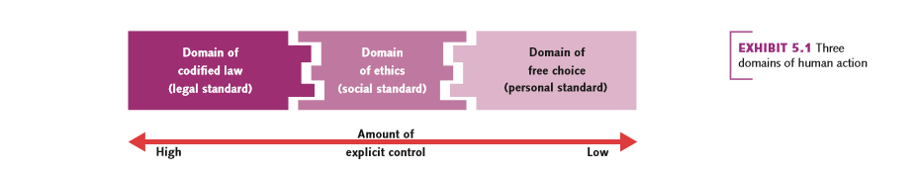
Three domains of human action

Slide 5
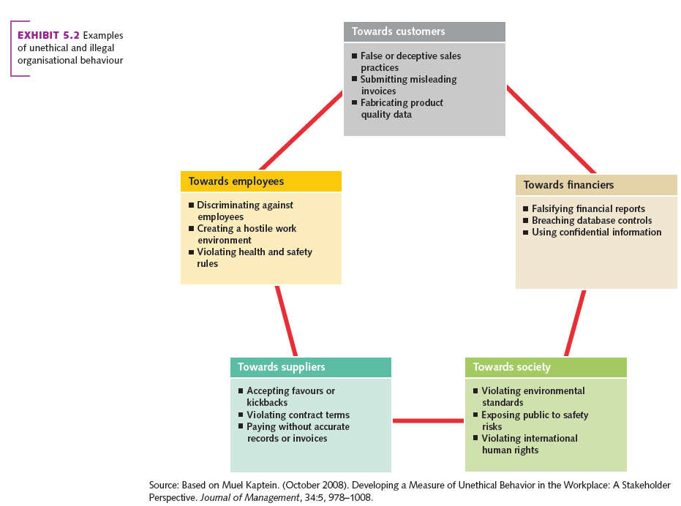
Examples of unethical and illegal organisational behaviour

Slide 6
ETHICAL DILEMMAS – WHAT WOULD YOU DO?
Being ethical is always about making decisions
Some ethical issues are difficult to resolve
An ethical dilemma arises in a situation in which:
  each alternative choice or behaviour is undesirable because of potentially harmful ethical consequences, AND
  right and wrong cannot always be clearly or crisply identified

Slide 7
Criteria for ethical decision making
Different approaches possible including:
Utilitarian approach
Individualism approach
Moral rights approach
Justice approach

Slide 8
Utilitarian approach
The ethical concept that moral behaviour produces the greatest good for the greatest number
Using simple economic costs and benefits to help make decisions.

Slide 9
Individualism approach
The ethical concept that acts are moral when they promote the individual’s best long-term interests, which ultimately leads to greater good
Often perceived as gratifying immediate self-interest
Promotes behaviour towards others that fits standards of behaviour that people want shown towards themselves

Slide 10
Moral rights approach
The ethical concept that moral decisions are those that best maintain the rights of those people affected by them
People have fundamental rights and liberties that cannot be taken away such as:
  The right to free consent
  The right to freedom speech

Slide 11
Justice approach
The ethical concept that moral decisions must be based on standards of equity, fairness and impartiality
Concepts of:
  Distributive justice: Different treatment of people not be based on arbitrary characteristics
  Procedural justice: Requires rules be administered fairly
  Compensatory justice: Compensation for the cost of their injuries by the party responsible

Slide 12
Practical approach
Decisions based on prevailing standards of the profession and larger society, taking the interests of all stakeholders into account
Side-steps the question of right, good or just

Slide 13
The individual manager and ethical choices
Influenced by several factors
One model suggests levels of moral development:
  Pre-conventional
    Follows rules to avoid punishment, acts in own interests and obedience for its own sake
  Conventional
    Lives up to expectations of others, fulfils duties and obligations of social system and upholds laws
  Post-conventional
    Follows self-chosen principles of justice and right, aware of differences and balances concern for individual with concern for common good

Slide 14
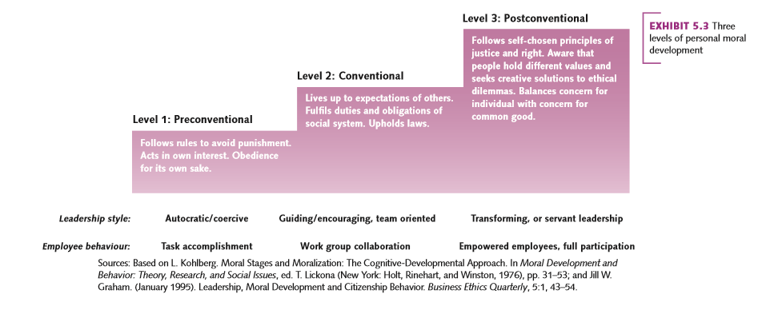
Three levels of personal development

Slide 15
WHAT IS Corporate social responsibility?
CSR: the obligation of organisation management to make decisions and take actions that will enhance the welfare and interests of society as well as the organisation
View organisation as having internal and external stakeholders
Careful balancing of stakeholder needs

Slide 16
Organisational stakeholders
Refers to individuals and groups that have a stake in the organisation’s performance
Organisations can use stakeholder mapping to identity stakeholders’ needs and expectations

Slide 17
The green movement
Going green is a new business imperative
Economic development that generates wealth and meets the needs of the current population while preserving the environment for the needs of future generations contributes to sustainability
Many companies have embraced triple bottom line

Slide 18
Evaluating corporate social responsibility
One model suggests using several criteria including:
Economic responsibility
Legal responsibility
Ethical responsibility
Discretionary responsibility

Slide 19
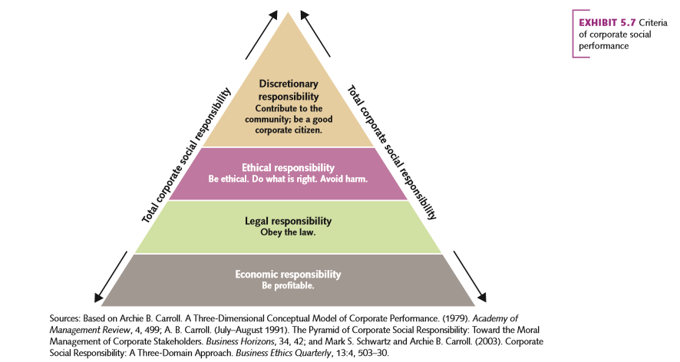
Criteria of corporate social performance

Slide 20
Managing company ethics and social responsibility
Various ways managers can create an ethical climate including:
Ethical leadership
Codes of ethics
Ethical structures
Supporting whistle-blowers

Slide 21
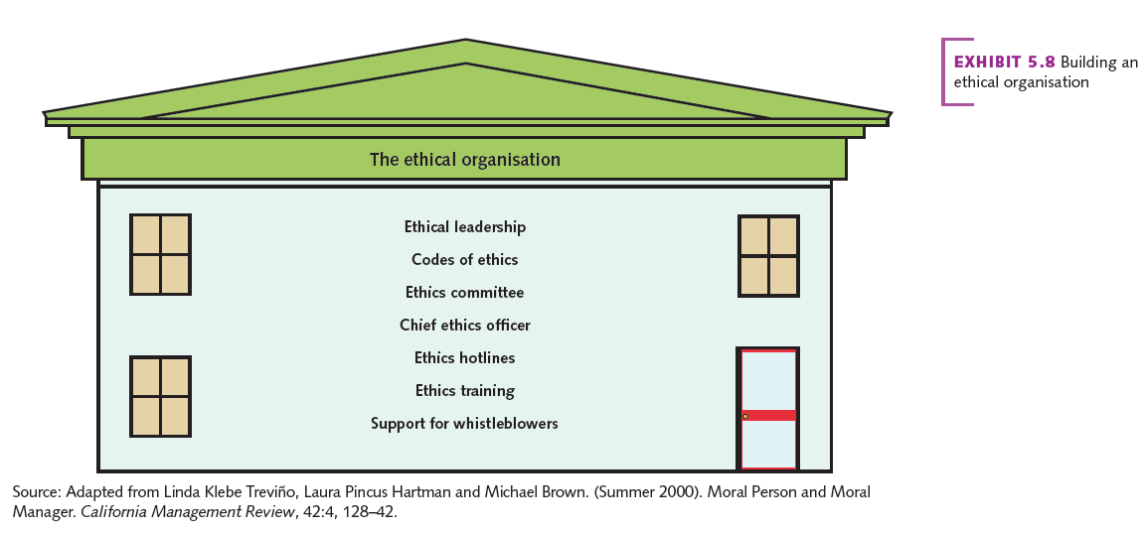
Building an ethical organisation

Slide 22
The business case for ethics and social responsibility
Paying attention to ethics and social responsibility as important as economic ends
Companies are making efforts to measure non-financial factors:
  People prefer to work for sustainable companies
  Customers also prefer to buy from organisations that are seen to be ethical

Slide 23
The why of sustainable development
Being seen as being sustainable is as important as being sustainable
Guiding principles of a sustainable orientation:
  Breadth of vision
  Stakeholder empowerment
  Being progressive

Slide 24
The what of sustainable development
Three generic strategic requirements:
Stakeholder support
Efficiency
Market edge

Slide 25
The when of sustainable development
Sustainability contributes to long-term success of an organisation
Sustainable practices are most effective when they:
  Are strategically congruent with the business
  Achieve genuine improvements in development outcomes
  Are mature, leading-edge approaches that offer best value
  Are well integrated with other business practices

Slide 26
Taking managerial action on sustainable development
There is no one single formula that connects sustainable development practices to business success
BUT sustainable development practices create business advantage and innovation

Slide 27
Successful companies
  Review, recognise & acknowledge sustainability orientation as an integral part of strategy and culture
  Canvass for sustainable development
  Analyse the potential for sustainable development practices to contribute to strategic business requirements

Slide 28
Successful companies
  Choose, develop & implement their unique set of practices
  Measure, adapt, review and extend sustainable practices within an evolving business environment, strategy, culture & business practice set

