Slide 1
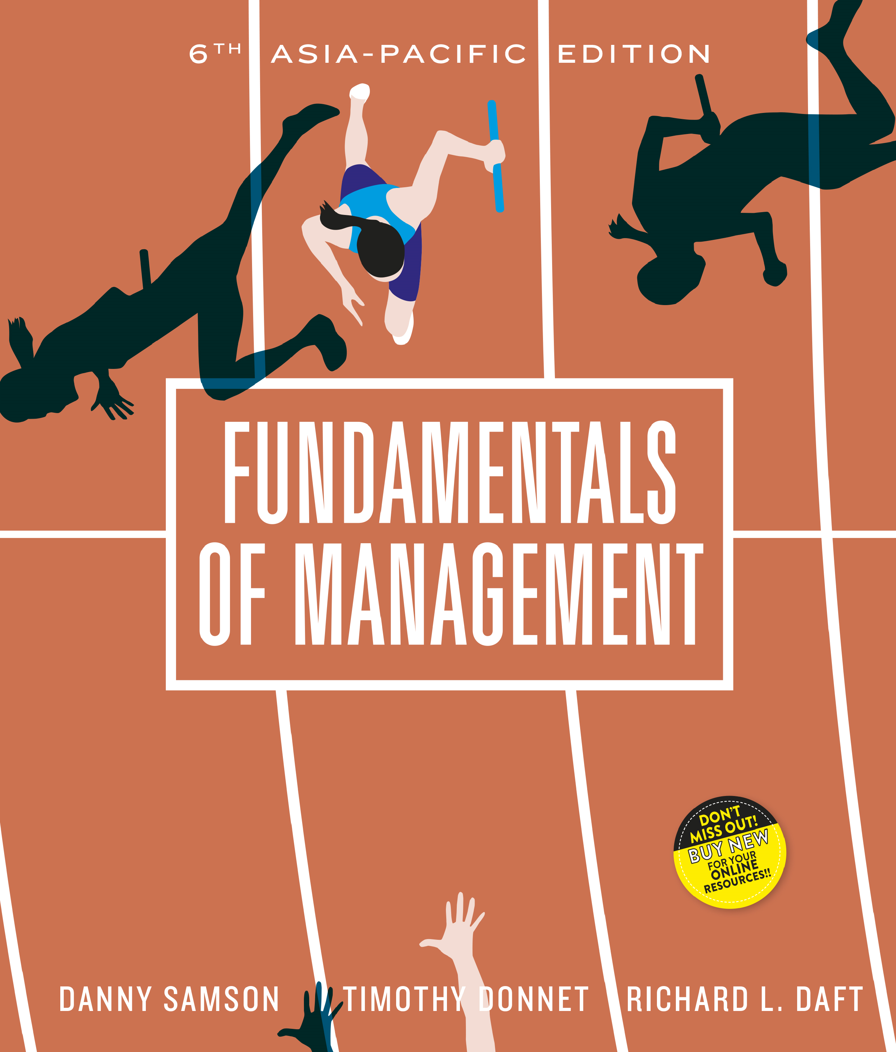

Slide 2
_{Chapter} ₉
Managing human resources

Slide 3
Human resource management (HRM)
Activities undertaken to attract, develop and maintain an effective workforce within an organisation
Human resource a key source of organisation competitive advantage

Slide 4
The strategic role of HRM IS TO DRIVE ORGANISATIONAL PERFORMANCE
Is to drive organisational performance
Top 3 factors for maintaining competitive success:
  All managers are HR managers
  Employees are assets
  HRM is a matching process
    Integrating organisational strategy and goals with the correct approach to managing the firm’s human capital

Slide 5
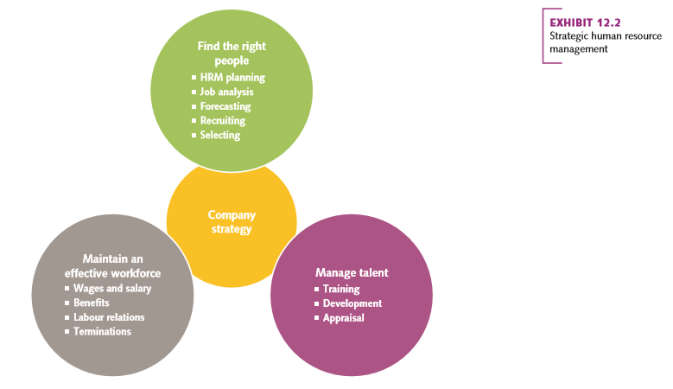
Strategic human resource management

Slide 6
Maintaining competitive edge
HRM a key contributor to organisational success
Changes in HRM focus:
  Building human capital to drive performance
  Developing global HR strategies
  Using information technology

Slide 7
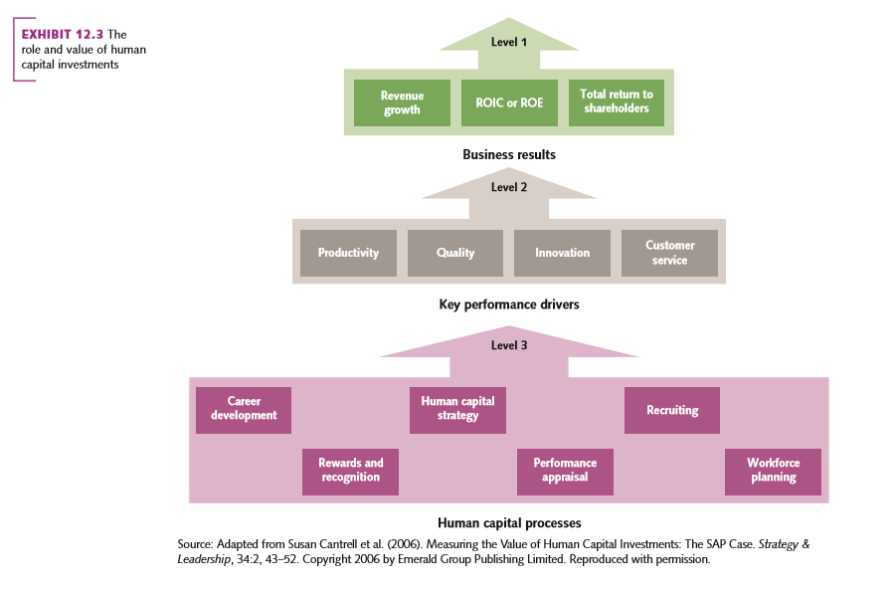
The role and value of human capital investment

Slide 8
External forces
Globalisation
    Competing on a global basis brings new challenges to HRM.
    International human resource management (IHRM).
      Addresses the complexity that results from recruiting, selecting, developing and maintaining a diverse workforce on a global scale.

Slide 9
Information technology
Human resource information system
An integrated computer system designed to provide data and information used in HR planning and decision making
Can dramatically improve effectiveness of long-term planning in HR.

Slide 10
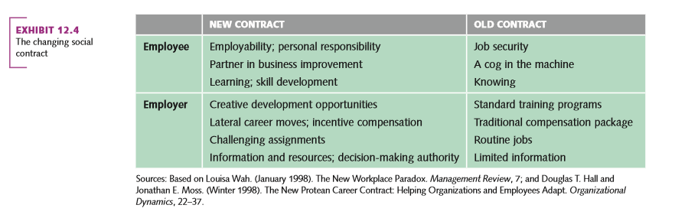
The changing social contract

Slide 11
Innovations in HRM
HRM faces constant change
Some key issues facing HRM today:
  Branding the company as an employer of choice
  Increasing focus on teams and projects
  Using temporary and part-time employees
  Promoting work-life balance

Slide 12
Human resource planning
Forecasting human resource needs and the projected matching of individuals with expected vacancies
  Recruiting
  Selecting
  Managing talent

Slide 13
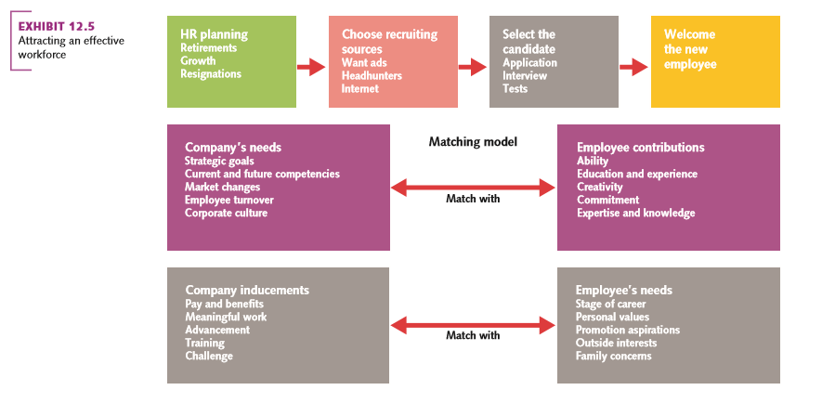
Attracting an effective workforce

Slide 14
Recruiting
Activities or practices that define the desired characteristics of applicants for specific jobs
Also referred to as talent acquisition
Can be:
  Internal
  External (contd.)

Slide 15
Recruiting contd.
Involves assessing jobs:
Job analysis
  The systematic process of gathering and interpreting information about the essential duties, tasks and responsibilities of a job.
Job description
  A concise summary of the specific tasks and responsibilities of a particular job
Job specification
  An outline of the knowledge skills, education and physical abilities needed to adequately perform a job (contd.)

Slide 16
Recruiting contd.
Job analysis enables the creation of:
  Realistic job previews (RJP)
    Gives applicants all pertinent information about the job and the organisation
Today employers make use of social media
  LinkedIn
  Facebook
Involves legal considerations
  Discrimination avoidance
  Equal Employment Opportunity (EEO)
  Affirmative actions

Slide 17
Selecting
The process of determining the skills, abilities and other attributes a person needs to perform a particular job
Most frequently used devices include:
  Application form
  Interview
  Employment test
  Assessment centres
  Online checks

Slide 18
Managing talent: developing an effective workforce
Training and development
On-the-job training
  Most common method for training and development
Social learning
  Informal learning from others using social media tools
Mentoring and coaching
  Using experienced employees (contd.)

Slide 19
Training and development contd.
Other approaches to training and development:
In-house development in corporate universities
  Broad-based learning opportunities for employees
Promotion from within
  Offers employees opportunities to grow and develop their abilities

Slide 20
Performance appraisal
The process of observing and evaluating an employee’s performance, recording the assessment and providing feedback
Assessing performance accurately
  360-degree feedback
    Uses multiple raters, including self-rating
Performance evaluation errors
  Halo effect
  Can be overcome with BARS
    Behaviourally anchored rating scale

Slide 21
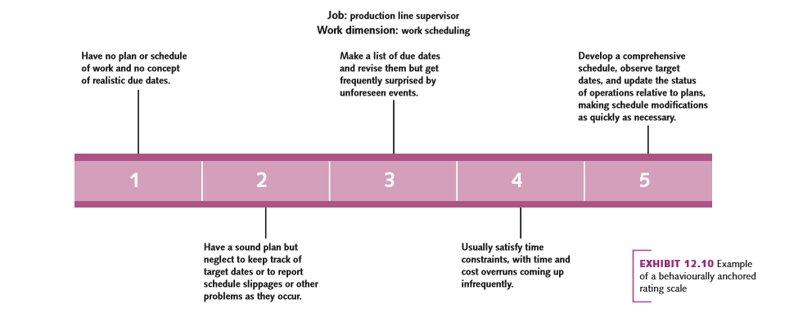
Example of a behaviourally anchored rating scale

Slide 22
Maintaining an effective workforce
Once recruited, HR needs to be maintained effectively
Involves:
  Compensation
  Benefits
  Termination

Slide 23
Compensation
Monetary payments (wage and salaries) and
non-monetary goods/commodities used to reward employees
Designed to fit company strategy and to provide:
  Compensation equity
Pay-for-performance
Benefits

Slide 24
Benefits
Make up 40 per cent of labour costs.
  Some are required by law.
    e.g. Superannuation, holiday leave loading, worker’s compensation.
  Others can be provided by the organisation.
    e.g. Health insurance, onsite fitness centres.
    e.g. Subsidised child care, tennis and squash courts.
    Provided to maintain an effective workplace.

Slide 25
Termination
Organisations lose employees through:
  Retirement
  Voluntary exit
  Involuntary
    Mergers, cutbacks
    Poor performance
  Exit interview useful for learning about potential problems in the organisation

Slide 26
Sustainability and people
HRM has strong link to sustainable development
In both sustainability and HRM the aim is to improve the outcomes and effectiveness of the organisation
  Performance is appraised against a broader set of measures in a sustainable organisation
  Sustainability represents an opportunity to improve staff satisfaction through improved engagement
    e.g. Google giving staff $5000 towards buying fuel efficient cars

