Slide 1
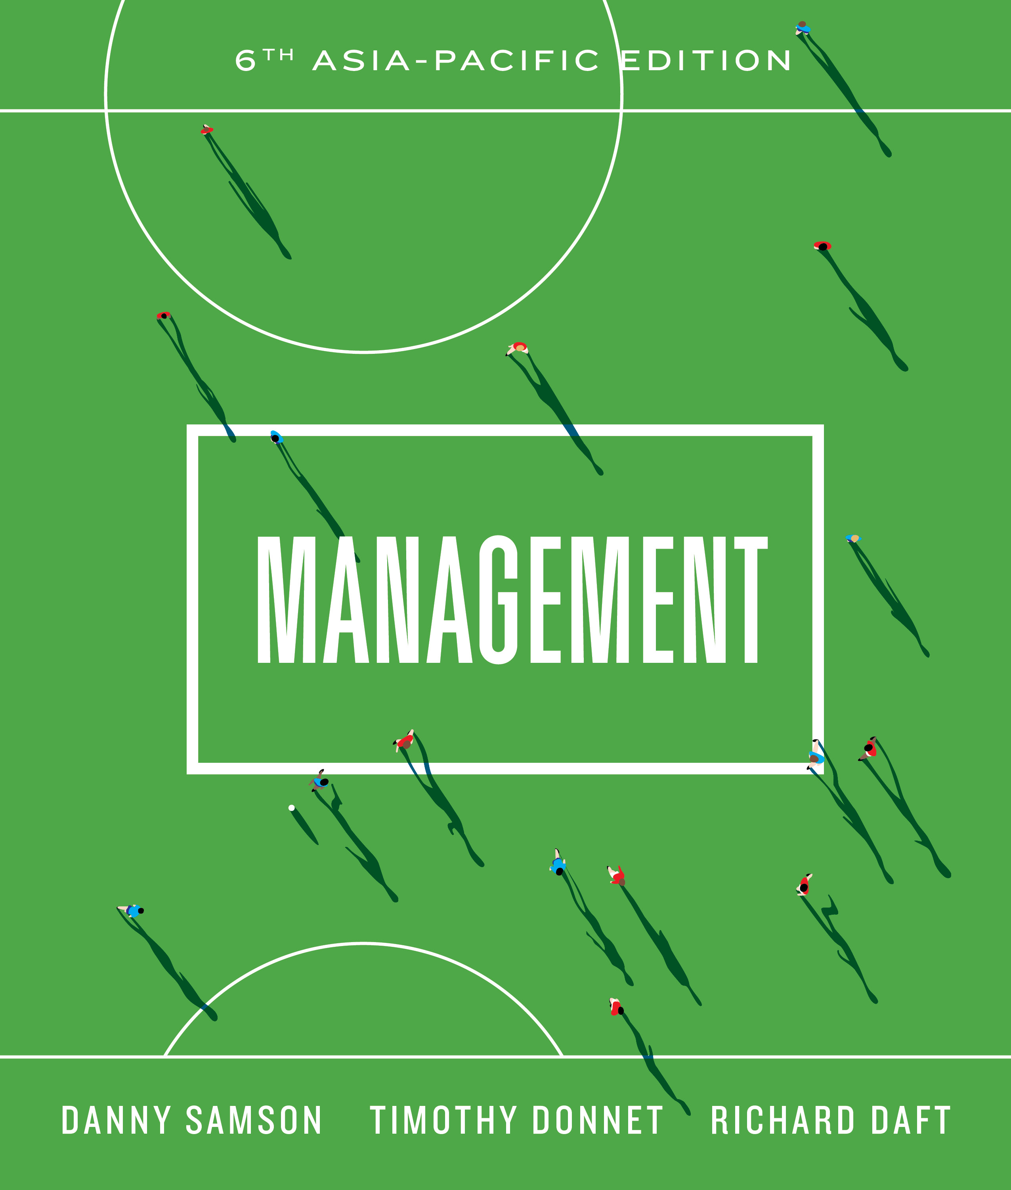

Slide 2
_{Chapter} ₃
The environment and corporate culture

Slide 3
The external environment
Reflects an open systems view of organisations
Includes all elements existing outside the boundary of the organisation
These elements have potential to affect the organisation
Two components:
  General environment
  Task environment

Slide 4
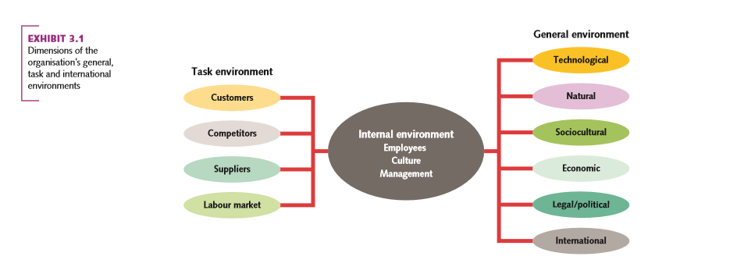
Dimensions of the organisation’s general, task and international environments

Slide 5
The general environment
Refers to the outer layer of the environment
Have indirect (not day-to-day) impact on organisation
Includes:
  International
  Technological
  Socio-cultural
  Legal-political
  Natural environment

Slide 6
The international dimension
Refers to:
  Events originating in foreign countries
  Opportunities for local organisations in other countries
Companies have to compete on a global basis
Managers have to have global mind-set

Slide 7
Technological dimension
Includes advances in technology and scientific knowledge
Influences various industries
  Medical
  Telecommunications
  Internet/E-business

Slide 8
Socio-cultural dimension
Refers to the demographic characteristics, norms, customs and values of the population within which the organisation operates
Key demographic trends include:
  Multiculturalism
  Ageing population
  Gen Y and Gen Z as employees with different needs in terms of employment
Organisations need to respond to changes brought about by diversity

Slide 9
Economic dimension
Refers to the overall economic health of the country or region in which the organisation operates
Includes such factors as:
  Consumer spending power
  Unemployment rate
  Interest rate
Globalisation increases complexity and uncertainty for managers

Slide 10
Legal-political dimension
Includes:
  Government regulations
  Political activities and legislation to control organisational behaviour
Includes the influence of pressure groups working within the legal-political framework
  Consumer advocacy groups
  Business lobby groups

Slide 11
Natural environment
Includes all elements that occur naturally on earth, including plants, animals, rocks and natural resources such as air, water, and climate.
Environment advocates are increasing pressure for organisations to operate with sensitivity toward the natural environment
Also regulations to protect environment and promote sustainable operations

Slide 12
task environment
The layer of the external environment that directly influences the organisation’s operations and performance
Customers
Competitors
Suppliers
Labour market

Slide 13
Customers
Refer to individuals and groups who consume goods or services produced by organisations
Impact on the success or failure of the organisation
Organisations (especially smaller ones) have to be innovative in reaching customers – niches:
  Ageing market
  Youth market

Slide 14
Competitors
Are other organisations in the same industry or type of business that provide goods and services to the same set of customers
Each industry is characterised by specific issues
Question: how to reach and maintain competitive edge?

Slide 15
Suppliers
Individuals or groups who provide goods or services to the organisations
Links between various groups in the production of a good or service is termed a supply chain
The supply chain is a vital part of organisation success

Slide 16
labour market
People available for hire by the organisation
Labour market forces:
  The growing need for computer literate workers
  Continuous investment in human resources
  The effects of international trading blocs, automation and shifting facility locations

Slide 17
The organisation–environment relationship
Environmental uncertainty
  Managers know what goal they wish to achieve, but information about alternatives and future events is incomplete
Two basic strategies for coping with uncertainty:
  Adapt the organisation to changes in the environment; and
  Influence the environment to make it more compatible with organisational needs

Slide 18
The organisation–environment relationship
Adapting to the environment
  Boundary-spanning
  Forecasting and planning
  Inter-organisational partnerships
  Mergers and joint ventures

Slide 19
Influencing the environment
Some companies shape the environment to their needs:
  Advertising and public relations
  Political activity
  Trade associations

Slide 20
The internal environment-CORPORATE CULTURE
Comprises:
  Corporate/organisational culture
  Production technology
  Organisation structure
  Physical facilities

Slide 21
Organisational culture
Key to creating competitive edge
Refers to the shared knowledge, beliefs, values, behaviours and ways of thinking among members of the organisations
Taught to new members
Can also have negative influences (contd.)

Slide 22
Organisational culture
Can be analysed on two levels:
Visible or surface level
  Physical symbols
  Dress codes
  Ceremonies
  Office layout
Invisible, deeply embedded assumptions and beliefs that guide behaviours

Slide 23
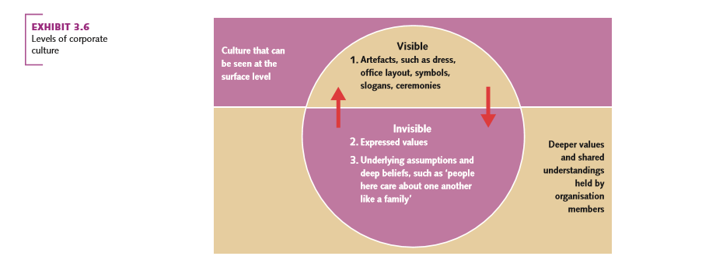
Level of corporate culture

Slide 24
Types of culture
Cultures vary across organisations
Right fit between culture, strategy and the environment associated with four (4) types of culture:
  Adaptability culture
  Achievement culture
  Involvement culture
  Consistency culture

Slide 25
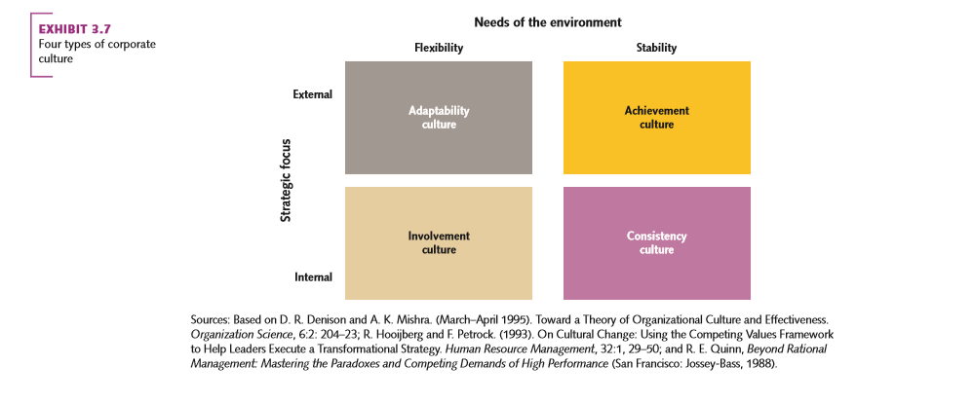
Four types of corporate culture

Slide 26
Adaptability culture
Response to environment that requires fast responses in such industries as:
  Cosmetics
  Electronics
Values creativity and innovation
May involve employee autonomy in decision making

Slide 27
Achievement culture
A results-oriented culture
Values competitiveness, personal initiative, cost-cutting and achievement
Handsome rewards for high performers
Suited to organisations in specific customer niches
Less intense need for flexibility and rapid response

Slide 28
Involvement culture
Places high value on meeting the needs of employees
Values cooperation, consideration and equality
Characterised by family-like atmosphere

Slide 29
Consistency culture
Values and rewards a methodical, rational, orderly way of doing things:
  Following rules
  Being thrifty
Uses an internal focus and a consistency orientation
Not always suitable for today's fast changing environment

Slide 30
Shaping corporate culture for innovative response
Corporate culture an important key for organisational success
But organisations also need to manage for high business performance
Need for managers to create and influence organisational culture to meet strategic goals

Slide 31
Cultural leadership
Defines and articulates important values that are tied to a clear and compelling mission
Managers must over-communicate to ensure employees understand the new culture values (in actions as well as words)
Influence culture in two key areas:
  Articulation of a vision for the organisational culture that employees can believe in
  Heeds the day-to-day activities that reinforce the cultural vision

Slide 32
Sustainable development and the business environment
Five aspects that have major implications for managers:
  Globalisation;
  Advanced technology;
  Industry maturity;
  Variance and volatility and
  Climate change
Modern managers are ‘doing well by doing good’
  Eg: Supermarkets eliminates plastic bags

