Slide 1


Slide 2
_{Chapter} ₄
Managing in a global environment

Slide 3
A borderless world
Organisations pursuing a global strategy need to recognise the impact of a world without borders
Managers need new competences:
  Ability to learn new languages
  Networking skills
  Developing a global mind-set

Slide 4
Globalisation
Production of a product is a joint-effort internationally
Difficult for consumers to tell origin

Slide 5
Globalisation contd.
Process of globalisation in 4 distinct stages:
  The domestic stage
  The international stage
  The multinational stage
  The global stage
Organisations can participate at any stage

Slide 6
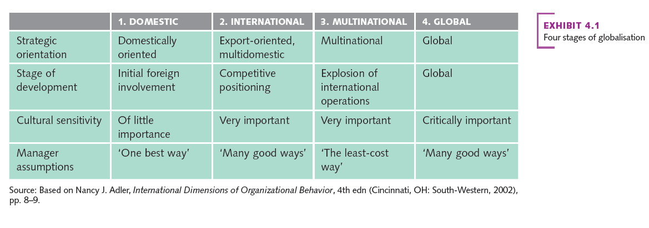
The four stages of globalisation

Slide 7
Developing a global mind-set
Managers need the ability to appreciate and influence individuals, groups, organisations and systems that represent different social, cultural, political, institutional, intellectual and psychological characteristics
Requires:
  Genuine interest and curiosity in other cultures
  Open-mindedness
  Ability to deal with ambiguity and complexity

Slide 8
Importance of international business in the study of management
Today’s companies can locate where it makes sense for them to locate
Services and jobs are shifting to countries where operating costs are lower
  Concerns around loss of jobs in local market
Thinking locally can be limiting

Slide 9
Multicultural corporations
A multicultural corporation (MNC) is an organisation that receives more than 25% of its total sales revenues from operations outside the parent company's home country
Also referred to as a global or transnational company (contd.)

Slide 10
Multicultural corporations contd.
MNC is managed as an integrated worldwide business system
Key strategic decisions made by a single management authority
Top managers presumed to display a global perspective

Slide 11
The multinational corporations (MNC)
Personal challenges for global managers.
  Being culturally flexible and adaptable to new situations
Developing cultural intelligence
Managing cross-culturally
Global learning
  Embracing learning and adaptability across borders.

Slide 12
Globalisation backlash
Increasing pressure for MNCs to operate ethically
Globalisation brings some negative impacts:
  Outsourcing and loss of jobs
  Work conditions in supply chain

Slide 13
Serving the bottom of the pyramid (BOP)
MNCs have power and resources to do good in the world
Bottom of the pyramid (BOP) combines business with social responsibility
  Organisations can help to alleviate poverty by selling to the poorest people

Slide 14
Getting started internationally
Various tactics available:
Exporting
Outsourcing
Licensing
Direct investing

Slide 15
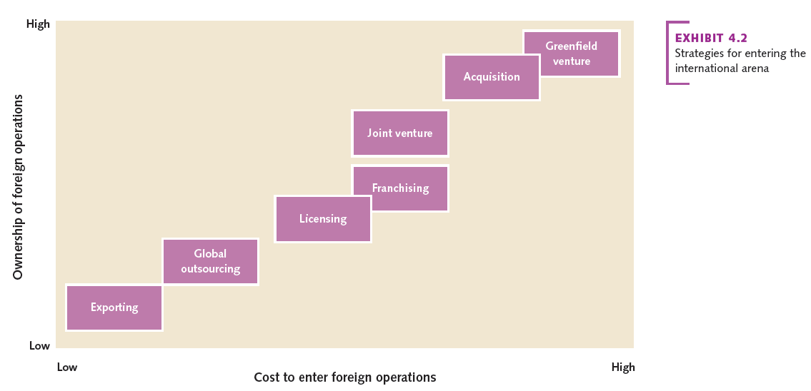
Strategies for entering the international arena

Slide 16
The international business environment
Refers to the management of business operations conducted in more than one country
Key environmental factors:
  Economic
  Legal-political
  Socio-cultural

Slide 17
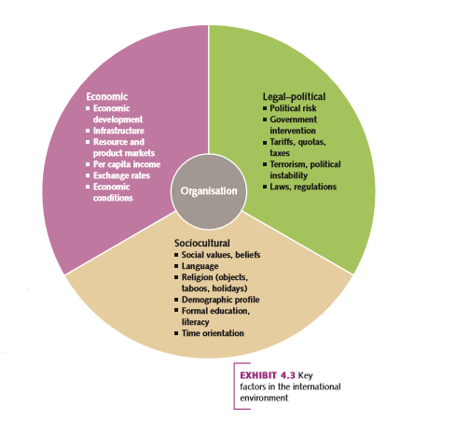
Key factors in the international environment

Slide 18
The economic environment
Represents the economic conditions in the country where the operates
Includes:
  Economic development
  Infrastructure
  Economic interdependence
  Resource and product markets
  Exchange rates
  Inflation, interest rates and economic growth

Slide 19
The legal–political environment
Major concerns for organisations
Political risk
Political instability
Laws and regulations

Slide 20
The sociocultural environment
Cross-cultural understanding is important for success
Hofstede’s social values:
  Power distance
    Acceptance of inequality in power among institutions, organisations and people
  Uncertainty avoidance
    Intolerance for uncertainty and ambiguity

Slide 21
The sociocultural environment Cont.
Hofstede’s social values:
  Individualism and collectivism
  Masculinity and femininity
    Masculinity (achievement, heroism, assertiveness, work centrality and material success) or femininity (cooperation, group decision making and quality of life).

Slide 22
GLOBE Project Value Dimensions
Assertiveness
Future orientation
Uncertainty avoidance
Gender differentiation
Power distance
Societal collectivism
Individual collectivism
Performance orientation
Humane orientation

Slide 23
Communication differences
Communication differences reflect differences in cultural values
Important to recognise differences and respond appropriately for business success
Culture can be:
  High-context
  Low-context

Slide 24
The changing international landscape
Organisations use outsourcing and other entry strategies to gain entry to other countries’ markets
Of increasing importance:
  China
  India
  Brazil

Slide 25
International trade alliances
GATT
WTO
EU
NAFTA
ASEAN (contd.)

Slide 26
International trade alliances contd.
Can be beneficial
But also pose new challenges:
  Questions around economic welfare
  Balance of power

Slide 27
Sustainable development: a global issue and opportunity
Consumers increasingly buy from companies who promote ‘doing good’
However some companies turn a blind eye to substandard approaches:
  e.g. – Nike using sweatshops in its production lines
  e.g. – Child and slave labour in the production of cocoa.

