Slide 1


Slide 2
_{Chapter} ₆
Managing start-ups and new ventures

Slide 3
WHAT IS Entrepreneurship?
Refers to the process of initiating business venture, organising the necessary resources, and assuming the associated risks and rewards
Needs the input of an entrepreneur

Slide 4
An entrepreneur
A person who recognises a viable idea for a business product or service and carries it out
Needs to find resources to get started
Assumes risks
Reaps the rewards of the business

Slide 5
Entrepreneurship as an option
Starting a business could be triggered by:
Organisational restructuring
  Downsizing forces employees to consider other options
Individual:
  View that running own business offers better use of time and skills
  Desire for more freedom and quality of life
Advanced technology making small businesses more competitive

Slide 6
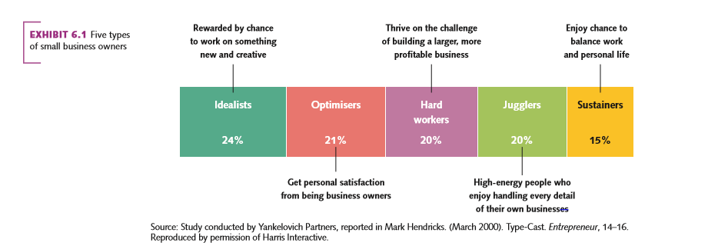
Five types of small business owners

Slide 7
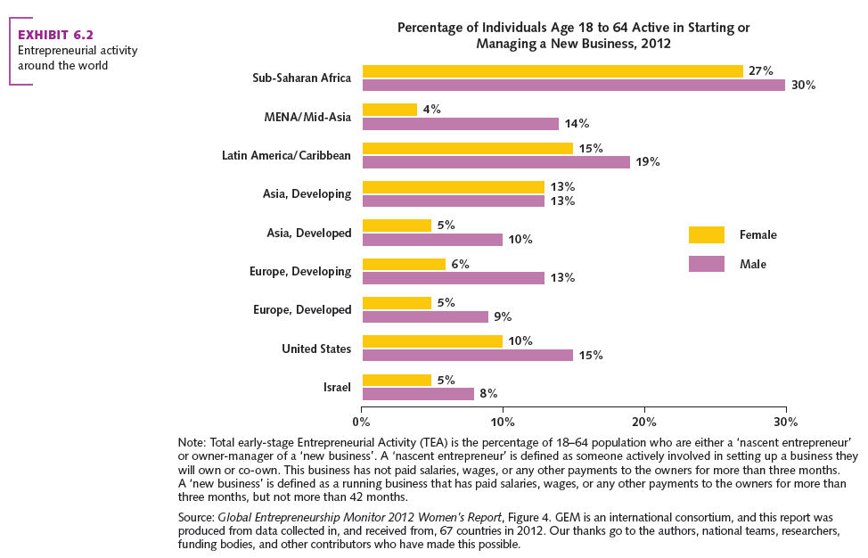
ENTREPRENEURSHIP INTERNATIONALLY

Slide 8
Entrepreneurship and the business environment
Economic changes
  Increasing change creates opportunities
Increasing trend to outsource work to companies that can offer lower costs
Globalisation and increased competition
Technology
New opportunities and marker niches

Slide 9
Impact of entrepreneurial organisations
Job creation
  Small businesses
Contribute to organisational innovation
  Products/services or processes
Opportunity to take advantage of diversity
  Women and minority groups given more opportunity for employment

Slide 10
WHO ARE ENTREPRENEURS?
Prominent Australian entrepreneurs include:
  Janine Allis (Boost Juice)
  George and Peter Dryen (Dryen Australia),
  Gerry Harvey (Harvey Norman)
Some famous international entrepreneurs include:
  Henry Ford (Ford Motor Company)
  Bill Gates (Microsoft)
  Sergey Brin and Larry Page (Google)

Slide 11
Traits of entrepreneurs
Autonomy
Perseverance in the face of struggles
Desire for power and influence
High energy
Need to achieve
Self-confidence
Tolerance of ambiguity

Slide 12
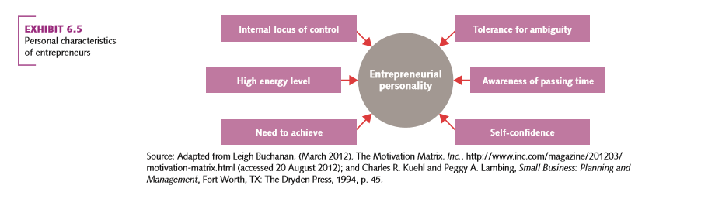
Personal characteristics of entrepreneurs

Slide 13
Social entrepreneurship:
An innovative approach to small business
Focus: solving social ills take priority
  Muhammad Yunus and Grameen bank
Combines creativity, business smarts, passion and hard work to change the world for the better
Not a new concept but becoming more prominent around the world

Slide 14
Social entrepreneurship:
An example
  David Green: Project Impact
  Factory in India making inexpensive and no cost surgical cataract lenses for poor people in India
  Now in other parts of the world
  Includes hearing aids to product mix

Slide 15
Starting an entrepreneurial firm
Start with the new-business idea
  Source of idea is in-depth understanding of industry/profession
  Source of idea is market niche spotted
The business plan
  A document for specifying the business details prepared by an entrepreneur in preparation for opening a new business.

Slide 16
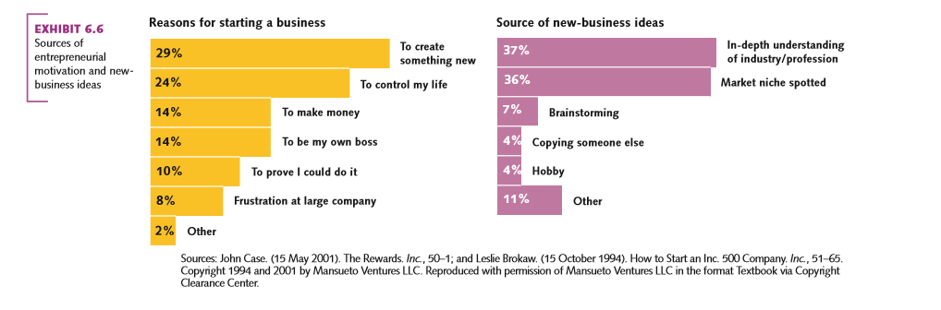
Sources of entrepreneurial motivation and new business ideas

Slide 17
The business plan
Is a document specifying the business details as preparation for opening a new business
It provides clear and detailed information on
  The vision
  Realistic financial projections
  The target market
  Industry and competitors
  The entrepreneurial management team
  Precise and concise

Slide 18
Choosing a legal structure
Need to choose appropriate legal structure
Three legal forms:
  1. Sole proprietorship (unincorporated)
    Owned by individual for profit
  2. Partnership (unincorporated)
    Two or more people
    But open to disagreements and unlimited liability
  3. Company (a legal entity)
    Exists apart from owners (limits liability)
    But expensive and complex (paperwork)

Slide 19
Arranging financing
Significant amount of money needed
  Investment is usually required to acquire labour, raw materials, building and equipment
Two options:
    Debt financing (loans)
    Equity financing (share ownership)

Slide 20
Arranging financing
Debt financing
Borrowing money that has to be repaid at a later date in order to start a business
Main sources:
  Family and friends or credit cards
  Banks
  Use Angels

Slide 21
Arranging financing
Equity financing
Refers to financing that consists of funds that are invested in exchange for ownership in a company
  Venture capital firm
  Crowdfunding
    Small amounts of money from a large number of investors
  Use social media

Slide 22
Becoming an entrepreneur
Different ways to become a business owner:
Start a new business
Buy an existing business
Buy a franchise
    Owner allows others to purchase the right to distribute the product or service (licensing)
  Participate in a business incubator
  Make use of Internet to start an online business

Slide 23
Starting an online business
Online businesses follow the usual steps required of a traditional business
Find a market niche
Create a professional website
Chose a domain name
Use social media

Slide 24
Stages of growth
Entrepreneurial businesses go through distinct stages of growth:
Set-up and existence
Survival
Success
Take-off
Resource maturity

Slide 25
Managerial functions in entrepreneurial business
Planning
  Tends to be informal
  Success often leads to need for more formal planning
Organising
  In first two stages: informal structure
  By stage three would need formal structure

Slide 26
Managerial functions in entrepreneurial business
Decision making
  Can be simple or complex
Leading
  Entrepreneur creates vision and culture
  By success stage, the owner needs to be able to motivate employees
Controlling
  Simple accounting giving way to more complex systems

Slide 27
Intrapreneurship in a growing business
The process of recognising the need for innovation and promoting it within an organisation
Organisations need to keep innovative spirit
  Google allows staff to spend 20% of their time on creative projects

Slide 28
Sustainability and the small or start-up organisation
Small to medium enterprise (SME) face day-to-day challenges
  Sustainability usually placed on hold
Important to be proactive and think sustainability
  Consider building long term win-win relationships with stakeholders
  No business is too small for doing well by doing good

