Slide 1
The History of Christianity
HT 251 Week 1
Jennifer Skerritt
Introduction and first century

Slide 2
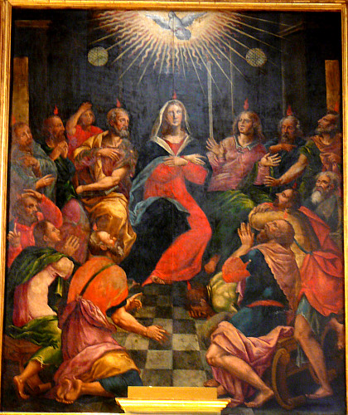
Pentecost
(the Ascension is 39 (or 40) days after Easter, on a Thursday) Pentecos
Notes:
Traditionally, Pentecost is the day when the Church is founded. It is 50 days after Easter (always on a Sunday)

Slide 3

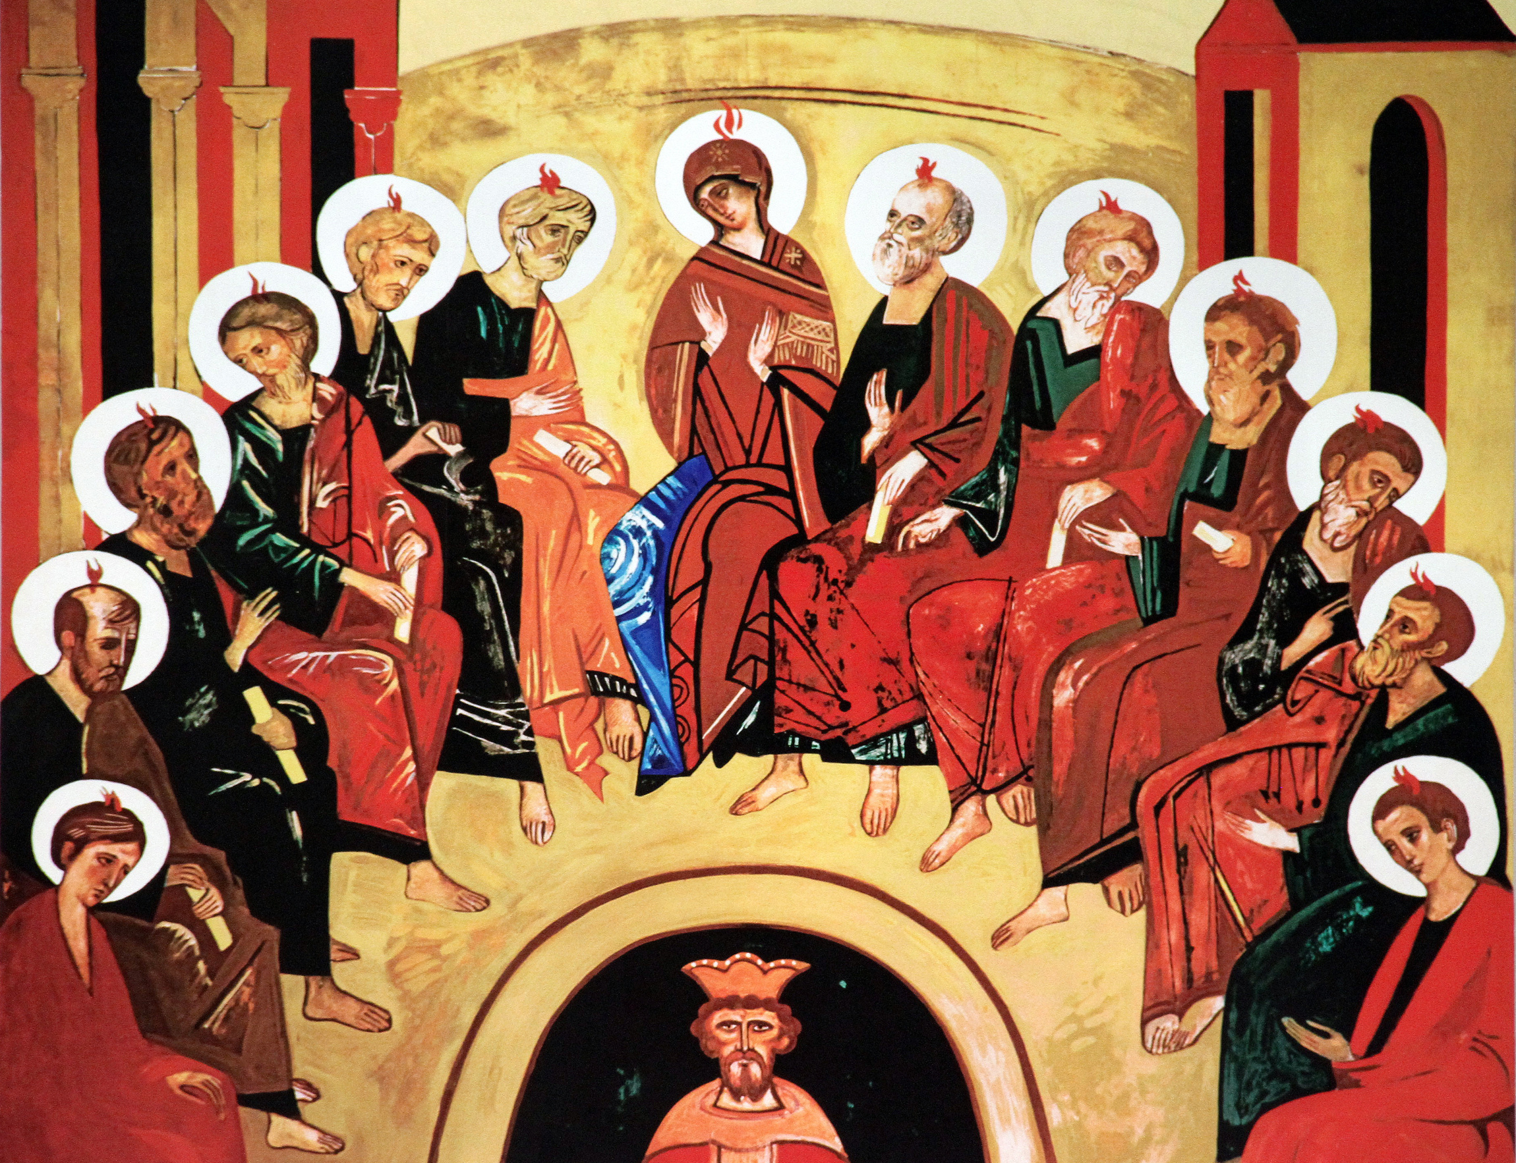

Acts of the Apostles
Pentecost
  Also known as Whitsunday in English
  The Jewish festival of Shavuoth. From the Greek Πεντηκοστή pentēkostē ‘fiftieth (day)’ (because the Jewish festival is held on the fiftieth day after the second day of Passover), via ecclesiastical Latin. Also known as the "Feast of Weeks" and the "Feast of 50 days" in rabbinic tradition.
  It is a harvest festival
  Pentecost is celebrated on the Seventh Sunday after Easter

Slide 4
The Early Church
Pentecost: 30 A.D. (Acts 2)
First Persecutions: 35 A.D. (Acts 3-4)
Martyrdom of Stephen.
Paul on the Road to Damascus: 36 A.D. (Acts 9)
Writing of the Book of Matthew: 43 A.D.
Execution of James: 44-45 A.D. (Acts 12:2)
Notes:
Timeline
All of the early persecution was by Jews or jewish authorities, which saw Christianity as a heretical jewish sect. (the Romans also saw Christianity as a Jewish sect, but they didn’t really care as long as order was maintained.
Stephen, (died 36 CE, Jerusalem; feast day December 26), Christian deacon in Jerusalem and the first Christian martyr, whose apology before the Sanhedrin (Acts of the Apostles 7) points to a distinct strand of belief in early Christianity. His defense of his faith before the rabbinic court enraged his Jewish audience, and he was taken out of the city and stoned to death. His final words, a prayer of forgiveness for his attackers (Acts of the Apostles 7:60), echo those of Jesus on the cross (Luke 23:34). Stephen is the patron saint of deacons and stonemasons. His feast day is observed with both religious and secular traditions in a number of countries. See also St. Stephen’s Day.
The name Stephen is Greek, and chapter 6 of Acts of the Apostles tells us that he was a Hellenist (a foreign-born Jew who spoke Greek). He lived in Jerusalem and had become a Christian. The Hellenist converts, who probably formed a minority in the early Christian community, complained that the care of their elderly widows was neglected by the Hebrew-speaking majority. The Apostles presented the matter to the congregation and, pleading the press of responsibilities, instructed it to select seven deacons for this community service. They were chosen and ordained, and Stephen, who became the best known of the seven, was recognized as a man with special gifts as an evangelist. He engaged in religious discussions among the adherents of synagogues of Diaspora Jews in the capital. Growth in the number of Jewish converts, including “many of the priests,” provoked a reaction. He was summoned before the Sanhedrin, the supreme rabbinic court in Jerusalem, and charged with speaking against “this holy place and the law.” The charge is very general; the report of his defense before the Sanhedrin is the primary resource for learning what Stephen stood for.
Stephen’s response was Jewish in its concerns, and in form it followed Hellenistic rhetorical conventions (Joshua 24:2–14; Acts of the Apostles 3:12–26). Many scholars see a Samaritan connection to Stephen’s community, postulating that it may have migrated there when Jerusalem was destroyed in 70 CE. They assume that the speech may have been modified in its transmission through the years between its delivery and its incorporation in St. Luke’s text which appears as Acts of the Apostles. In any event, what Stephen seems to say about temple and law would not have displeased Samaritan ears either, though it is probably Stephen’s independent and original conviction.
Stephen was bitterly opposed to the Temple in Jerusalem and its sacrificial cult. He revered the Law of Moses but considered the temple cult an illegitimate part of it. For Stephen, Moses was “both ruler and deliverer” (Acts of the Apostles 7:35); he had delivered “living oracles,” the true law, and he had promised that God would raise up another prophet (Jesus) as he had raised up Moses (7:37). Stephen seems to think of Jesus as the “restorer of Mosaic religion.” In his discourse, he sets Aaron over against Moses, the Temple over against the tent, and Solomon, who built the Temple, over against David, who was persuaded not to. For Stephen, the building of the Temple was a bit of idolatry, comparable to Aaron’s golden calf; “the Most High does not dwell in houses made with hands” (7:48).
Stephen’s feelings about the Temple seem to have been more completely negative than those of the first Christians generally; the latter, including St. Paul, continued to frequent it. Its sacrificial rites served in many ways to shape the theological interpretation of salvation through the death of Jesus. There is no hint that Stephen assigned doctrinal significance to the death of Jesus. On the other hand, it has been suggested that he may have been the first to anticipate the return (Second Coming) of Jesus. In a moment of rapture, at the close of his apology, he saw the heavens opened and “the Son of Man standing at the right hand of God.” The title “Son of Man,” with its intensely eschatological-apocalyptic connotations, is used in the New Testament only by Jesus himself, with this single exception from the mouth of Stephen. For St. Paul, Jesus had brought deliverance from the “curse of the law” (Galatians 3:13). For Stephen, deliverance still awaits the rebirth of the Mosaic tradition in its purity. Though Stephen was an intensely committed follower of Jesus, his faith may have rested as much on the old basis as on the new. Stephen, to whose fate the Pharisee Saul of Tarsus assented, spoke for an overwhelmingly Jewish, pre-Pauline Christian movement, the precise outlines of which are not easily recoverable, because they have been covered by layers of great change.
Execution of James during an interregnum between governors
List of Judean governors appointed by the Romans:
Judean Governor Archelaus 1 BC-6AD
Joseph moves from Egypt to Nazareth
under Governor Antipas: Mt 2:22
Judean Governor Coponius 6-9 AD
Judean Governor Marcus Ambibulus 9-12 AD
Judean Governor Annius Rufus 12-15 AD
Judean Governor Valerius Gratus 15-26 AD
Judean Governor Pontius Pilate 26-36 AD
Jesus begins to proclaim gospel (Luke 3:23) 30AD
Jesus Died 3 April 33 AD
Judean Governor Marcellus 36-37 AD
Judean Governor Marullus 37-41 AD
Ababus predicts famine: 40 AD (Acts 11:28; Jos. Ant. 20.100-101)
Judean Governor Cuspius Fadus 44-46 AD
Governor Tiberius Alexander 46-48 AD
Governor Cumanus 48-52 AD
Governor Antonius Felix 52-57 AD
Paul before Felix, imprisoned 2 years (Acts 24) 55-57 AD
Judean Governor Porcius Festus 57-62 AD
Judean Governor Albinus 62-64 AD
Judean Governor Gessius Florus 64-66 AD
1st Jewish War: The Great Revolt 66-70 AD
Jerusalem and Temple destroyed: 70 AD Lk 21:20; Mt 24:1:14
Jewish Rebellion in diaspora in Egypt
Alexandria, Cyrene Cyrenaica, Cyprus
(under Trajan )116-117 AD
2rd Jewish War, Bar-Kokhba Revolt 132-135AD
135 Hadrian expels Jews, renames Jerusalem Aelia Capitolina and renames Judah “Palestine” (after the Philistines), builds temple of Jupiter on Temple Mount.
Festus died and in the interregnum the Sanhedren used the opportunity to execute James.
Eusebius and Clement

Slide 5
Nero Emperor of Rome: 54 A.D. – 68 A.D.​
Writing of Book of Romans: 58 A.D.​
Execution of Matthew: 60 A.D.​
Writing of Book of James: 62 A.D.​
Writing of 1 Peter: 63 A.D.​
Writing of Acts: 63 A.D.​
Writing of Book of Mark: 64 A.D.​
Writing of 2 Peter: 65 A.D.​
Execution of Peter: 64-67 A.D.

Slide 6
Jerusalem falls to Rome: 70 A.D.​
Execution of Thomas, possibly in India: 72 A.D.​
Writing of Jude: 75 A.D.​
Writing of John's Gospel: 85 A.D.​
Writing of John's Letters: 90 A.D.​
John on Patmos: 96 A.D.​
Writing of Book of Revelation: 97 A.D.​
Apostle John Dies: 100 A.D.

Slide 7
Hebrews and Greeks
The Jewish people tended to be divided into Hebrews- Aramaic speaking Jews who reside in the traditional territories of the Jewish people, and 'Greeks'- Greek speaking Jews with a more Hellenised culture, residing in various cities of the Roman Empire and beyond.
Traditionally, the Sadducees are more Hellenised, and the Pharisees more traditional, or purist.

Slide 8
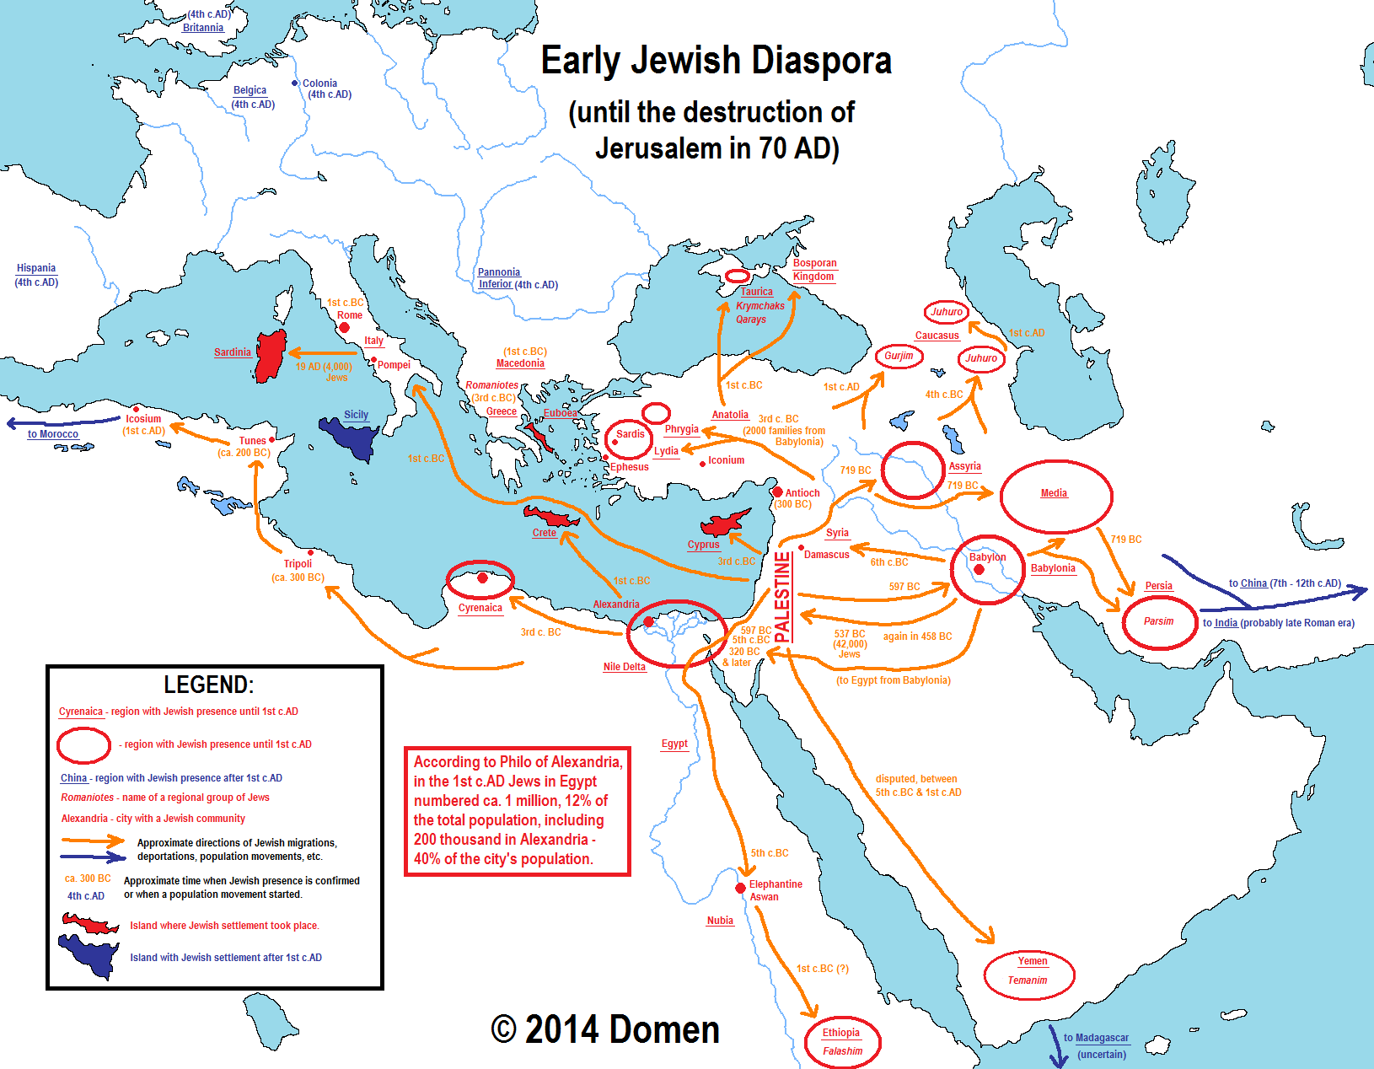
Map of significant Jewish settlement in the first century

Slide 9
Christians and/or Jews
The first Christians were Jewish (Messianic Jews are Jews who accept Jesus as the Messiah)
The Pharisees followed the Law, written, oral and traditional, tending towards excessive legalism. The believed in the afterlife, and the coming of a Messiah.
The Sadducees embraced more of Greek (Hellenistic) culture and were more reserved in belief. They only followed the Torah, did not believe in the resurrection of the dead or judgement after death.
The Essenes were very austere and had some characteristics of early Christianity, including ritual washing, celibacy and desert retreats.
Notes:
And the Zealots

Slide 10
Gentiles
As Christianity spread, more non-Jewish people were converted.
This caused conflict as church leaders attempted to distinguish between religion or belief and Jewish culture and customs.
Circumcision and kosher eating practices were the main issues.
Accounts of the First Council of Jerusalem are found in Acts 15 and possibly in Paul's letter to the Galatians chapter 2.
It is my judgment, therefore, that we should not make it difficult for the Gentiles who are turning to God. Instead we should write to them, telling them to abstain from food polluted by idols, from sexual immorality, from the meat of strangled animals and from blood. For the law of Moses has been preached in every city from the earliest times and is read in the synagogues on every Sabbath. (Acts 15:19–21)

Slide 11
Conflict
Initially, the Romans (or non-Jews) did not distinguish between Jews and Christians. eg Suetonius.
The Neronian persecutions were the first time they are mentioned as separate in non religious material.
Initial persecution came primarily from Jewish authorities
Stephen
James
Notes:
Stephen was probably executed about 33. Pilate left in 37, but Vitellius, governor of Syria was keeping a close eye on the province. Stephen was either construed as an informal lynching, or Pilate decided to ignore it as it was fait accompli and his political position was extremely tenuous.
James was executed in the interregnum following the death of Festus, the governor in 62.

Slide 12
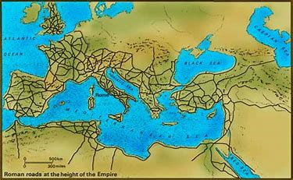

Slide 13
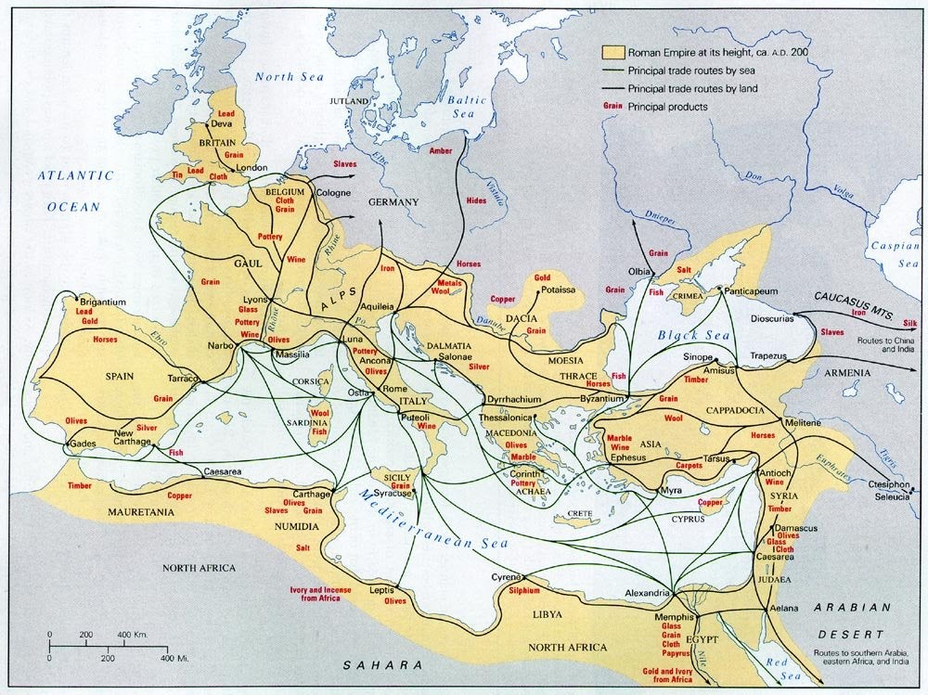

Slide 14
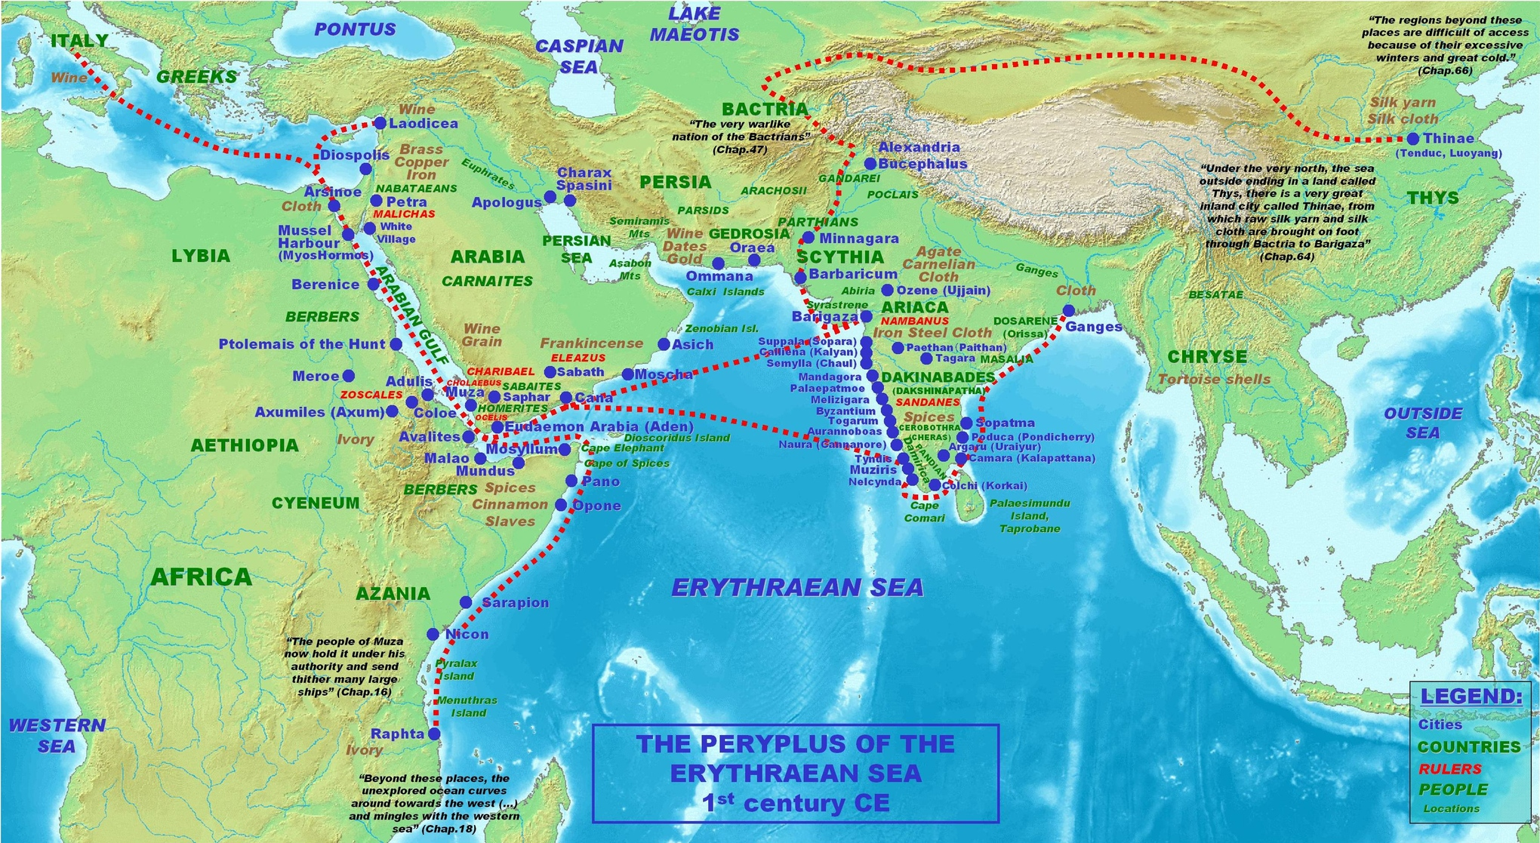

Slide 15
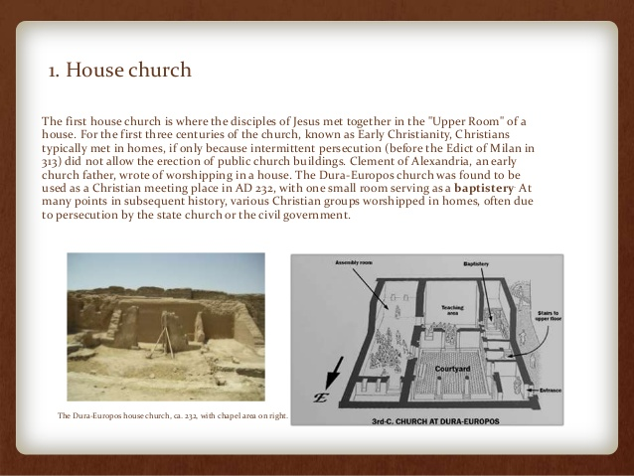
Notes:
A "second" house church, meaning a newly discovered one, is actually a mosaic floor in Megiddo, Israel, that is believed to have been part of a house church. It's not the second ever discovered, as Dura-Europos in Syria is well-known, but it's a significant new find alongside the Capernaum house church. This Megiddo mosaic, dating back to the Roman era, features inscriptions mentioning a Roman soldier named Gaianus and another inscription referencing Akeptous, "the friend of God".

Slide 16
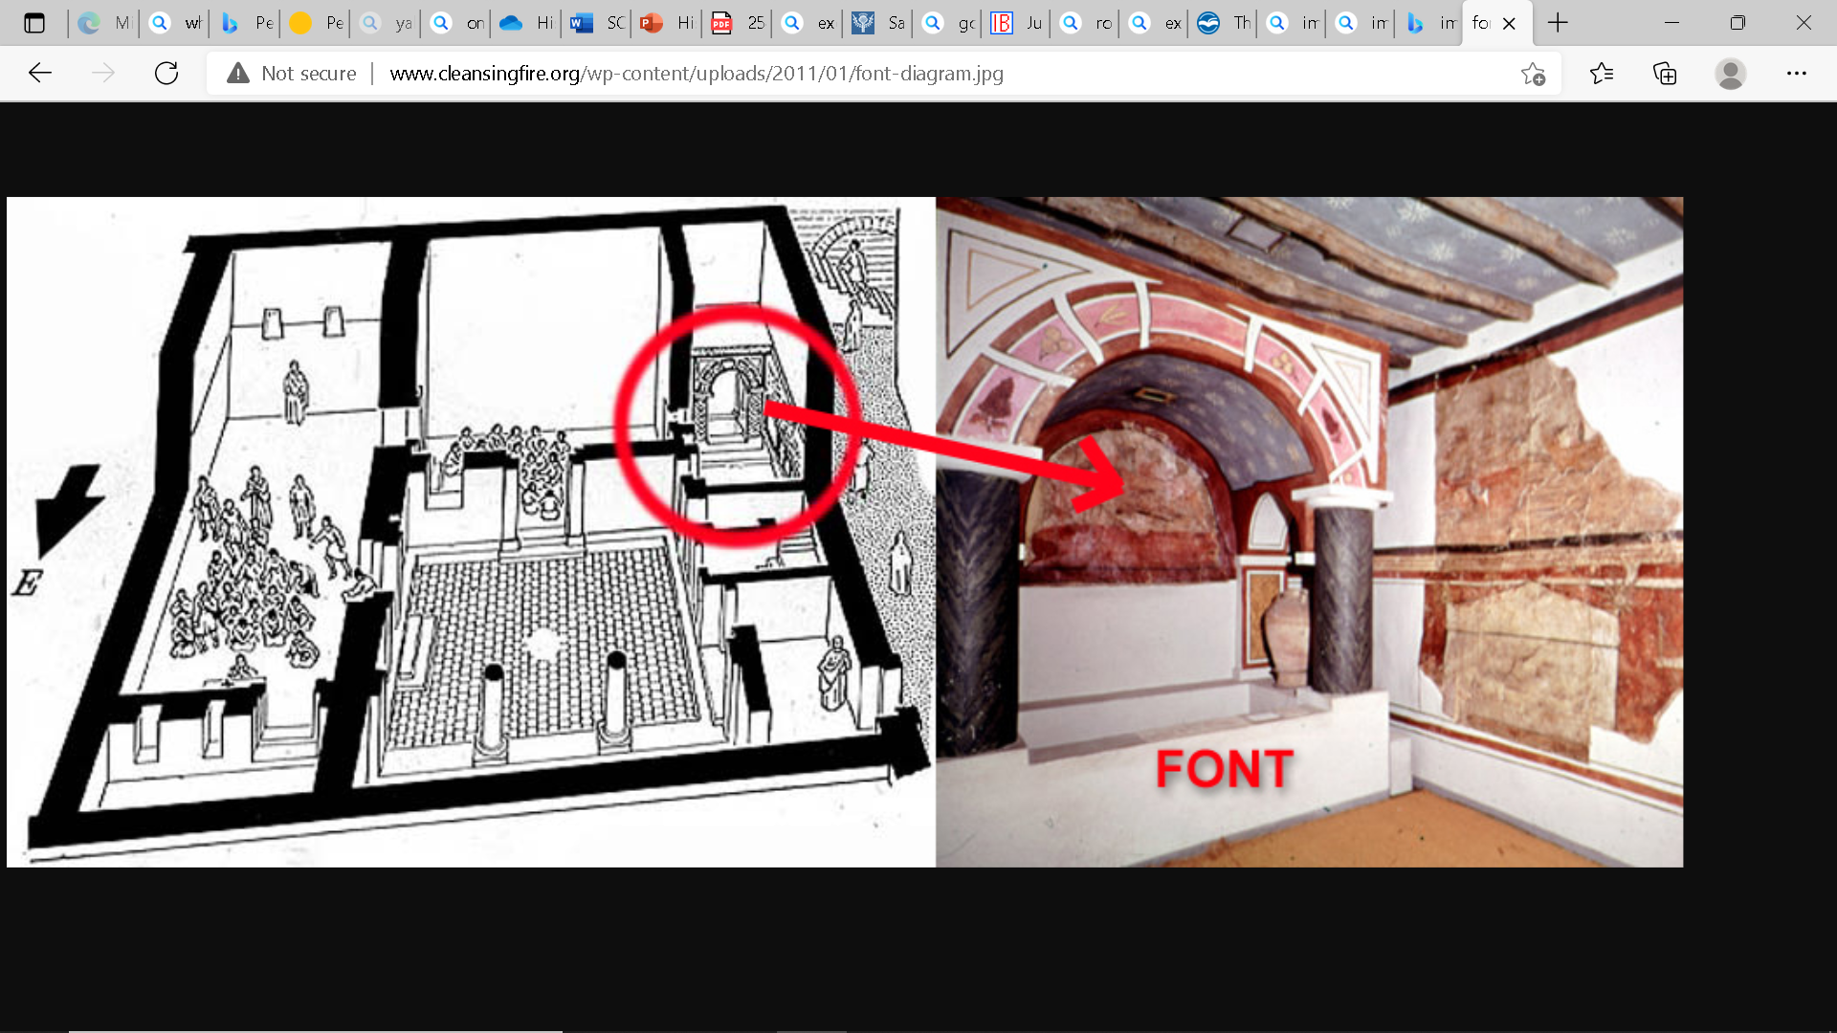

Slide 17
Early Worship
Liturgy of the Word
Liturgy of the Eucharist
Notes:
Justin Martyr p70
Eucharist means thanksgiving
Early Christian sources[edit]
The Didache (Greek: Διδαχή, "teaching") is an Early Church treatise that includes instructions for baptism and the Eucharist. Most scholars date it to the late 1st century,[57] and distinguish in it two separate Eucharistic traditions, the earlier tradition in chapter 10 and the later one preceding it in chapter 9.[58][note 2] The Eucharist is mentioned again in chapter 14.[note 3]
Ignatius of Antioch (born c. 35 or 50, died between 98 and 117), one of the Apostolic Fathers,[note 4] mentions the Eucharist as "the flesh of our Saviour Jesus Christ":
They abstain from the Eucharist and from prayer, because they confess not the Eucharist to be the flesh of our Saviour Jesus Christ, which suffered for our sins, and which the Father, of His goodness, raised up again. ... Let that be deemed a proper Eucharist, which is [administered] either by the bishop, or by one to whom he has entrusted it.[60]
Take heed, then, to have but one Eucharist. For there is one flesh of our Lord Jesus Christ, and one cup to [show forth ] the unity of His blood; one altar; as there is one bishop, along with the presbytery and deacons, my fellow-servants: that so, whatsoever you do, you may do it according to [the will of] God.[61]
Justin Martyr (born c. 100, died c. 165) mentions in this regard:
And this food is called among us Εὐχαριστία [the Eucharist], of which no one is allowed to partake but the man who believes that the things which we teach are true, and who has been washed with the washing that is for the remission of sins, and unto regeneration, and who is so living as Christ has enjoined. For not as common bread and common drink do we receive these; but in like manner as Jesus Christ our Saviour, having been made flesh by the Word of God, had both flesh and blood for our salvation, so likewise have we been taught that the food which is blessed by the prayer of His word, and from which our blood and flesh by transmutation are nourished, is the flesh and blood of that Jesus who was made flesh.[62][63]

